Slide 1


DEPARTMENT
SCHOOL OF Information and Communication Technologies
"Funded by the European Union. Views and opinions expressed are however those of the author(s) only and do not necessarily reflect those of the European Union. Neither the European Union nor the granting authority can be."
Network of centers for regional short study programs in the countries of the Western Balkans
Call: ERASMUS-EDU-2023-CBHE
Project number: 101128813

Slide 2

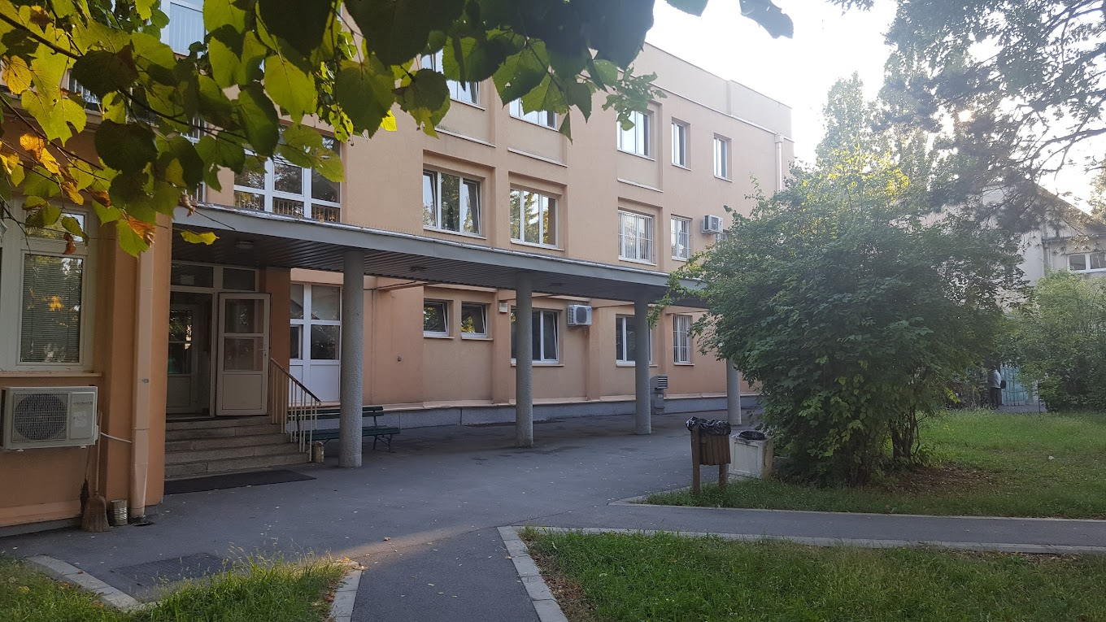
Department School of
Information and Communication Technologies
Network of centers for regional short study programs in the countries of the Western Balkans
Call: ERASMUS-EDU-2023-CBHE
Project number: 101128813

Slide 3
ICT History
Started its operation in 1974 within the School PTT Center, as the Higher Education Technical PTT School.
On January 16, 2003, three independent institutions were established, pursuant to the decisions issued by the Government of the Republic of Serbia.
• Higher Education Technical PTT School
• High Technical PTT School
• High PTT School Dormitory
Network of centers for regional short study programs in the countries of the Western Balkans
Call: ERASMUS-EDU-2023-CBHE
Project number: 101128813

Slide 4
ICT History
In 2003, pursuant to the Decision of the Government of the Republic of Serbia the School changed its name into: Higher Education School for Information and Communication Technologies.
Having received the work permit issued on the basis of the Certificate of Accreditation of the higher education institution received from the Commission for Accreditation and Quality Assurance l 2012, the School (now operating under the name ICT College of Applied Studies)
2020 – The Academy of Technical and Art Applied Studies Belgrade – Department School of Information and Communication Technologies
Network of centers for regional short study programs in the countries of the Western Balkans
Call: ERASMUS-EDU-2023-CBHE
Project number: 101128813

Slide 5
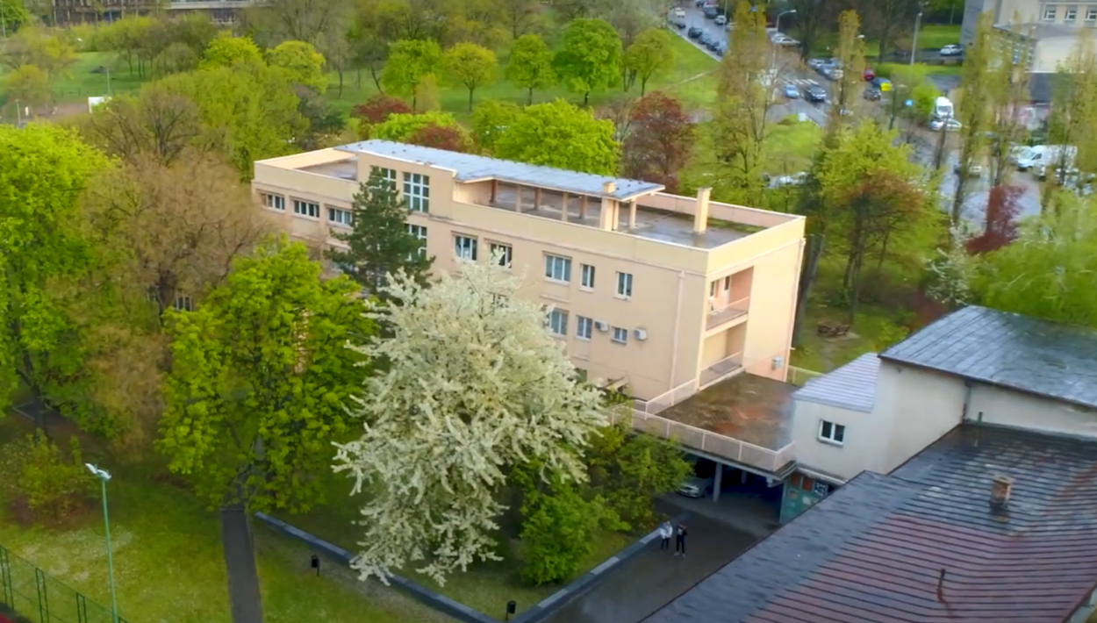
Department School of
Information and Communication Technologies
Network of centers for regional short study programs in the countries of the Western Balkans
Call: ERASMUS-EDU-2023-CBHE
Project number: 101128813

Slide 6
Department School of
Information and Communication Technologies
Undergraduate applied studies (180 ECTS)
Communication Technologies
Internet Technologies
Postal Logistics Systems
Banking and Business Informatics
Network of centers for regional short study programs in the countries of the Western Balkans
Call: ERASMUS-EDU-2023-CBHE
Project number: 101128813

Slide 7
Communication Technologies
The study programme of Communication Technologies is realized through two modules: System Engineering and Engineering Management. In the first year of studies, all students have the same courses, and then, in the second year of studies, students choose the module which enables them to acquire knowledge in the branch of communication technologies that best suits their interests.
The aim of the study programme of Communication Technologies is to train qualified and competent personnel who are committed to professional excellence in: maintaining landline and mobile communication networks, sensor networks, electronic and optical communication devices; management and selling of communication services and devices; use of telecommunication measuring equipment; jobs related to electronic media and technical support in a TV studio.
Network of centers for regional short study programs in the countries of the Western Balkans
Call: ERASMUS-EDU-2023-CBHE
Project number: 101128813

Slide 8
Communication Technologies
The objectives of Communication Technologies study program are to qualify professional and competent personnel for the purpose of:
implementation and maintenance of communication equipment by applying up-to-date technical methods, specialized software tools and up-to-date network technologies, primarily in the existing landline and mobile communication networks, sensor networks and new generation networks;
introduction, monitoring and maintenance of a large number of user services, as well as acquiring skills in the field of engineering management and multimedia communication.
More details on website: https://en.ict.edu.rs/studies/undergraduate-studies/communication-technologies
Network of centers for regional short study programs in the countries of the Western Balkans
Call: ERASMUS-EDU-2023-CBHE
Project number: 101128813

Slide 9
Internet Technologies
The aim of the study programme of Internet Technologies is to enable students to perform jobs in the fields of computer networks, databases, programming and web programming. The study programme of Internet Technologies has four modules which students choose in the second year of their studies in accordance with their own interests. These modules are established to meet the needs for different types of professionals in the field of ICT. The student can choose one of the following modules: Web Programming, Computer Network Administration, Medical Informatics and Information Technologies
Therefore, upon completion of the studies, students can opt to work as a: computer network administrator, system engineer, database administrator, programmer or web programmer. In the first year of studies, which lasts for three trimesters, all students have the same compulsory courses in the field of computer networks, databases and programming. Then, from the second year of studies the students choose one of the four modules.
Network of centers for regional short study programs in the countries of the Western Balkans
Call: ERASMUS-EDU-2023-CBHE
Project number: 101128813

Slide 10
Internet Technologies
The courses in the field of software engineering enable students to acquire knowledge in:
methods and tools used for the programming of web and desktop applications
database design and implementation: SQL server, Oracle, MySQL, MS Access
database administration
object-oriented programming: .Net framework, C#, Java
web programming
multimedia graphics and animation
Students can also attend at the ICT School, which is synchronized with the regular teaching classes. Local Cisco Academy is highly recommended to students who opt for the field of computer networks since, after graduating from the School, they will be prepared to obtain CCNA certificate.
More details on website: https://en.ict.edu.rs/studies/undergraduate-studies/internet-technologies
Network of centers for regional short study programs in the countries of the Western Balkans
Call: ERASMUS-EDU-2023-CBHE
Project number: 101128813

Slide 11
Postal Logistics Systems
The main goal of this study programme is to enable students to get acquainted with different methodological approaches in solving engineering problems and to apply the acquired knowledge in the field of organizing postal and logistics services. The goal is achieved through a detailed study of technology, processes, work procedures and business environment, as well as by mastering practical skills necessary for providing services, functioning and quality control of postal and logistics operators, relying on the cooperation with the most prominent representatives of the sector.
Starting from the school year 2021/22, students of the study programme of Postal and Logistics Systems will have the opportunity to choose the dual model of studies (DMS) based on the Law on the Dual Model of Studies in Higher Education (2019).
Network of centers for regional short study programs in the countries of the Western Balkans
Call: ERASMUS-EDU-2023-CBHE
Project number: 101128813

Slide 12
Postal Logistics Systems
The field of postal technologies:
providing postal, financial, electronic and other services in postal traffic
organization, management and supervision of work in postal network units
gathering, processing and analysis of data related to services and parcel flows
training in an up-to-date PostTIS laboratory, which is connected to the PostTIS/Intranet network of the PE Post of Serbia and used in a regular teaching process
The field of logistics services:
tracking and management of the flows of goods and services, the organization of cargo transport for third parties
organizing transport by using modern technologies composed of transport, organization and management of logistics chains
choosing vehicles and planning traffic itineraries
More details on website: https://en.ict.edu.rs/studies/undergraduate-studies/postal-logistics-systems
Network of centers for regional short study programs in the countries of the Western Balkans
Call: ERASMUS-EDU-2023-CBHE
Project number: 101128813

Slide 13
Banking and Business Informatics
The study programme of Banking and Business Informatics aims to enable students to perform jobs in those areas in a service sector which are related to finance and business informatics.
Banking and Business Informatics study program aims to enable students to perform activities in the field of services related to finances and business informatics:
To qualify graduates to work in marketing,
banking, insurance, auditing, finance, commerce, broker agencies,
IT industry,
government institutions,
market research agencies,
tourism and hotel management,
human resources management.
Network of centers for regional short study programs in the countries of the Western Balkans
Call: ERASMUS-EDU-2023-CBHE
Project number: 101128813

Slide 14
Banking and Business Informatics
By mastering Banking and Business Informatics study program, the student acquires general and subject specific skills to work as a/an:
expert in banking and finance
consultant for business software solutions, consultant in the area of business informatics, SAP system administrator, expert in information system auditing
expert in business intelligence, data researcher and analyst, database administrator
business architect, business operations analyst
specialized IT project manager and high-positioned personnel in a company
business IT consultant and project manager in the field of business informatics, business transformation and digitalization
independent entrepreneur in the field of digital transformation and the application of information technologies in business
More details on website: https://en.ict.edu.rs/studies/undergraduate-studies/banking-and-business-informatics
Network of centers for regional short study programs in the countries of the Western Balkans
Call: ERASMUS-EDU-2023-CBHE
Project number: 101128813

Slide 15
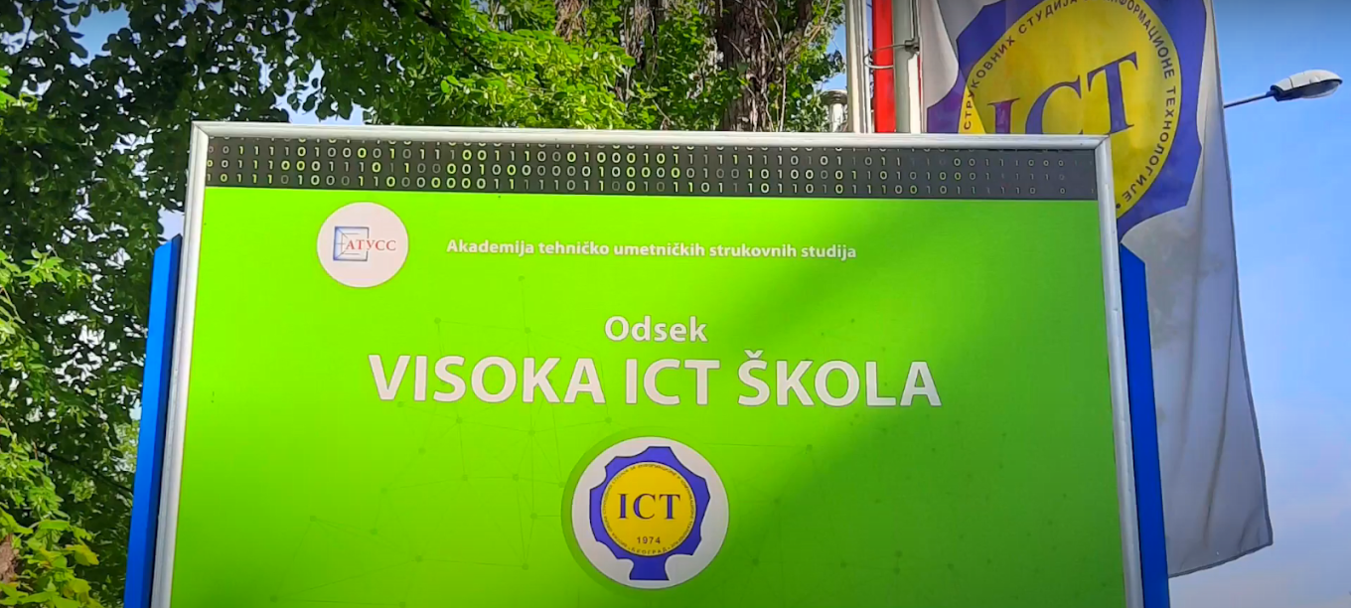
Department School of
Information and Communication Technologies
Network of centers for regional short study programs in the countries of the Western Balkans
Call: ERASMUS-EDU-2023-CBHE
Project number: 101128813

Slide 16
Department School of
Information and Communication Technologies
Master applied studies (120 ECTS)
Network and Software Engineering
Network of centers for regional short study programs in the countries of the Western Balkans
Call: ERASMUS-EDU-2023-CBHE
Project number: 101128813

Slide 17
Network and Software Engineering
The study programme of Network and Software Engineering represents the second degree of master applied studies, which enables students to master theoretical and practical knowledge necessary to handle complex ICT problems in a real-world setting. Students become high-quality professionals capable of performing jobs related to the configuration and administration of computer and telecommunication networks.
Besides compulsory courses aimed at training students to work in real market conditions, students choose elective courses which enable them to create their professional development in accordance with their needs and aspirations or requirements of a particular job. Strong practical orientation is achieved through providing internship for all our students. The study programme is particularly focused on current issues of network systems, system administration and software engineering, by analyzing both theoretical and practical aspects of these expanding fields.
Network of centers for regional short study programs in the countries of the Western Balkans
Call: ERASMUS-EDU-2023-CBHE
Project number: 101128813

Slide 18
Network and Software Engineering
Upon completion of the master study programme of Network and Software Engineering, students should be able to:
independently handle problems for a longer period of time
analyze problems and make problem-solving plans
design practical models to simplify implementation
make real-world plans taking account of different options, limitations and time-efficiency
gather and analyze different types of information using common sense and critical thinking
continuously write lengthy reports and report observation findings in well-written technical documents
exchange knowledge in both oral and written forms
comply with professional ethics
More details on website: https://en.ict.edu.rs/node/645
Network of centers for regional short study programs in the countries of the Western Balkans
Call: ERASMUS-EDU-2023-CBHE
Project number: 101128813

Slide 19
Our Mission
The School's mission is to function as an open, flexible and modern-oriented higher education institution that meets the educational, professional and development needs of the economic environment and social community in the areas of: internet technology, postal and banking technology and telecommunications.
Network of centers for regional short study programs in the countries of the Western Balkans
Call: ERASMUS-EDU-2023-CBHE
Project number: 101128813

Slide 20
Our Vision
The school, based on its development plans as a future institution of higher education, expects integration into a single system of European education. It will educate experts who will be able to perform tasks related to highly specialized practical experience in the fields for which it trains students.
With their knowledge and commitment, students and teachers will be able to get involved in professional and scientific research projects, thereby acquiring new knowledge needed for cooperation with business organizations and improving the development of their own environment. The educational process according to modern world trends, as well as cooperation with economic organizations, are a guarantee of profit that will be invested in equipment and staff training, in order to ensure continuity in the development and constant progress of the School.
Network of centers for regional short study programs in the countries of the Western Balkans
Call: ERASMUS-EDU-2023-CBHE
Project number: 101128813

Slide 21
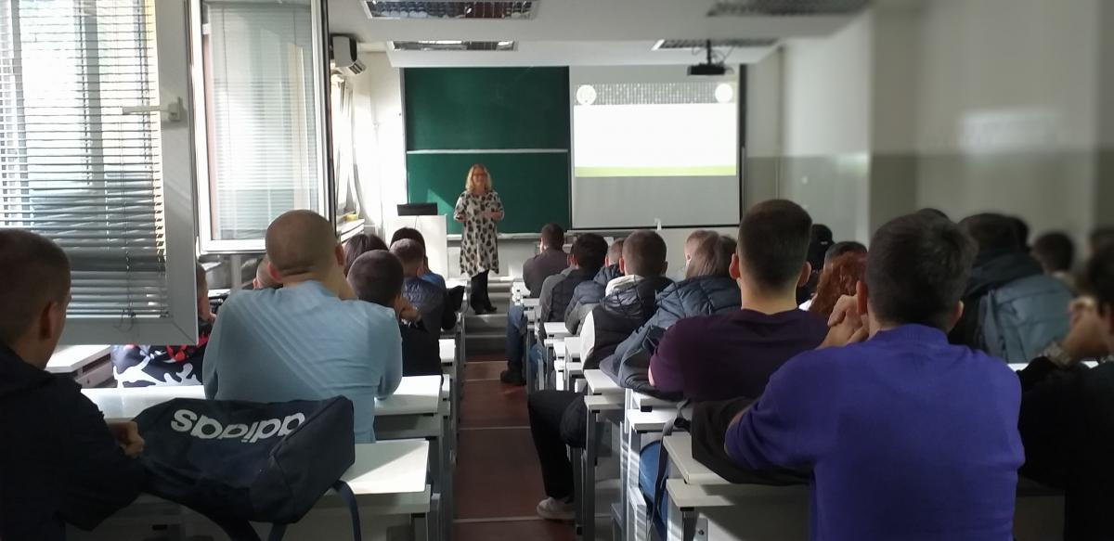
Network of centers for regional short study programs in the countries of the Western Balkans
Call: ERASMUS-EDU-2023-CBHE
Project number: 101128813

Slide 22
ICT as CISCO academy
Cisco Academy is an educational program in the field of network technologies. The goal of this program is to train participants to design, implement and maintain small and medium-sized computer networks. Through the program itself, participants acquire a wide range of knowledge from the IT world, related to network technologies, which enables them to find jobs in this field more easily. Experienced Cisco instructors, in addition to the necessary knowledge, provide their participants with the necessary confidence that is necessary in the IT world. The program offers both theoretical and practical training on modern network devices.
Cisco Academy is primarily intended for students and pupils who want to expand their knowledge and gain more experience in the field of computer networks than the one offered by the existing educational system.
Network of centers for regional short study programs in the countries of the Western Balkans
Call: ERASMUS-EDU-2023-CBHE
Project number: 101128813

Slide 23
ICT as MikroTik academy
The College of Vocational Studies for Information and Communication Technologies is the first MikroTik Academy in Serbia. It has now been succeeded by Mikrotik Academy ATUSS Belgrade.
Students have the opportunity to obtain the MTCNA (MikroTik Certified Network Associate) certificate as part of regular classes, through the course Praktikum z computer networks 2 (according to the old Praktkum plans). As ATUSS Belgrade is now a MikroTik Academy, all students of ATUSS can attend training and obtain the MTCNA certificate.
Network of centers for regional short study programs in the countries of the Western Balkans
Call: ERASMUS-EDU-2023-CBHE
Project number: 101128813

Slide 24
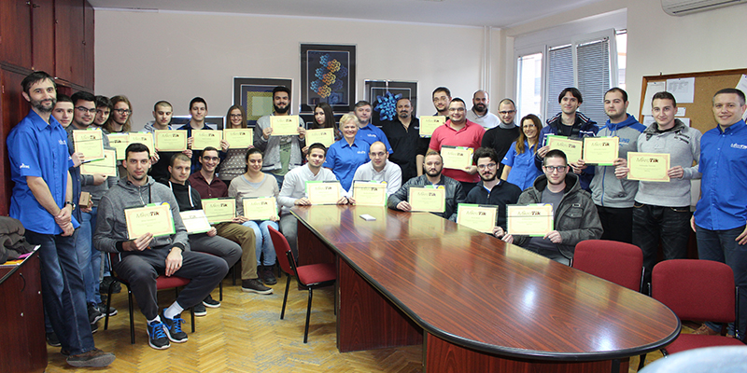
ICT as MikroTik academy
Network of centers for regional short study programs in the countries of the Western Balkans
Call: ERASMUS-EDU-2023-CBHE
Project number: 101128813

Slide 25
ICT as ORACLE academy
ORACLE is a leading company that covers database and information systems services, as well as Java programming solutions. The company also cooperates with educational institutions in the world, providing at the same time its own resources and expertise, all with the aim of educating young experts in the field of ICT.
Since 2009, the Department of the Higher ICT School has been a member of the ORACLE Academy (OracleAcademy) within the ICS (Introduction to Computer Science) program. Students of the Higher ICT School Department in their undergraduate studies can listen to the program "Oracle Database Design and Programming with SQL" for free as part of the Practicum in Databases course. This course opens up opportunities for further training in the field of programming and the use of relational databases.
Network of centers for regional short study programs in the countries of the Western Balkans
Call: ERASMUS-EDU-2023-CBHE
Project number: 101128813

Slide 26
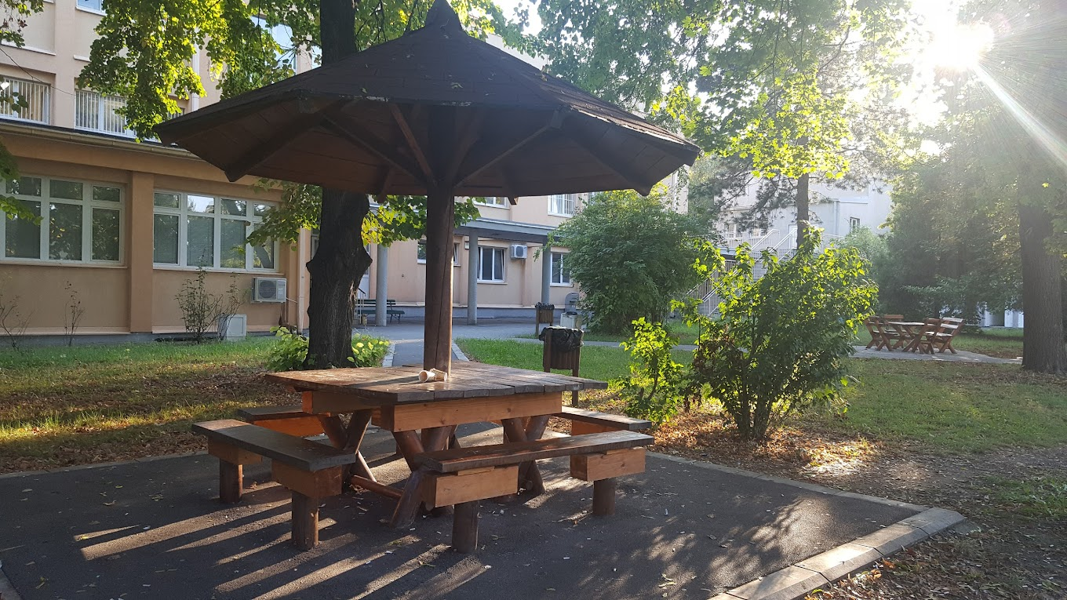
Department School of
Information and Communication Technologies
Network of centers for regional short study programs in the countries of the Western Balkans
Call: ERASMUS-EDU-2023-CBHE
Project number: 101128813

