Slide 1

KICK-OFF MEETING
PRESENTATION OF THE UNIVERSITY OF BIHAĆ
"Funded by the European Union. Views and opinions expressed are however those of the author(s) only and do not necessarily reflect those of the European Union. Neither the European Union nor the granting authority can be."
Amel Toroman….
Senior Teaching Assistant
UNBI
Network of centers for regional short study programs in the countries of the Western Balkans
Call: ERASMUS-EDU-2023-CBHE
sProject number: 101128813

Slide 2
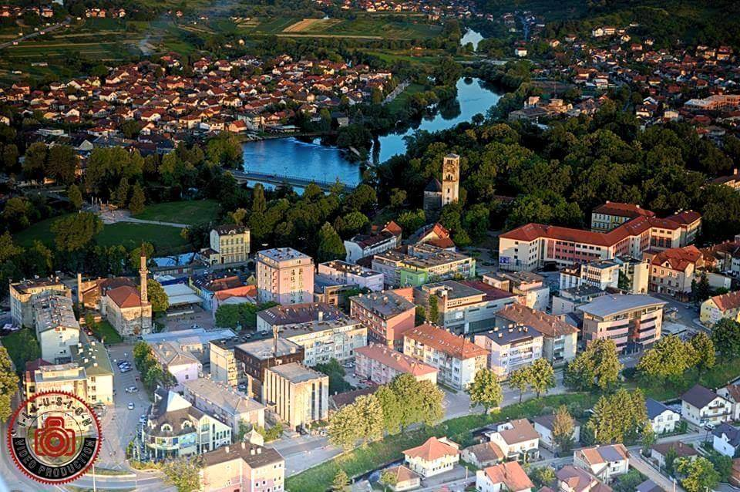


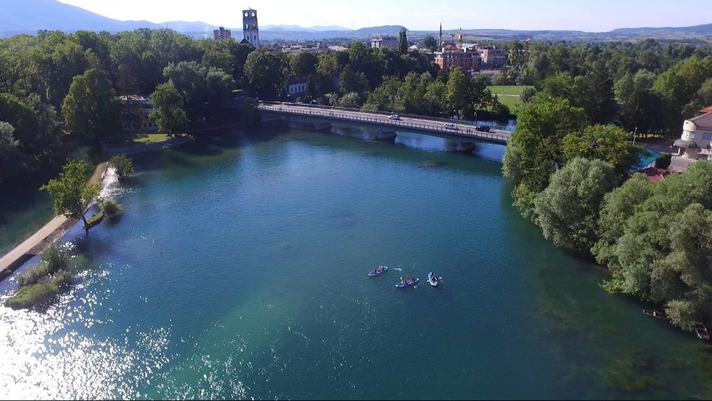
Bihać, Bosna i Hercegovina
Network of centers for regional short study programs in the countries of the Western Balkans
Call: ERASMUS-EDU-2023-CBHE
Project number: 101128813

Slide 3
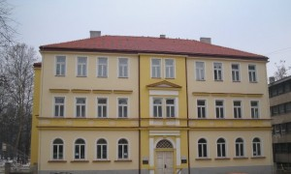
UNIVERSITY PROFILE
Official name: University of Bihać
Rector: Prof.dr. Fadil Islamović
Vice-rector for Academic and Students Affairs: -
Vice-rector for University Development and Financial Affairs: Prof.dr. Atif Hodžić
Vice-rector for Research and International Relations: Prof.dr. Nevzet Veladžić
Acronym: UNBI
Address: Pape Ivana Pavla II 2/2
Contact details:
Tel. +387 37 222 024
Fax +387 37 222 022
e-mail: rektorat@unbi.ba
web page: www.unbi.ba
Network of centers for regional short study programs in the countries of the Western Balkans
Call: ERASMUS-EDU-2023-CBHE
Project number: 101128813

Slide 4



UNIVERSITY PROFILE
28 July 1997
University of Bihać is an accredited public higher education institution established by the Assembly of Una-Sana Canton on 28 July 1997.
12 Jan. 2010
Since 12 January 2010, University operates as an integrated university with 6 organizational units and one associate member.
S: 3000 AO: 80 AO: 140 L: 7
Network of centers for regional short study programs in the countries of the Western Balkans
Call: ERASMUS-EDU-2023-CBHE
Project number: 101128813

Slide 5
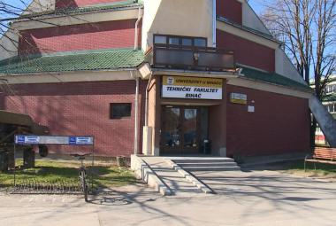

Faculty of Technical Engineering
5 departments
1 institute
Civil Engineering
Mechanical Sciences
Wood-processing technology
Electrotechnical Sciences
Textile design and technology
Model of study
4 +1 +3
Institute
More at http://www.tfb.ba/
Network of centers for regional short study programs in the countries of the Western Balkans
Call: ERASMUS-EDU-2023-CBHE
Project number: 101128813

Slide 6
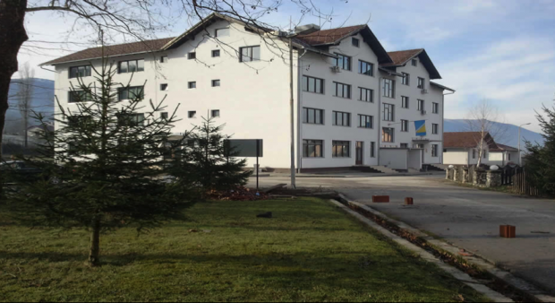

Pedagogical Faculty
7 departments
Physical education
Elementary education
Pre-school education
Mathematics and physics
German language and literature
Model of study
4 +1 +3
English language and literature
Bosnian language and literature
More at http://pfb.unbi.ba/
Network of centers for regional short study programs in the countries of the Western Balkans
Call: ERASMUS-EDU-2023-CBHE
Project number: 101128813

Slide 7
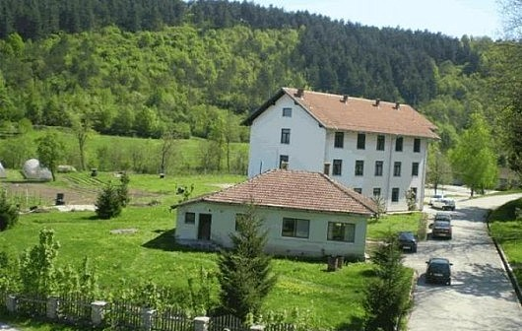

Biotechnical Faculty
3 departments
Agricultural Sciences
Food Processing Technology
Environmental Sciences
Forestry department
Model of study
4 +1 +3
More at http://btf.unbi.ba/
Network of centers for regional short study programs in the countries of the Western Balkans
Call: ERASMUS-EDU-2023-CBHE
Project number: 101128813

Slide 8
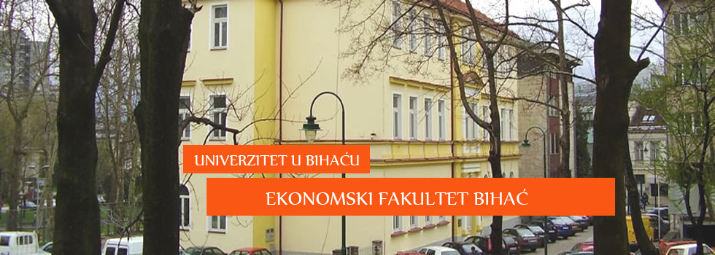

Faculty of Economy
Academic study program
Department of Business Economy
Professional study program
Model of study
4 +1 +3
3+0
More at http://efbi.unbi.ba/
Network of centers for regional short study programs in the countries of the Western Balkans
Call: ERASMUS-EDU-2023-CBHE
Project number: 101128813

Slide 9
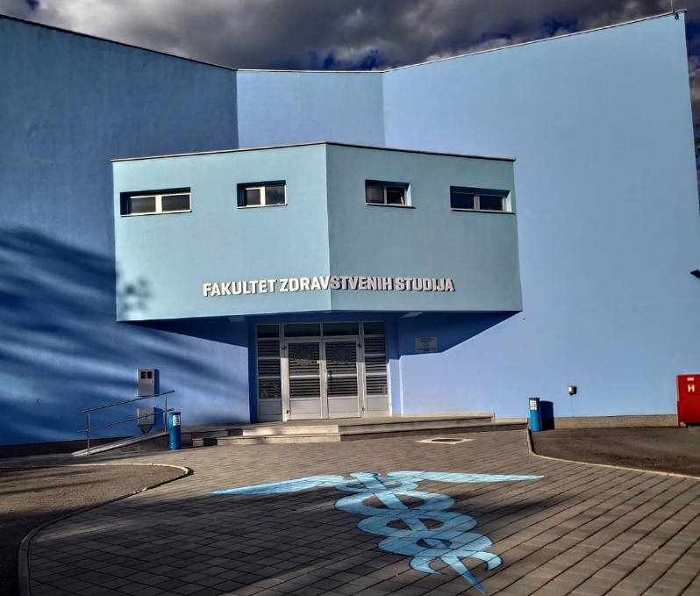

Faculty of Health Studies
3 departments
Nursing Studies
Sanitary Engineering
Physical therapy
Model of study
4+1+3
More at http://fzs.unbi.ba/
Network of centers for regional short study programs in the countries of the Western Balkans
Call: ERASMUS-EDU-2023-CBHE
Project number: 101128813

Slide 10
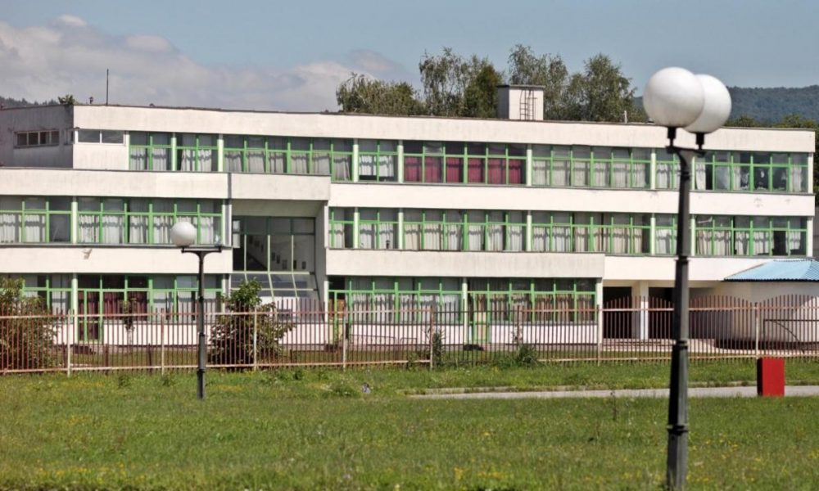


Faculty of Law
Model of study
4 +1 +3
More at http://prf.unbi.ba/
Network of centers for regional short study programs in the countries of the Western Balkans
Call: ERASMUS-EDU-2023-CBHE
Project number: 101128813

Slide 11
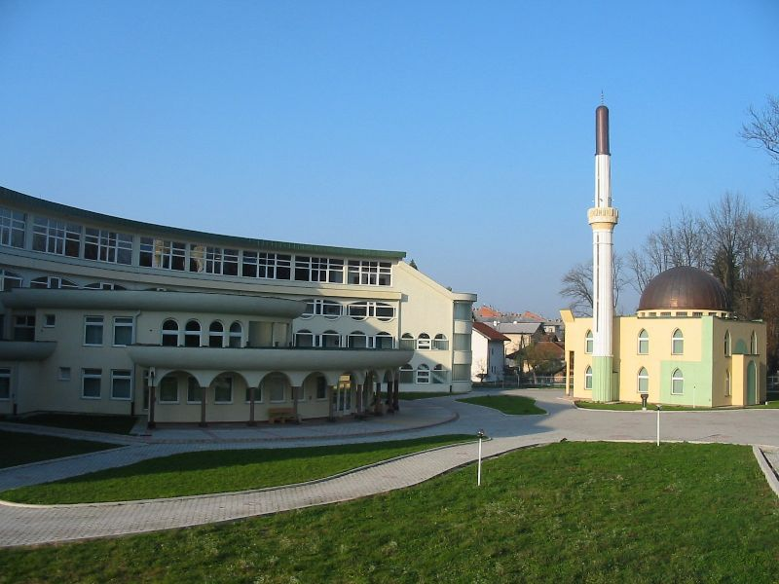
Islamic Pedagogical Faculty
2 departments
Islamic Education
Social pedagogy and spiritiual care
Model of study
4 +1 +3
More at http://ipf.unbi.ba/
Network of centers for regional short study programs in the countries of the Western Balkans
Call: ERASMUS-EDU-2023-CBHE
Project number: 101128813

Slide 12
UNIVERSITY PROFILE
There are 51 study programs at the University of Bihac, 30 in the first study cycle, 19 in the second and 2 in the third one.
The implementation of second cycle studies began in the academic 2010/11. The second cycle is organized at all faculties.
Third cycle study began:
  in academic 2017/18 at Mechanical and Department of Wood-processing Technology of the Faculty of Technical Engineering under title „Contemporary production technologies”,
  in academic 2020/21 at Electrotechnical Department of the Faculty of Technical Engineering under title „Electrical engineering and computing”.
Network of centers for regional short study programs in the countries of the Western Balkans
Call: ERASMUS-EDU-2023-CBHE
Project number: 101128813

Slide 13
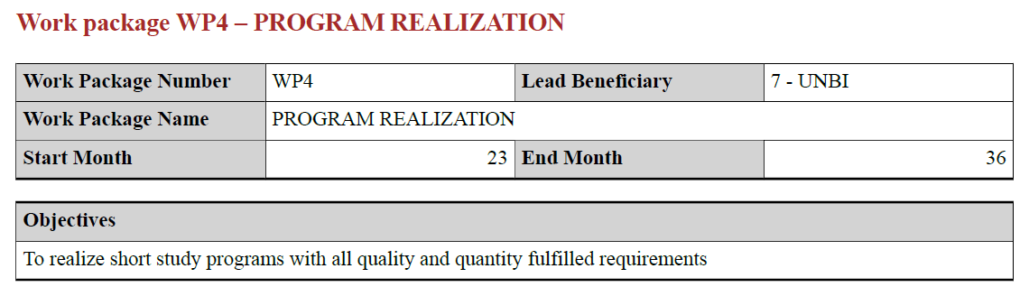
THE ROLE OF UNBI IN THE PROJECT
Members of the UNBI team:
  Aladin Crnkić, PhD, leader
  Atif Hodžić, PhD
  Husein Rošić, PhD
  Amel Toroman, Mr.ing.
  Jasna Hamzabegović, PhD
  Adnan Ramakić, PhD
  Ermin Bajramović, PhD
  Una Drakulić, Mr.
  Amel Džanić, Mr.
  Melisa Haurdić, Mr.
Network of centers for regional short study programs in the countries of the Western Balkans
Call: ERASMUS-EDU-2023-CBHE
Project number: 101128813

Slide 14

Aladin Crnkić, PhD
Faculty of Technical Engineering
University of Bihać
aladin.crnkic@unbi.ba
Mr. ing. Amel Toroman
Faculty of Technical Engineering
University of Bihać
amel.toroman@unbi.ba
Atif Hodžić, PhD
Faculty of Technical Engineering
University of Bihać
atif.hodzic@unbi.ba
Husein Rošić, PhD
Faculty of Technical Engineering
University of Bihać
husein.rosic@unbi.ba
Network of centers for regional short study programs in the countries of the Western Balkans
Call: ERASMUS-EDU-2023-CBHE
Project number: 101128813

Slide 15

Network of centers for regional short study programs in the countries of the Western Balkans
Call: ERASMUS-EDU-2023-CBHE
Project number: 101128813

