Slide 1
KICK-OFF MEETING, BELGRADE, 23-25 JAN 2024
Presentation of Universidad Politecnica de Madrid UPM
Spain
"Funded by the European Union. Views and opinions expressed are however those of the author(s) only and do not necessarily reflect those of the European Union. Neither the European Union nor the granting authority can be."
SLOBODAN BOJANIĆ
professor
UPM
Network of centers for regional short study programs in the countries of the Western Balkans
Call: ERASMUS-EDU-2023-CBHE
sProject number: 101128813

Slide 2
Universidad Politécnica de Madrid UPM
Oldest and largest Spanish technical university.
Almost 3,000 faculty members, 414 researchers and 1,900 administrative staff.
Around 36,000 undergraduate and master’s students, and 1,900 doctoral students.
18 UPM schools cover most engineering disciplines.
160 bachelor’s and master’s degrees,
47 internationally accredited.
On-line education: OCW member, MOOC platforms EdX, MiriadaX, etc., MOOC awards.
Network of centers for regional short study programs in the countries of the Western Balkans
Call: ERASMUS-EDU-2023-CBHE
Project number: 101128813

Slide 3
Universidad Politécnica de Madrid UPM
Sends 1,800 and receives 1,300 students per year.
Erasmus+, Magalhães, China Scholarship Council, Heritage, etc. programs.
Office exclusively dedicated for support of incoming students and staff exchange.
Assistance for accommodation and immigration procedures, especially for non-EU citizens.
Coordinator or partner in ~50 Erasmus+ KA2 projects.
200 research groups and 17 research centres and institutes,
H2020 top funded Spanish university, 24% participation. FP7 funding ≥€64 M, 242 projects.
Network of centers for regional short study programs in the countries of the Western Balkans
Call: ERASMUS-EDU-2023-CBHE
Project number: 101128813

Slide 4
Universidad Politécnica de Madrid UPM
Knowledge and Innovation Communities KIC member, approved by European Institute of Technology.
Industry collaboration: ~50% of R&D funding.
Technological Innovation Support Centre: innovation, spin-offs, internationalization, platforms for campus start-up companies, fundraising and external investment, identify needs and market trends.
Sustainable Development Goals and European Agenda, coordinator of European Universities Alliance EELISA, student future Citizen and Managers of Int. Companies & Institutions for SDG’s commitment.
Network of centers for regional short study programs in the countries of the Western Balkans
Call: ERASMUS-EDU-2023-CBHE
Project number: 101128813

Slide 5
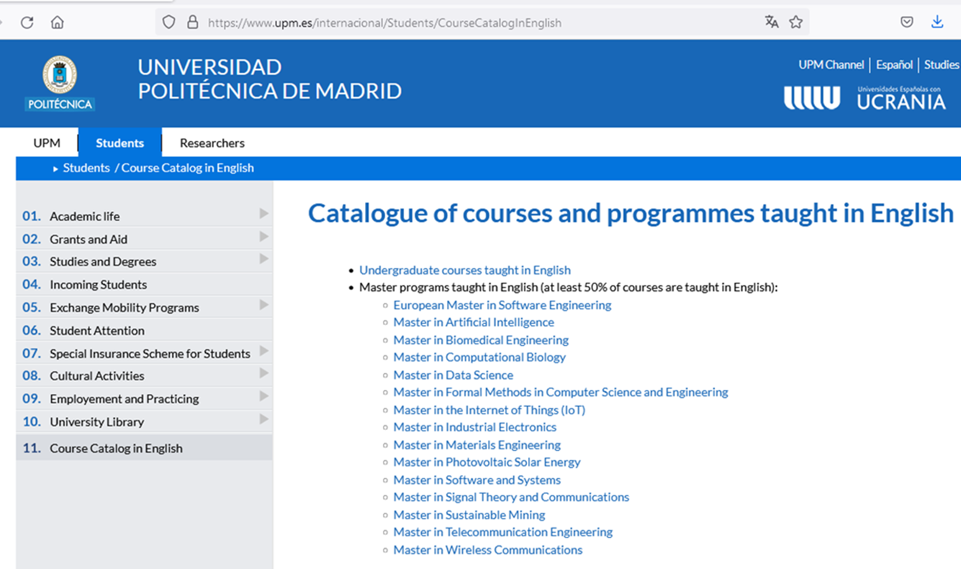
Network of centers for regional short study programs in the countries of the Western Balkans
Call: ERASMUS-EDU-2023-CBHE
Project number: 101128813

Slide 6
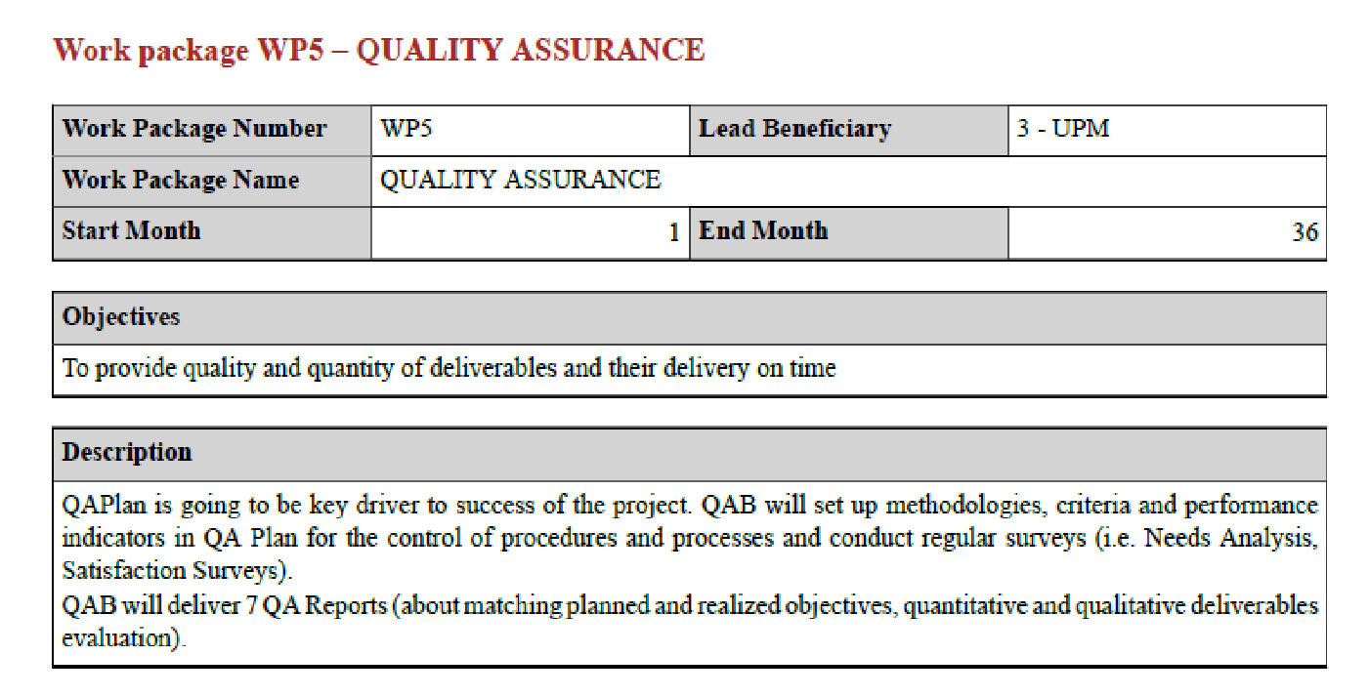
Network of centers for regional short study programs in the countries of the Western Balkans
Call: ERASMUS-EDU-2023-CBHE
Project number: 101128813

Slide 7
Thank you for attention!
Network of centers for regional short study programs in the countries of the Western Balkans
Call: ERASMUS-EDU-2023-CBHE
Project number: 101128813

