Slide 1


DEPARTMENT
SCHOOL OF CIVIL ENGINEERING
AND GEODESY
"Funded by the European Union. Views and opinions expressed are however those of the author(s) only and do not necessarily reflect those of the European Union. Neither the European Union nor the granting authority can be."
Network of centers for regional short study programs in the countries of the Western Balkans
Call: ERASMUS-EDU-2023-CBHE
Project number: 101128813

Slide 2
VGGŠ History
1976 – High school of directed education in the construction profession
1986/87 – High School of Civil Engineering
1960 – High Geodetic School
1996 – High School of Civil Enginering and Geodesy
Network of centers for regional short study programs in the countries of the Western Balkans
Call: ERASMUS-EDU-2023-CBHE
Project number: 101128813

Slide 3
VGGŠ History
2007 – 1st Accreditation by the new Law on Higher Education
2017 – 3rd Accreditation
2020 – The Academy of Technical and Art Applied Studies Belgrade – Department School of Civil Enginering and Geodesy
Network of centers for regional short study programs in the countries of the Western Balkans
Call: ERASMUS-EDU-2023-CBHE
Project number: 101128813

Slide 4
Department School of Civil engineering and Geodesy
Undergraduate applied studies (180 ECTS)
Civil engineering;
Architecture;
Geodesy-geomatics;
Network of centers for regional short study programs in the countries of the Western Balkans
Call: ERASMUS-EDU-2023-CBHE
Project number: 101128813

Slide 5
Department School of Civil engineering and Geodesy
Master applied studies (120 ECTS)
Civil engineering;
Architecture;
Geodesy-geomatics;
Network of centers for regional short study programs in the countries of the Western Balkans
Call: ERASMUS-EDU-2023-CBHE
Project number: 101128813

Slide 6
National Cooperation
Cooperation with industry
Cooperation with Civil engineering school
Cooperation with Association of geodetic and construction schools of Serbia
Network of centers for regional short study programs in the countries of the Western Balkans
Call: ERASMUS-EDU-2023-CBHE
Project number: 101128813

Slide 7
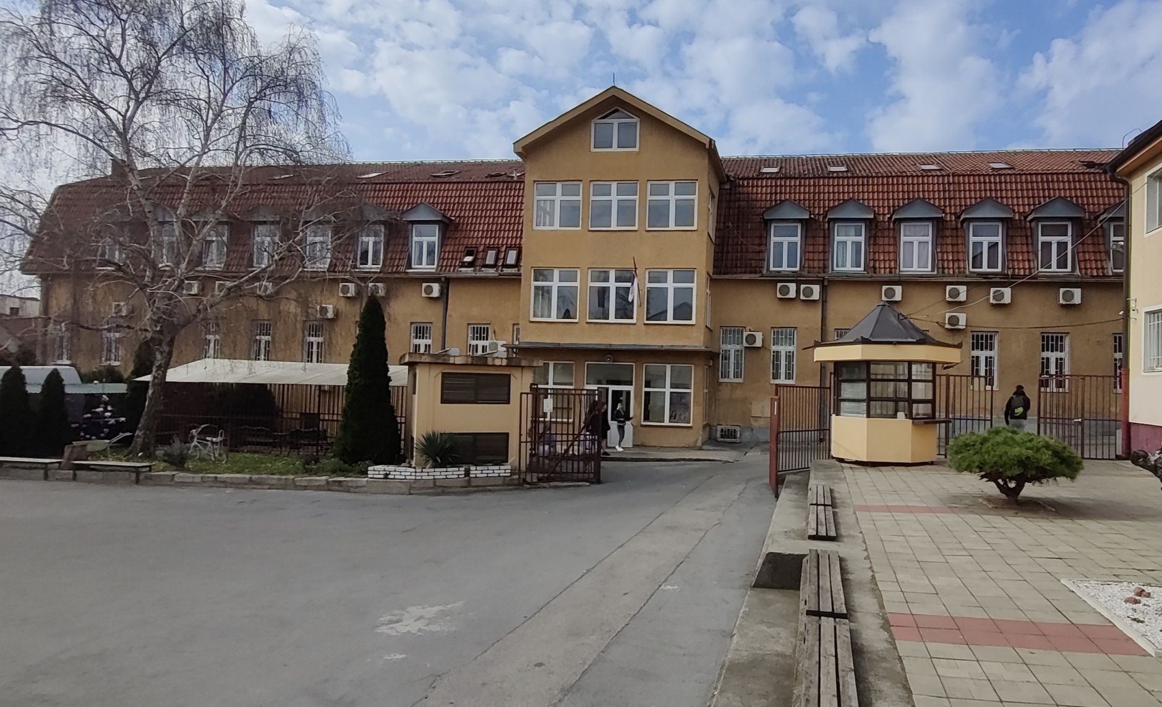
Welcome to VGGŠ
Network of centers for regional short study programs in the countries of the Western Balkans
Call: ERASMUS-EDU-2023-CBHE
Project number: 101128813

