Slide 1


DEPARTMENT
TEXTIL SCHOOL FOR DESIGN, TECHNOLOGY AND MENAGEMENT
"Funded by the European Union. Views and opinions expressed are however those of the author(s) only and do not necessarily reflect those of the European Union. Neither the European Union nor the granting authority can be."
Network of centers for regional short study programs in the countries of the Western Balkans
Call: ERASMUS-EDU-2023-CBHE
Project number: 101128813

Slide 2
VTŠDTM History
1958 – Higher Technical Textile School;
1960/61 – Mechanical-textile, Chemical and textile industry;
1974 – Ready-made knitwear course;
The direction:
  1993/94 – Design for textiles and clothing
  1994/95 – Management and quality management in the textile industry
  1998/99 – Modeling and construction department
Network of centers for regional short study programs in the countries of the Western Balkans
Call: ERASMUS-EDU-2023-CBHE
Project number: 101128813

Slide 3
VTŠDTM History
2007 – 1st Accreditation by the new Law on Higher Education
  Textile and Apparel Design;
  Textile Engineering;
  Clothing technology (with two modules, technological and modeling and construction);
  Management in the textile industry.
2020 – The Academy of Technical and Art Applied Studies Belgrade – Department Textil school for design, technology and menagement
Network of centers for regional short study programs in the countries of the Western Balkans
Call: ERASMUS-EDU-2023-CBHE
Project number: 101128813

Slide 4
Department Textil School for Design, Technology and Menagement
Undergraduate applied studies (180 ECTS)
Textile and Apparel Design;
Textile Engineering;
Management in the Textile Industry.
Network of centers for regional short study programs in the countries of the Western Balkans
Call: ERASMUS-EDU-2023-CBHE
Project number: 101128813

Slide 5
Department Textil School for Design, Technology and Menagement
Textile and Apparel Design
This study program belongs to the broader educational field of art, and the artistic field applied arts and design.
The ability to express themselves artistically when designing textile and clothing by applying different methods, techniques and materials;
Creating unique textile and garments through the application of modern methods and conceptual solutions;
Basic construction and modeling of certain items of women’s, men’s and children’s clothing;
Applying information and communication technologies in mastering modern working methods and keeping up with new tendencies and innovations in the fields of textile and apparel design.
Network of centers for regional short study programs in the countries of the Western Balkans
Call: ERASMUS-EDU-2023-CBHE
Project number: 101128813

Slide 6
Department Textil School for Design, Technology and Menagement
Textile Engineering
This study program belongs to the broader educational field of technical and technological sciences, the field of technological engineeringand the narrower field of textile engineering.
Providing sufficient knowledge and competences that allow the Bachelor of Applied Techology to build a successful career in companies dedicated to the production of textile and clothing, in institutes and laboratories, as teachers of practical classes in high schools; also, to allow the graduate to implement their knowledge into their own production of textile and clothing.
Knowledge of the primary production of textile materials, their structure and characteristics;
Planning and preparing the production in the apparel industry, garment construction and modeling, work study, technology processes related to apparel manufacturing;
Network of centers for regional short study programs in the countries of the Western Balkans
Call: ERASMUS-EDU-2023-CBHE
Project number: 101128813

Slide 7
Department Textil School for Design, Technology and Menagement
Management in the Textile Industry.
This study program belongs to the broader educational field of technical and technological sciences, the field of industrial engineering and engineering management, and the narrower field of management.
By employing engineering managers, the quality of the workforce in the textile and apparel industry will improve. Through their work and knowledge obtained through this study program, our Bachelors of Applied Management will influence the development of the textile and apparel industry, its competitive edge, and through that the development of the society on the whole.
Thorough knowledge and understanding of management in the textile industry;
Solving concrete challenges and problems that come up in textile companies;
Management, organization and control of business processes, starting with a production plan and up to product realization and its placement on the market;
Network of centers for regional short study programs in the countries of the Western Balkans
Call: ERASMUS-EDU-2023-CBHE
Project number: 101128813

Slide 8
Department Textil School for Design, Technology and Menagement
Master applied studies (120 ECTS)
Textile and Apparel Design;
Textile Engineering;
Management in the Fashion Industry.
Network of centers for regional short study programs in the countries of the Western Balkans
Call: ERASMUS-EDU-2023-CBHE
Project number: 101128813

Slide 9
Department Textil School for Design, Technology and Menagement
Textile and Apparel Design
The basic goal of this study program is to educate masters of applied textile and apparel design who would actively participate in the textile, apparel and fashion industry and in the field of electronic/digital media through an innovative use of design which takes into account sociological, economic, and ecological sustainability.
Mastering methods and techniques applied in the design and development of new products
Thorough knowledge and understanding of the culture and art that envelop the design process, whose integral part is textile and apparel design.
Actively applying innovative creative techniques during the design process.
Network of centers for regional short study programs in the countries of the Western Balkans
Call: ERASMUS-EDU-2023-CBHE
Project number: 101128813

Slide 10
Department Textil School for Design, Technology and Menagement
Textile Engineering
The basic goalofthis study program is to educate masters of applied engineering while focusing on advanced professional knowledge, competences and skills that would allow them to integrate into textile and apparel companies quickly and in the best possible way.
Mastering methods and techniques applied in the production, distribution and exploitation of textile and clothing.
Thorough knowledge and understanding of the textile technology processes.
Competences related to the ecological aspects of manufacturing and dispposing of textile and apparel products.
Network of centers for regional short study programs in the countries of the Western Balkans
Call: ERASMUS-EDU-2023-CBHE
Project number: 101128813

Slide 11
Department Textil School for Design, Technology and Menagement
Management in the Fashion Industry
The basic goal of this study program is to educate masters of applied management while focusing on the abilities of independent management of businesses and other types of organizations in the fashion industry ;
Mastering theoretical and highly specialized knowledge, practical skills, methods and procedures related to procurement, production, distribution, sales and services;
Connecting and implementing basic knowledge in the fields of management, textile engineering, and textile and apparel design; keeping up with contemporary achievements and innovations in the fashion industry;
Network of centers for regional short study programs in the countries of the Western Balkans
Call: ERASMUS-EDU-2023-CBHE
Project number: 101128813

Slide 12
National Cooperation
Cooperation with industry
Cooperation with secondary textile schools in Serbia
Cooperation with fashion apparel cluster Serbia
Network of centers for regional short study programs in the countries of the Western Balkans
Call: ERASMUS-EDU-2023-CBHE
Project number: 101128813

Slide 13
International Cooperation
As part of the Erasmus+ FASHIORATION project, a workshop dedicated to the modern interpretation of folk costumes was organized. The models produced were displayed at an exhibition in Belgrade during June.
They will participate in the Belgrade Fashion Week in 2023 and BAFE (Balkan Art Fashion Event) fashion shows.
Network of centers for regional short study programs in the countries of the Western Balkans
Call: ERASMUS-EDU-2023-CBHE
Project number: 101128813

Slide 14
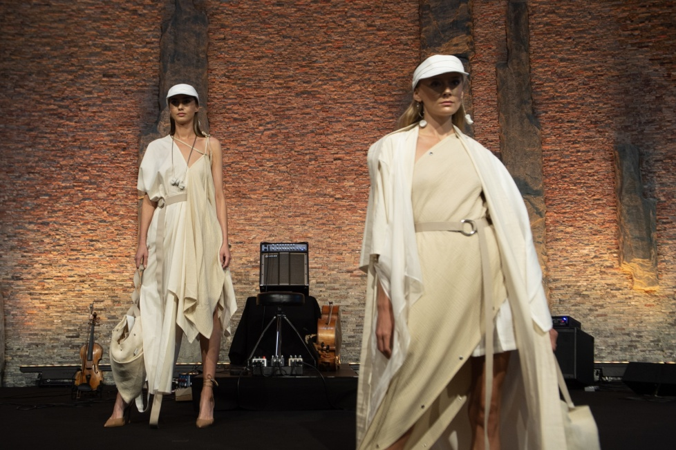
International Cooperation
Assistant Sonja Jocić, as a representative of the Republic of Serbia, opened the She Inspires fashion show with her models, held as part of the general assembly of the World Intellectual Property Organization in Geneva.
Network of centers for regional short study programs in the countries of the Western Balkans
Call: ERASMUS-EDU-2023-CBHE
Project number: 101128813

Slide 15
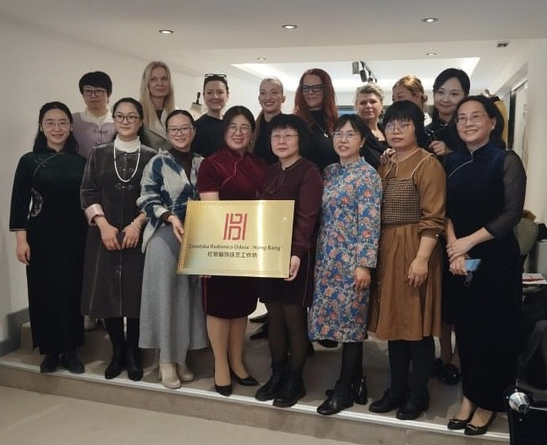
International Cooperation
Solemn inauguration of the cooperation between the Republic of Serbia and the Chinese Association for the Cooperation of Industry and Education, as well as the Hong Bang workshop for making traditional Chinese costumes.
Network of centers for regional short study programs in the countries of the Western Balkans
Call: ERASMUS-EDU-2023-CBHE
Project number: 101128813

Slide 16
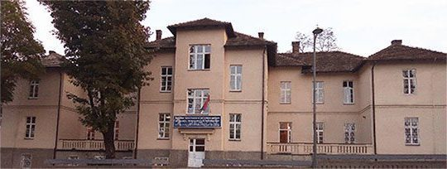
Welcome to VTŠDTM
Network of centers for regional short study programs in the countries of the Western Balkans
Call: ERASMUS-EDU-2023-CBHE
Project number: 101128813

