Slide 1


DEPARTMENT
SCHOOL OF ELECTRICAL AND COMPUTER ENGINEERING
"Funded by the European Union. Views and opinions expressed are however those of the author(s) only and do not necessarily reflect those of the European Union. Neither the European Union nor the granting authority can be."
Ivana Milošević, PhD ….
Professor
Network of centers for regional short study programs in the countries of the Western Balkans
Call: ERASMUS-EDU-2023-CBHE
Project number: 101128813

Slide 2
VIŠER History
1987 – The Advanced School of Electrical Engineering
2007 – The School of Electrical and Computer Engineering –
1st Accreditation by the new Law on Higher Education
2017 – 3rd Accreditation
2020 – The Academy of Technical and Art Applied Studies Belgrade – Department School of Electrical and Computer Engineering
Network of centers for regional short study programs in the countries of the Western Balkans
Call: ERASMUS-EDU-2023-CBHE
Project number: 101128813

Slide 3

Department School of Electrical and Computer Engineering
Undergraduate applied studies (180 ECTS)
Audio and Video Technologies
Automation and Vehicle Control Systems
Information Systems
Electronics and Telecommunications
New Energy Technologies
New Computer Technologies
Computer Engineering
Network of centers for regional short study programs in the countries of the Western Balkans
Call: ERASMUS-EDU-2023-CBHE
Project number: 101128813

Slide 4
Department School of Electrical and Computer Engineering
Master applied studies (120 ECTS)
Electrical Engineering;
Multimedia Engineering;
Computer Engineering;
Network of centers for regional short study programs in the countries of the Western Balkans
Call: ERASMUS-EDU-2023-CBHE
Project number: 101128813

Slide 5
National Cooperation
Cooperation with industry
Cooperation with electrotechnical schools
  National electrotechnics competition
  National programming competition
  National multimedia competition
Network of centers for regional short study programs in the countries of the Western Balkans
Call: ERASMUS-EDU-2023-CBHE
Project number: 101128813

Slide 6
International Cooperation
ERASMUS+ mobility project (КА103 2022)
ERASMUS+ ERASMUS-EDU-2023-CBHE, WBNET - 101128813
(2023-2026)
ERASMUS+ ERASMUS-EDU-2023-CBHE, NEST4WB - 101129321
(2023-2026)
Network of centers for regional short study programs in the countries of the Western Balkans
Call: ERASMUS-EDU-2023-CBHE
Project number: 101128813

Slide 7
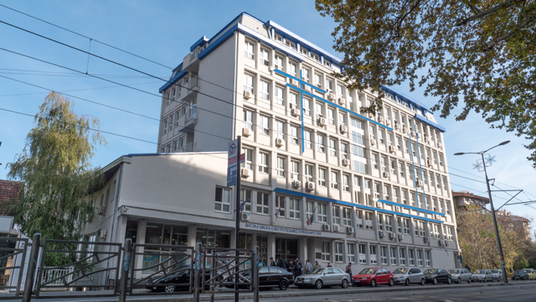
Welcome to
VIŠER
Network of centers for regional short study programs in the countries of the Western Balkans
Call: ERASMUS-EDU-2023-CBHE
Project number: 101128813

