Slide 1

CONSORTIUM MEETING
April 16th 2024.
-WBNET-
WHAT WAS DONE,
WHAT SHOULD BE DONE
- TIMELINE-
"Funded by the European Union. Views and opinions expressed are however those of the author(s) only and do not necessarily reflect those of the European Union. Neither the European Union nor the granting authority can be."
LJILJANA PECIĆ,
Project coordinator,
ATUSS
Network of centers for regional short study programs in the countries of the Western Balkans
Call: ERASMUS-EDU-2023-CBHE
Project number: 101128813

Slide 2
DONE TILL NOW
WP1 DELIVERABLES:
D 1.1 SC, QAB, DB, WP WGs formed– on February 29th submitted to SYGMA,
D 1.2 Project Management Plan – on February 29th submitted to SYGMA
D 1.3 First SC Report created and SC will meet again during this consortium meeting to update info for new SC Report (M6 – end of May 2024)
WP5 MILESTONES:
MS1: Project Agreement (PA) signed – February 29th submitted to SYGMA
MS2: Project Management Plan - February 29th submitted to SYGMA,
Network of centers for regional short study programs in the countries of the Western Balkans
Call: ERASMUS-EDU-2023-CBHE
Project number: 101128813

Slide 3
DONE TILL NOW
WP2 :
T 2.1 Study visit to ATUSS,
T 2.2.1 Training 1
2.2.1 Training 1 - Aims and technical conditions for opening center for short study cycles
Materials are available on shared Google Drive,
Satisfaction survey done and it showed that participants were very satisfied
Network of centers for regional short study programs in the countries of the Western Balkans
Call: ERASMUS-EDU-2023-CBHE
Project number: 101128813

Slide 4
DONE TILL NOW
WP5 DELIVERABLES:
D 5.1 Quality Assurance Plan – submitted to SYGMA on time
D 5.2 First QA Report created – set in Google Drive
WP5 MILESTONES:
MS8: Quality Assurance Plan– February 29th submitted to SYGMA
Network of centers for regional short study programs in the countries of the Western Balkans
Call: ERASMUS-EDU-2023-CBHE
Project number: 101128813

Slide 5
DONE TILL NOW
WP7 DELIVERABLES:
D 7.1 Dissemination Plan – submitted to SYGMA on March 31st
D 7.2 Project website– lunched on time, sustaining with materials; instructions for using distributed
D 7.3 Promo materials for the project promotion – developed logo, addopted by all partners; printed material for the Kick-off-meeting; some additional promo
D 7.4 - Media contents and announcements through social media of HEIs and economy partners – we lunched Facebook, Instagram and Linkedin pages - STARTED
WP7 MILESTONES:
MS10: Project website – established and sustained till now
Network of centers for regional short study programs in the countries of the Western Balkans
Call: ERASMUS-EDU-2023-CBHE
Project number: 101128813

Slide 6
DONE TILL NOW
  Kick-off –meeting succesfully organized
    only representatives from ASRPU did not attend it,
    good atmosphere,
    meeting was evaluated with survey
  Communication is good and established on a daily base (wbnet@atuss.edu.rs – central email address)
  All documents are in one folder that all partners have equal access, including photo gallery from Kick-off-meeting
  Funds transfer – to only one partner ASRPU funds were not transfered due the validation process – coordinator received INSTRUCTION on April 12th
Network of centers for regional short study programs in the countries of the Western Balkans
Call: ERASMUS-EDU-2023-CBHE
Project number: 101128813

Slide 7
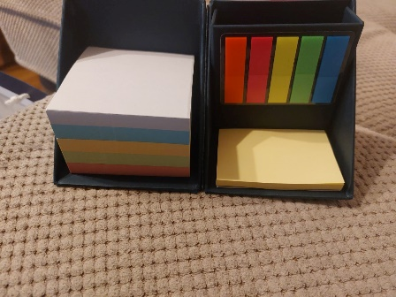
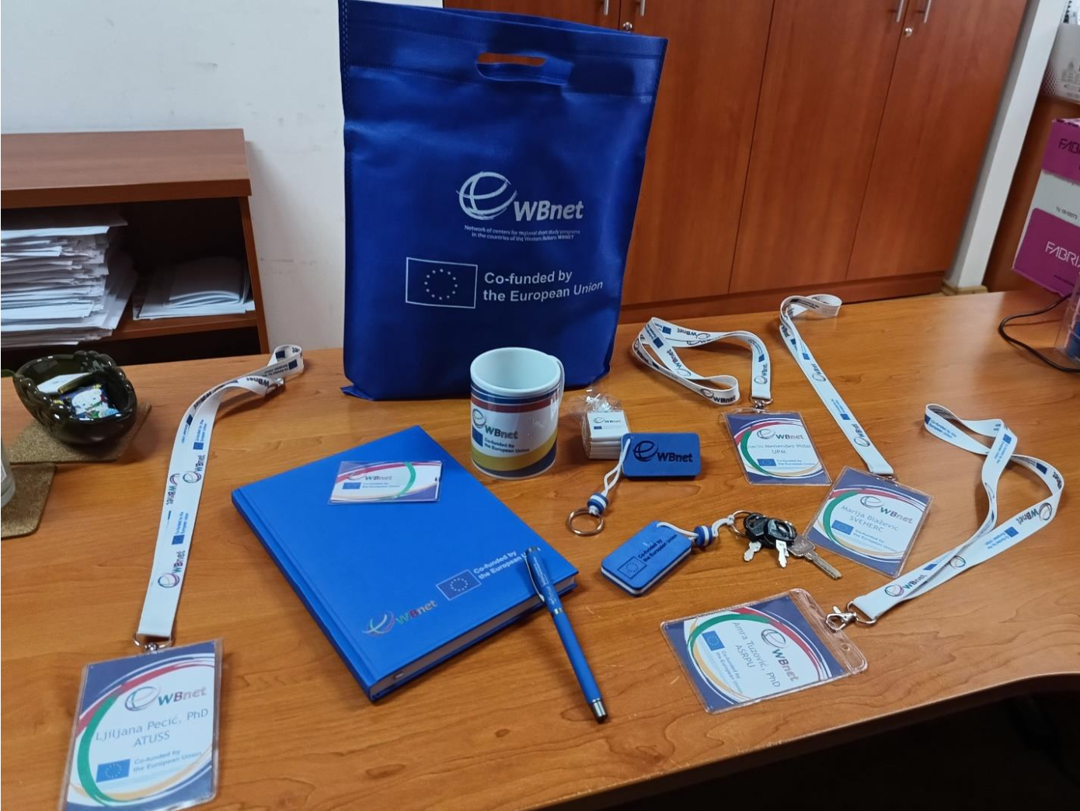
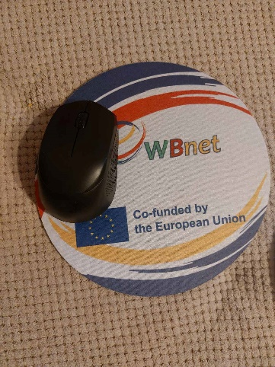
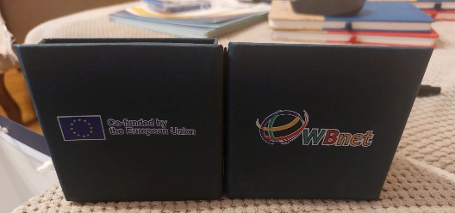
WHAT WE ALSO DID?
All HEIs set on their websites the information about the project?
AASKM, UPKM and UNBI held In-home-training 1, prepared report and announcements are published on website and social networks
Printed some promo materials...
Network of centers for regional short study programs in the countries of the Western Balkans
Call: ERASMUS-EDU-2023-CBHE
Project number: 101128813

Slide 8
TIMELINE FOR TASKS RESULTS DELIVERY
PERIOD: M5 – M15
T 2.2 In-home trainings 1 and 2 (M8 - end of July 2024) – with report, and published announcements
  provide surveys about In-home trainings
  T 2.3 Defining goals of centers (M5 – M11)
  - Prepare a surveys, condact them among students, companies, conduct meetings with economy partners about their needs – M10 - end of September 2024) – use meeting in Madrid for discussion and practice/experience exchange among partners
  Lunch a procedures on institutional level in order to establish Centres (M10- M11 – end of October 2024)
  D 2.1 Define goals of Centres – draft defined on each WB HEI due M11- October 2024 - last date for submission report to Project Coordinator - January 15th
Network of centers for regional short study programs in the countries of the Western Balkans
Call: ERASMUS-EDU-2023-CBHE
Project number: 101128813

Slide 9
TIMELINE FOR TASKS RESULTS DELIVERY
T 3.1 Purchasing equipment – start now if not jet
  updated purchasing lists submit to PC due to April 23th
  Must be established and documented by the end of M17 – April 2025
  Make all necessary documentation and prepare report
  Reports must be set in Google Drive and submitted to the PC before May 15th
  prepare announcements about equipment establishment in WBHEIs before
  if possible contact local TV stations to make a report about previously mentioned
Network of centers for regional short study programs in the countries of the Western Balkans
Call: ERASMUS-EDU-2023-CBHE
Project number: 101128813

Slide 10
WP2 - DEVELOPING CENTRES FOR SHORT STUDY PROGRAMS (ULFE)
UPCOMING PERIOD: M5-M18
Two study visits:
  ULFE – 16.04.2024 – 18.04.2024- ongoing
  UPM - M12 – 24.09.2024 – 26.09.2024.
  Set of trainings are ongoing these days
  2.2.2 Training 2 - Developing curriculums for short study programs
ULFE – run one/two surveys:
  On - line survey– about the quality of trainings
  On-line survey about the overall management of event
Network of centers for regional short study programs in the countries of the Western Balkans
Call: ERASMUS-EDU-2023-CBHE
Project number: 101128813

Slide 11
After training 2 at EU partners, at WB HEIs In-home trainings have to be organized
  provide survey about satisfaction of participants
Meetings with economy partners, surveys among students, employees and non-employed persons about missing skills
  On-line surveys are recommended
As a result, goals for WB Centers for Short Study programs should be defined – must be submitted due M15
Documentation for the WB HEIs Councils have to be prepared and asked for permit for opening centres within the HEIs – must be submitted due -M16,
Registration centres according to national law (as part of infrastructure of HEIs with own account or subaccount of HEI, can be different in each WBHEI) – M16
Network of centers for regional short study programs in the countries of the Western Balkans
Call: ERASMUS-EDU-2023-CBHE
Project number: 101128813

Slide 12
RULES FOR COMMUNICATION IN THE FUTURE
GOOGLE DRIVE: WBNET DELI SE SA PARTNERIMA/REPORTING
  WP1 – WP7
  ATUSS-ULFE-UPM-UPKM-AASKM-SVEHERS-UNBI-W3LAB-ASRPU
ATUSS
WP1
WP2
WP3
WP4
WP5
WP6
WP7
IPC to easy write Reports
Network of centers for regional short study programs in the countries of the Western Balkans
Call: ERASMUS-EDU-2023-CBHE
Project number: 101128813

Slide 13
RULES FOR COMMUNICATION IN THE FUTURE
GOOGLE DRIVE: WBNET DELI SE SA PARTNERIMA/REPORTING
  WP1 – WP7
  ATUSS-ULFE-UPM-UPKM-AASKM-SVEHERS-UNBI-W3LAB-ASRPU
ACTIVITIES
WP1
ATUSS
ULFE
UPM
AASKM
SVEHERC
UNBI
W3LAB
UPKM
ASRPU
COST/ FUNDS
WP Leaders to easier write Reports
categories
DELIVERABLES
REPORTS
Network of centers for regional short study programs in the countries of the Western Balkans
Call: ERASMUS-EDU-2023-CBHE
Project number: 101128813

Slide 14
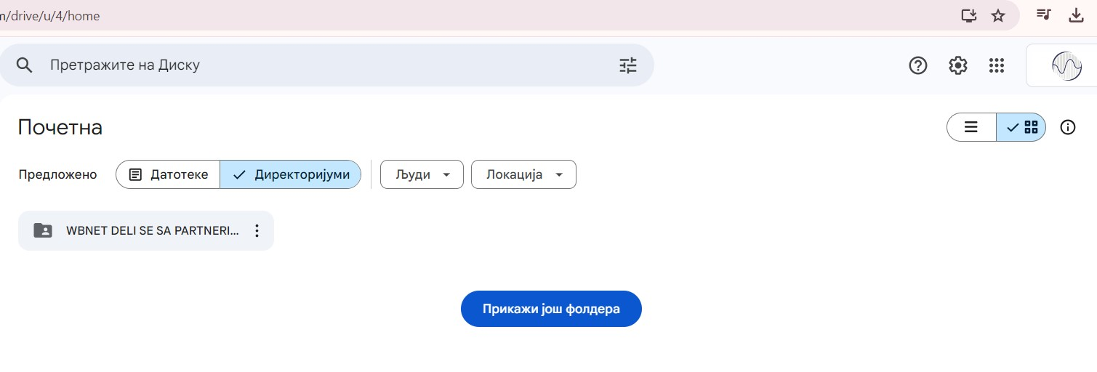
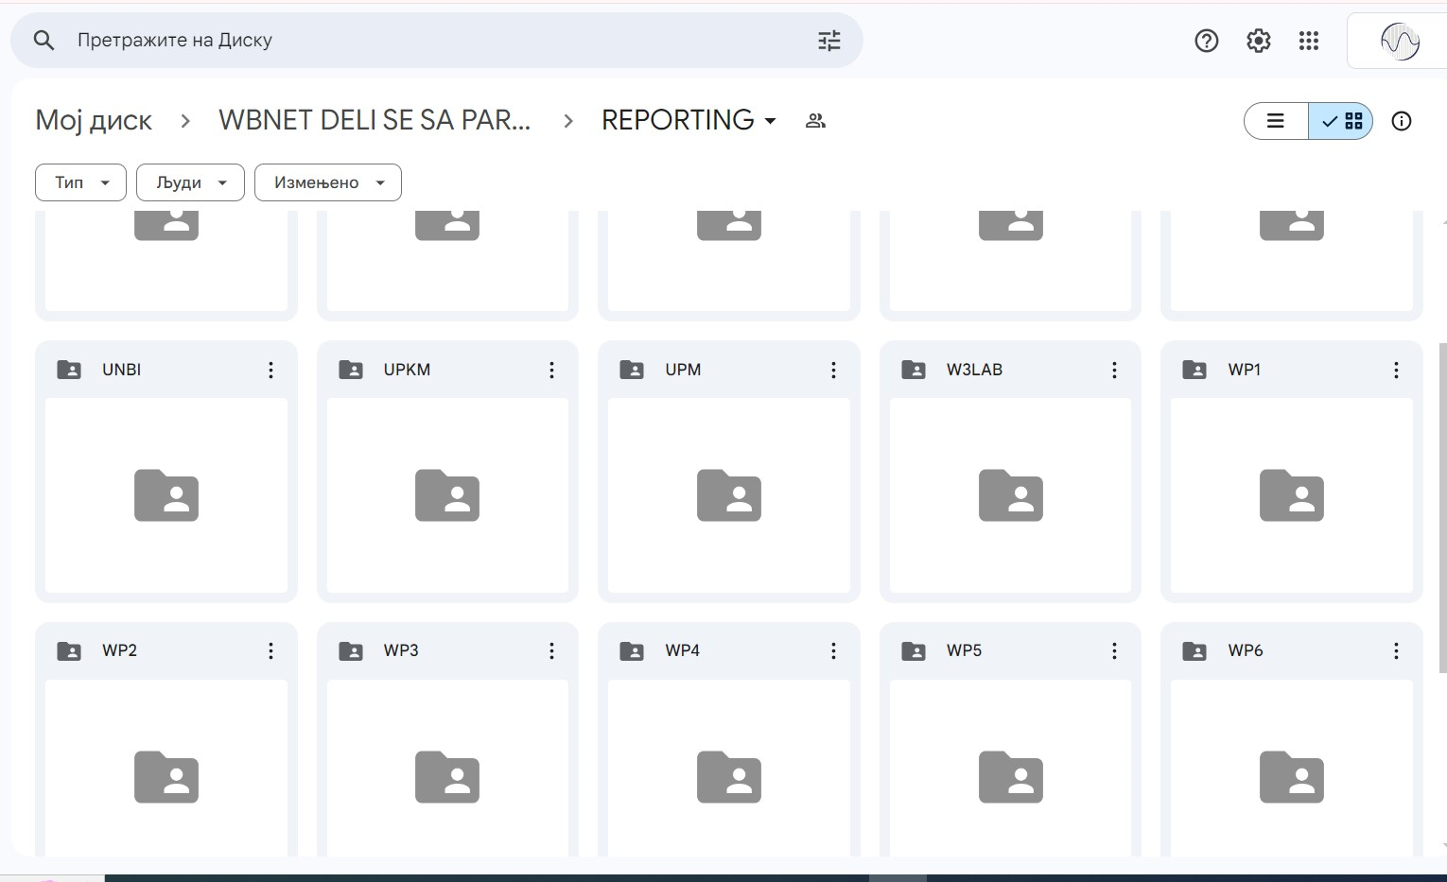
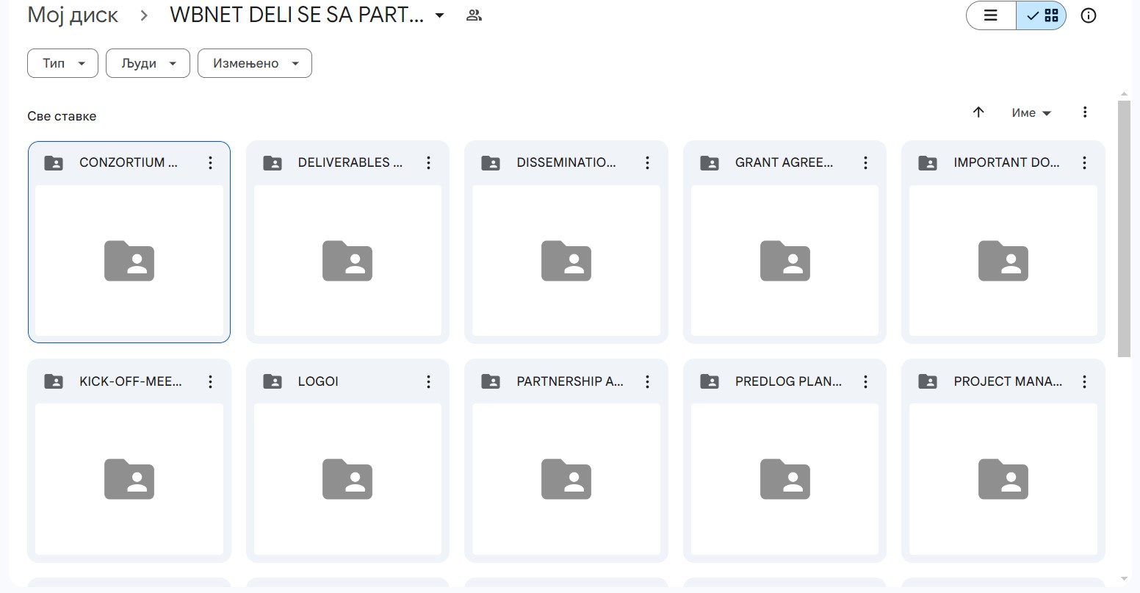
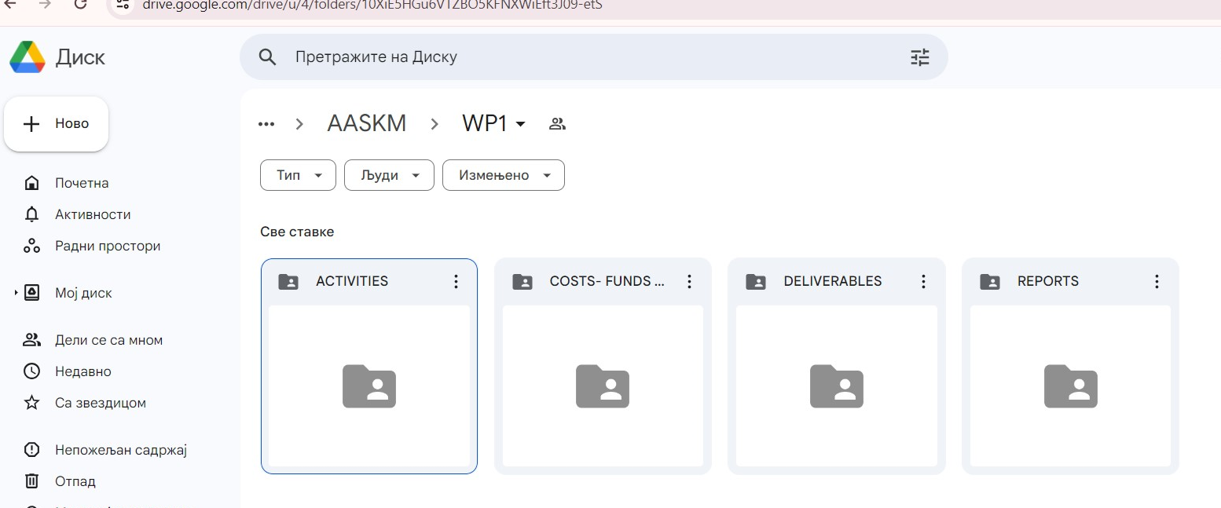
RULES FOR COMMUNICATION IN THE FUTURE
Network of centers for regional short study programs in the countries of the Western Balkans
Call: ERASMUS-EDU-2023-CBHE
Project number: 101128813

Slide 15
RULES FOR COMMUNICATION IN THE FUTURE
Instructions for filling the parts of meeting reports are:
  Working package: one of WPs,
  Type of meeting: development, management,
  Order number of a meeting: order number in a category (institutional, consortium),
  Meeting format: live/online
  Meeting level: consortium/institutional
  Report must contain number of participants and number of female and male participants – SYGMA DEMAND
Network of centers for regional short study programs in the countries of the Western Balkans
Call: ERASMUS-EDU-2023-CBHE
Project number: 101128813

Slide 16
RULES FOR COMMUNICATION IN THE FUTURE
Instructions for filling the parts of Periodic WP reports are:
  Working package/INSTITUTION: one of WPs/ACRONYM,
  Order number of a Report: order number in a category (institutional, consortium),
EXAMPLE:
  WP2/1 - already written
  WP2/2 – have to be written till the May 15th.
Network of centers for regional short study programs in the countries of the Western Balkans
Call: ERASMUS-EDU-2023-CBHE
Project number: 101128813

Slide 17
RULES FOR DISSEMINATION IN THE FUTURE
Tasks must be done in agreed time line,
Events must be covered with dissemination material
  prepare announcement for the project website and project social networks and WBHEIs websites and social networks
  Communicate about this with Instituional PC (IPC),
  After approval:
    send to PC email about the done job
    send email to WP7 leader – AASKM – danijela.zubac@akademijakm.edu.rs
    WP7 leader will provide publishing on the project website
    upload in WP7 and HEIs folder
  publish announcement on HEIs website and social networks,
  keep records about this and distribute to WP7 leader for preparing Periodic report - M6, 12 (May 10th, November 10th) and submit in WP7
  WP7 Leader submits Periodic report not letter than May 15th, November 15th to PC and in Google Drive
Network of centers for regional short study programs in the countries of the Western Balkans
Call: ERASMUS-EDU-2023-CBHE
Project number: 101128813

Slide 18
RULES FOR COMMUNICATION IN THE FUTURE
Interim Institutional Report must contain:
  description of done tasks,
  subcontracting costs,
  purchase costs,
    travel costs
    equipment costs
    printing,
    etc
  staff costs
So – keep records of spendings
Network of centers for regional short study programs in the countries of the Western Balkans
Call: ERASMUS-EDU-2023-CBHE
Project number: 101128813

Slide 19
SUMMARY
TASK – REPORT-ANNOUNCEMENT if it is applicable
REPORTING:
  1. Put in the addecuate folder
  2. Put in HEIs Folder in addequate subfolder –WP
  3. Create announcement and publish inside your HEI
  4. Send announcement to Project Coordinator and WP7 leader to publish on website and social networks
  5. Leaders of WPs create a Periodic Reports on time
Network of centers for regional short study programs in the countries of the Western Balkans
Call: ERASMUS-EDU-2023-CBHE
Project number: 101128813

Slide 20
WP3-CREATING A PROGRAM OF SHORT STUDIES IN MULTIMEDIA
ENGINEERING AND COMPUTING - UPKM
PERIOD: M10-M25
OBJECTIVES: to develop and get accreditation for 8 short study programs (2 per WB HEI) and equip 4 Centres labs with equipment
WB HEIs should lunch as soon as possible:
  Procedures for purchasing equipment
  Discuss about main goals for short study programs on each WB HEI (from today till the M13)
  Prepare documentation for WB HEIs Councils necessary to lunch registration procedures
Network of centers for regional short study programs in the countries of the Western Balkans
Call: ERASMUS-EDU-2023-CBHE
Project number: 101128813

Slide 21
On each of 4 WB HEI the equipment for 4 Centres must be purchased -
Equipment shall be purchased to be in the function of short study programs and in line with GA and national law.
ATUSS will supervise if necessary
Two training will be conducted:
  Training 3 - Pedagogical Methodology for Short Study Cycles – M12 (UPM)
  Training 4 - Training for conducting placements in companies - experience transfer – ATUSS and ULFE (M18)
The curriculums for multimedia and programming are going to be developed for 4 WB HEIs, based on needs of labour market in surroundings of each WB HEI
Network of centers for regional short study programs in the countries of the Western Balkans
Call: ERASMUS-EDU-2023-CBHE
Project number: 101128813

Slide 22
NOTE:
Each HEI should set the main data about the project,
Each HEI should disseminate our meetings
All should be set on project website and social networks
Network of centers for regional short study programs in the countries of the Western Balkans
Call: ERASMUS-EDU-2023-CBHE
Project number: 101128813

Slide 23

Network of centers for regional short study programs in the countries of the Western Balkans
Call: ERASMUS-EDU-2023-CBHE
Project number: 101128813

