Slide 1
STUDY VISIT, MADRID, 24-26. September 2024.
AASKM
PROGRESS REPORT
"Funded by the European Union. Views and opinions expressed are however those of the author(s) only and do not necessarily reflect those of the European Union. Neither the European Union nor the granting authority can be."
Bojan Prlinčević, professor Danijela Zubac, professor
Milan Mišić, professor Uroš Jakšić, professor
AASKM
Network of centers for regional short study programs in the countries of the Western Balkans
Call: ERASMUS-EDU-2023-CBHE
sProject number: 101128813

Slide 2
Progres report
In the previous period, AASKM has carried out the following activities:
Continuous project website updates
Conducted II In-home training.
Presented the WBnet project in the media and social media.
Survey conducted.
Conducted analysis of surveys and studies on needs, limitations and opportunities for the development of short studies
Network of centers for regional short study programs in the countries of the Western Balkans
Call: ERASMUS-EDU-2023-CBHE
Project number: 101128813

Slide 3
Project information on institutional websites
The partners have shared project information on their institutional websites:
AASKM has implemented all the activities outlined in the Dissemination Plan related to the website.
UPKM has carried out all the activities specified in the Dissemination Plan regarding the website.
UNIBI has carried out all the activities specified in the Dissemination Plan regarding the website.
SVEHERC has carried out all the activities specified in the Dissemination Plan regarding the website.
Network of centers for regional short study programs in the countries of the Western Balkans
Call: ERASMUS-EDU-2023-CBHE
Project number: 101128813

Slide 4
Conducted II In-home training
In accordance with WP 2, Task T2.2, an Inhome training session was conducted at AASKM.
The training took place on April 30, 2024, in the premises of the Zvečan Department.
The training was attended by the teaching staff of the Zvečan Department, with a total of 33 teacher present.
The InHome training session was attended by 29 male and 4 female teachers.
Network of centers for regional short study programs in the countries of the Western Balkans
Call: ERASMUS-EDU-2023-CBHE
Project number: 101128813

Slide 5
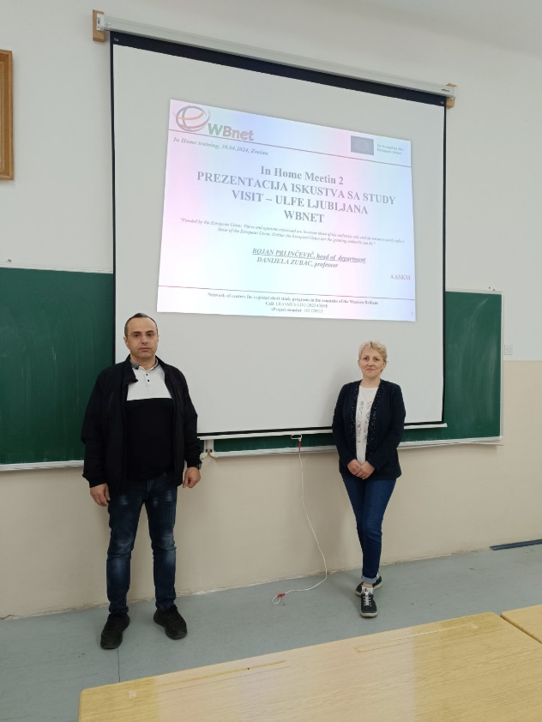
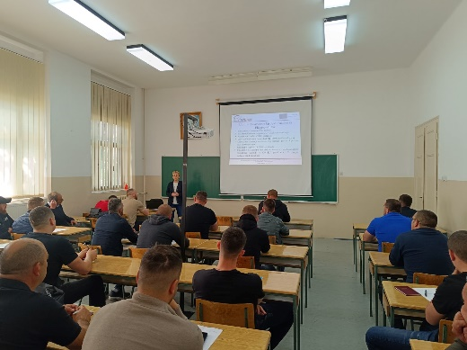
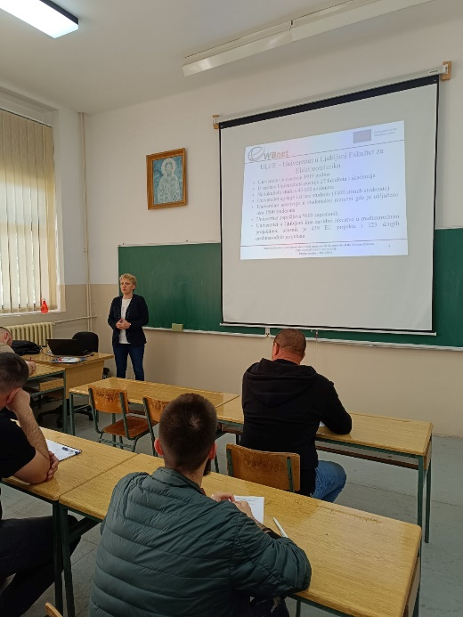
Conducted II In-home training
Network of centers for regional short study programs in the countries of the Western Balkans
Call: ERASMUS-EDU-2023-CBHE
Project number: 101128813

Slide 6
Presented the WBnet project in the media and social media
In accordance with Work Package 7, Task T7.4 - Promotion in Media and Social Networks, AASKM has carried out the following activities related to the promotion of the WBnet project:
The project was presented on the local TV station TV Most. The guest appearance on the morning program and the project presentation were conducted by Prof. Prlinčević and Prof. Jakšić.
https://akademijakm-my.sharepoint.com/:v:/g/personal/bojan_prlincevic_akademijakm_edu_rs/EdUEJTP4RvdMpvc39Y8NvE4BET4BAP23JD97dCkIIPQPMQ?e=tkMk2R
Network of centers for regional short study programs in the countries of the Western Balkans
Call: ERASMUS-EDU-2023-CBHE
Project number: 101128813

Slide 7
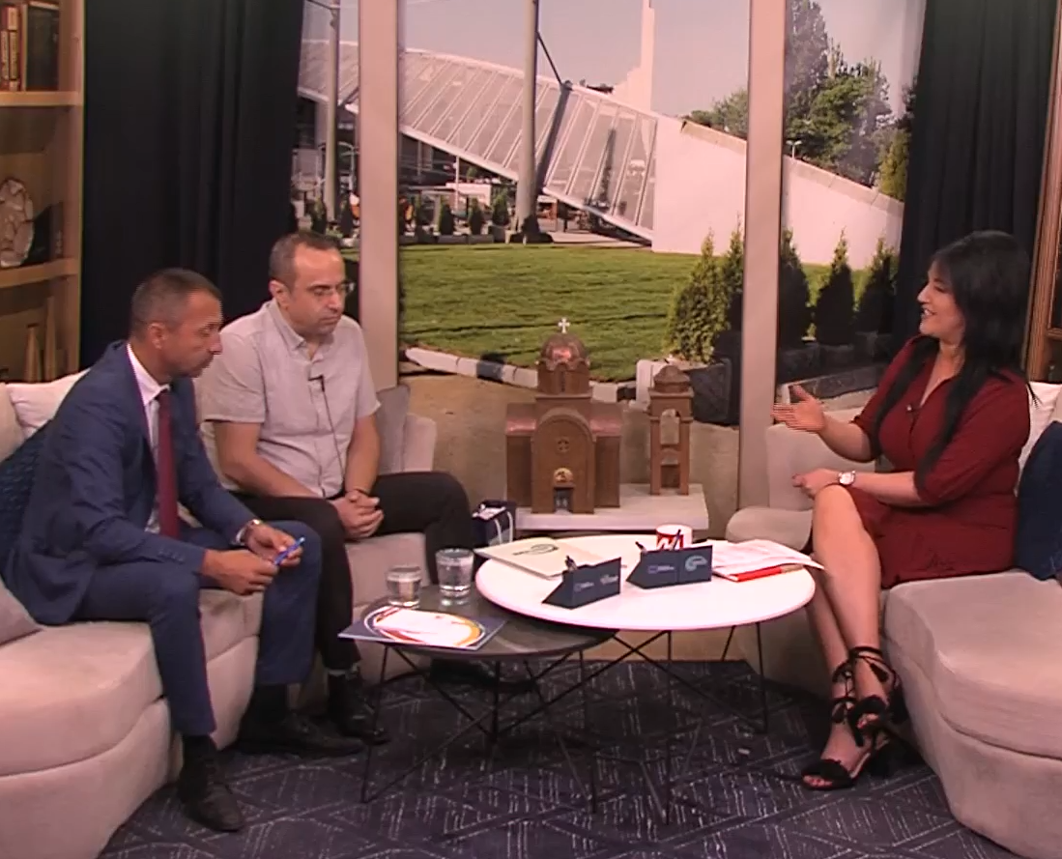
Screenshot of the WBnet project presentation on the TV Most
Network of centers for regional short study programs in the countries of the Western Balkans
Call: ERASMUS-EDU-2023-CBHE
Project number: 101128813

Slide 8
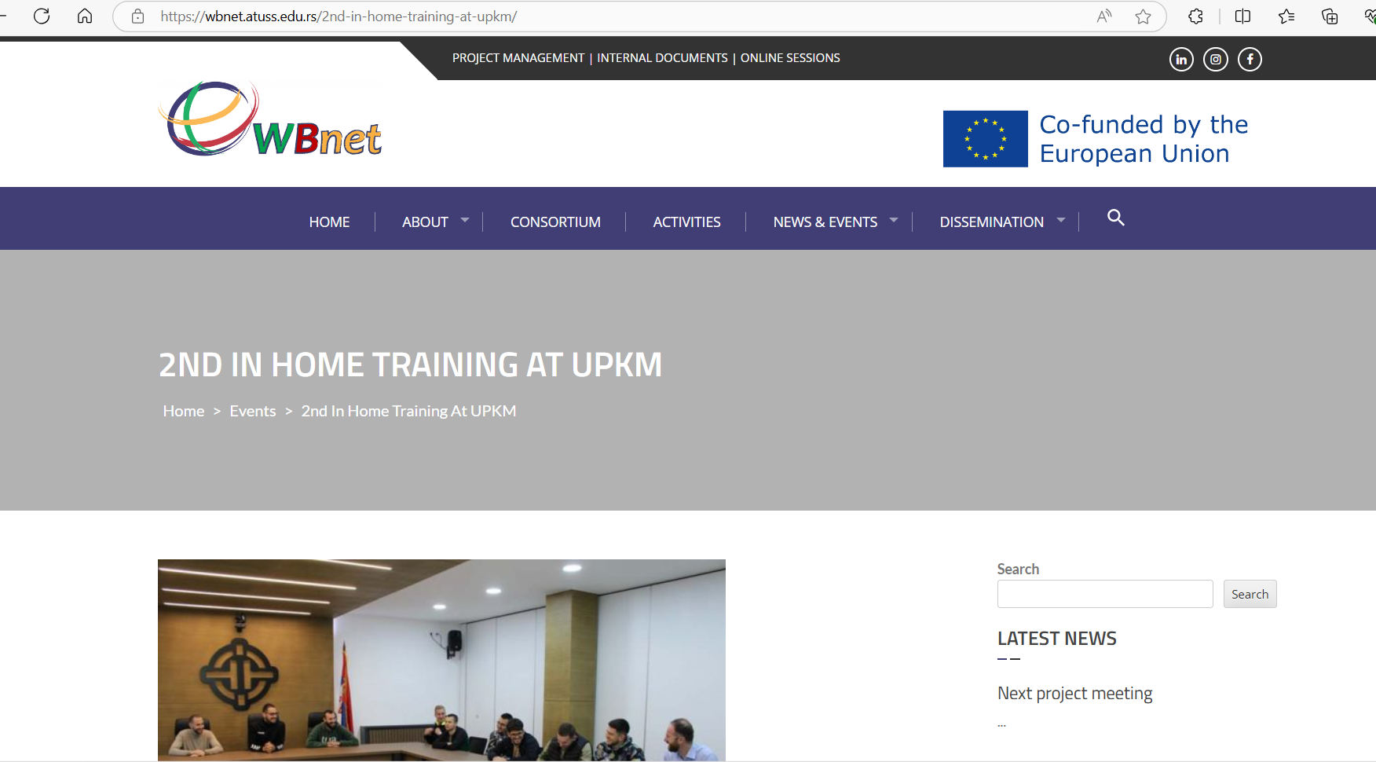
Screenshot of the WBnet project’s Web page
Network of centers for regional short study programs in the countries of the Western Balkans
Call: ERASMUS-EDU-2023-CBHE
Project number: 101128813

Slide 9
Surveys conducted
AASKM has conducted a survey to assess needs and market conditions.
Ninety-nine participants were surveyed, with the majority being male (83%).
Half of the respondents represent the younger population, aged 18-25, making up 46% of the total.
Out of the 99 respondents, 62 are employed, 36 are unemployed, and 29 both work and study at the same time.
Network of centers for regional short study programs in the countries of the Western Balkans
Call: ERASMUS-EDU-2023-CBHE
Project number: 101128813

Slide 10
Analysis of surveys and studies has been conducted
Study on the needs, constraints and possibilities for the development of short studies was conducted. Document is prepared:
The preparation of the necessary regulations and accompanying documentation required for the implementation of short study programs is underway.
Network of centers for regional short study programs in the countries of the Western Balkans
Call: ERASMUS-EDU-2023-CBHE
Project number: 101128813

Slide 11
Thank you for attention!
Network of centers for regional short study programs in the countries of the Western Balkans
Call: ERASMUS-EDU-2023-CBHE
Project number: 101128813

