Slide 1
Madrid, September 24 -26th, 2024
WHAT WAS DONE,
WHAT SHOULD BE DONE
- TIMELINE-
DR LJILJANA PECIĆ
Project coordinator

Slide 2
AGREED IN LJUBLJANA
PERIOD: M5 – M15
WBHEIs - T 2.2 In-home trainings 1 and 2 (M8 - end of July 2024) – with report, and published announcements
provide surveys about In-home trainings
T 2.3 WBHEIs – preparing suggestions for developing goals of centers (M5 – M11)
- Prepare a surveys, condact them among students, companies, conduct meetings with economy partners about their needs – M10 - end of September 2024) – use meeting in Madrid for discussion and practice transfer
Lunch a procedures on institutional level in order to establish Centres (M10- M11 – end of October 2024)
D 2.1 Define goals of Centres – defined on each WB HEI due M11
- last date for submission report to Project Coordinator - January 15th
T 3.1 Purchasing equipment – start now
Must be established and documented by the end of M17
prepare announcements about equipment establishment in WBHEIs

Slide 3
WP1 – MANAGEMENT (M01-M36) - ATUSS
T 1.1 - Partnership Agreement preparation
MS1 – Signed PA
T 1.2 – Kick-off Meeting
T 1.3 – Developing Project management plan
MS2 – Project Management Plan
T 1.4 – Meetings of SC
7 times
T 1.5 – Day-to-day coordination and communication
T 1.6 - Periodic and final reporting

Slide 4
1st Interim Reporting?
- Delays in reporting evident – more on SC meeting

Slide 5
WP2 – M01-M18 (due end of May 2025)
T 2.1 Study visits to EU partners
T 2.2 Training of WB HEI staff
T 2.3 Defining goals of centers
MS3 – M15 (end of February 2025)
T 2.4 Establishment of the Center at WB HEIs
MS4 - Centers involved in WB HEIs documentation – M18 (end of May 2025)
T 2.5 Registration of Centers according to the law
MS5 - Defined financial status of Centers

Slide 6
STUDY VISITS (T 2.1)
ATUSS – 23.01. -25.01.2024. – DONE
Done,
Questionares – done
Announements – published
Report – done
ULFE – 16.04. - 18.04.2024. – DONE
Done,
Questionare – done
Announcements – published
Report – done
UPM – 24.09. – 26.04.2024. – IN PROGRESS

Slide 7
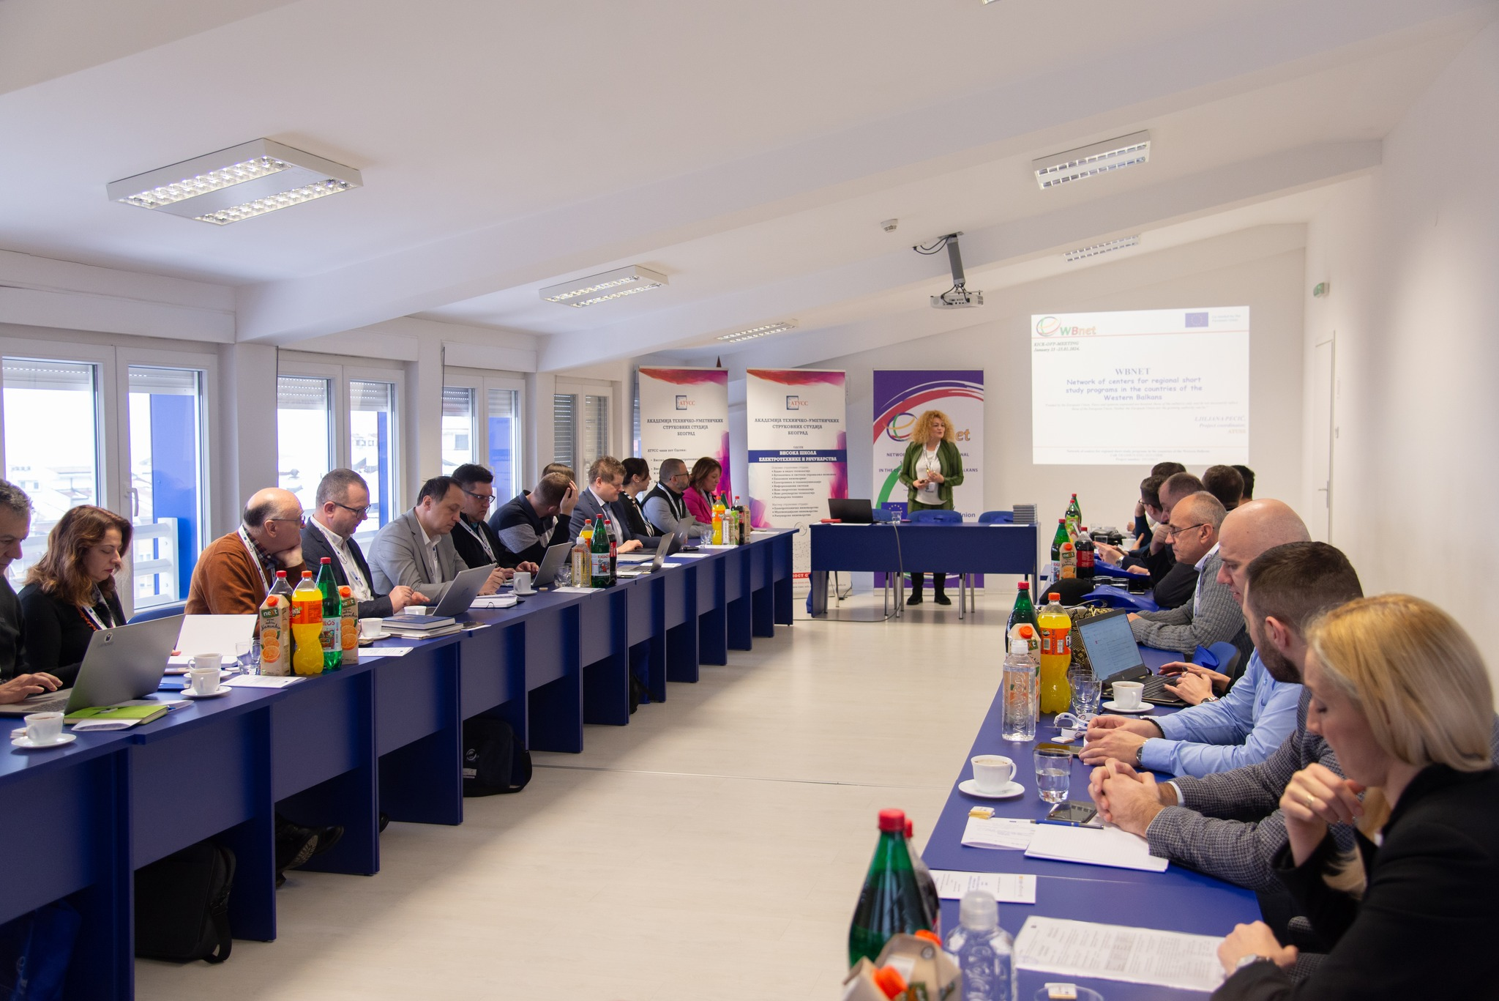
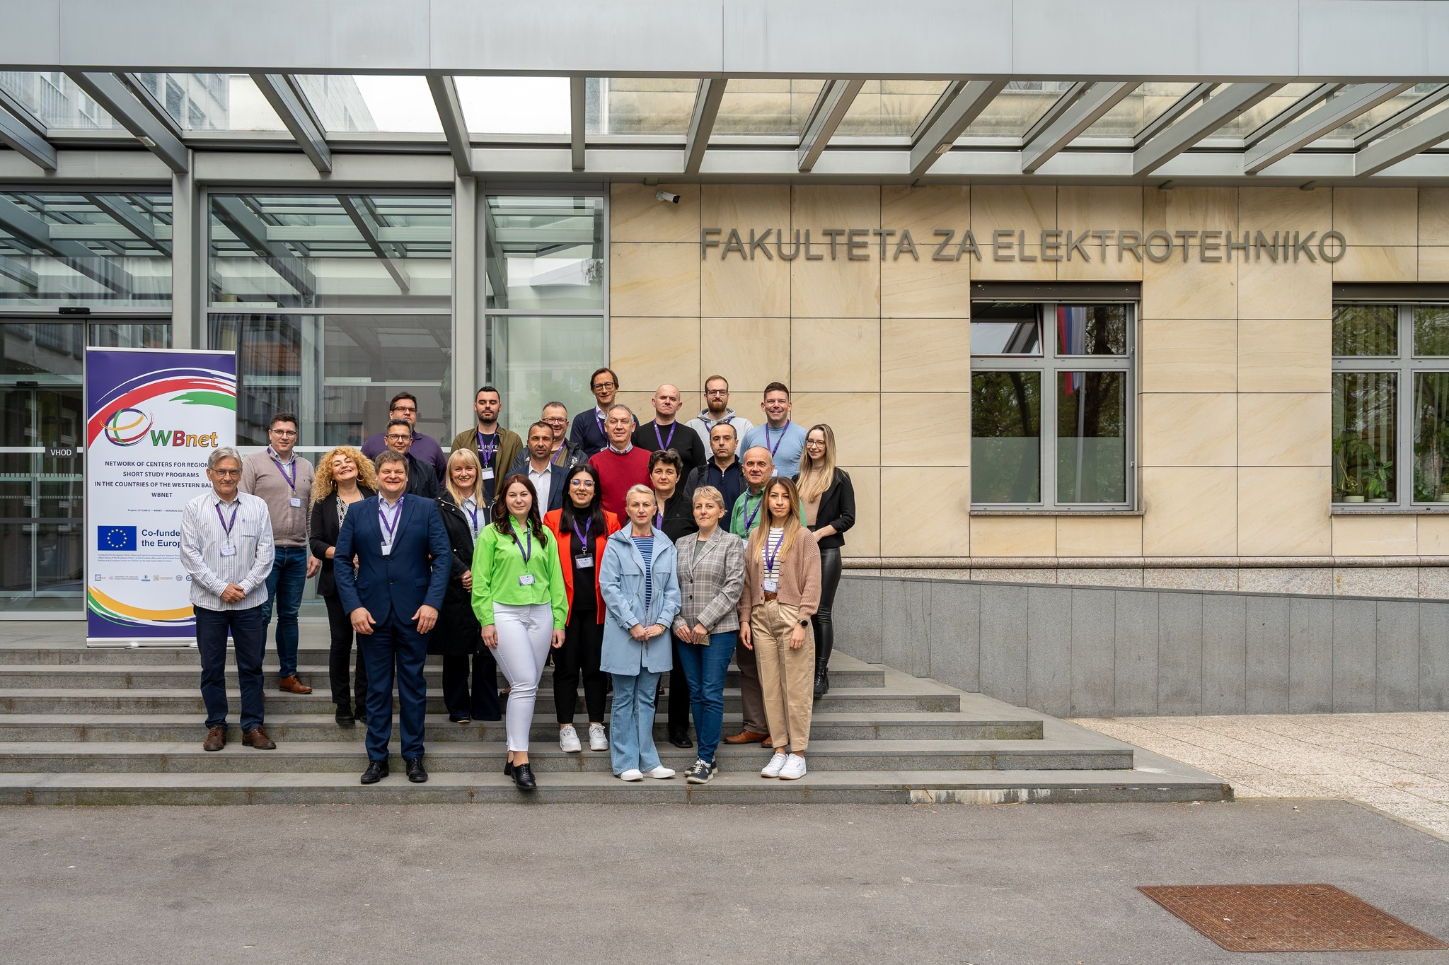
Training of WB HEI staff (T 2.2)
Training 1 - Aims and technical conditions for opening center for short study cycles
- 23.01. -25.01.2024.
Training 2 - Developing curricula for short study programs
- 16.04. - 18.04.2024.

Slide 8
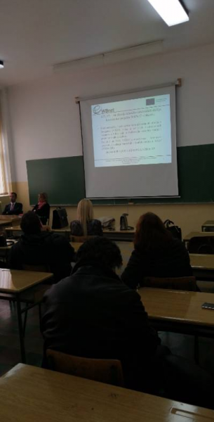
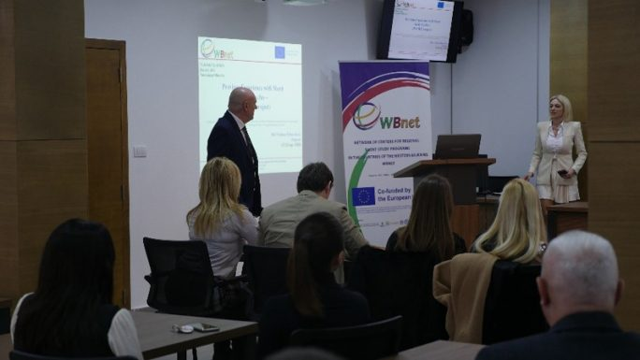
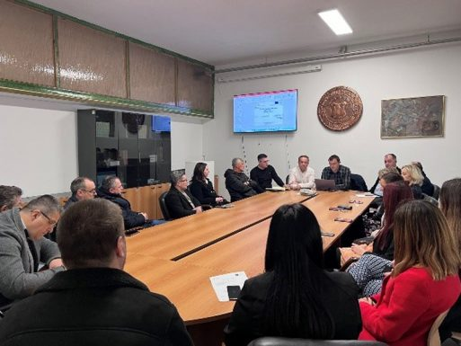
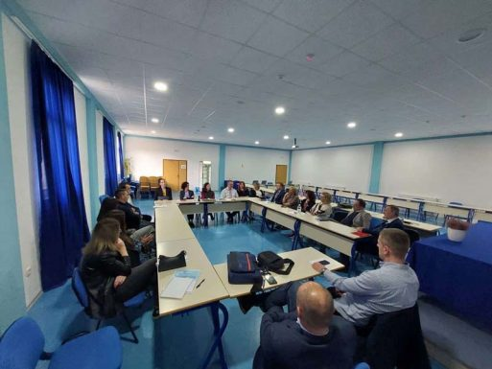
1st In-Home Training (T 2.2)
Done on all partner WBHEIs – UPKM, AASKM, SVEHERC, UNBI
UPKM - The training was held on March 6, 2024 at the Faculty of Technical Sciences in Kosovska Mitrovica,
AASKM - 20.02.2024. to the teachers of AASKM department Zvečan,
UNBI – 06.02. 2024. at the Faculty of Technical Engineering of the University of Bihać
SVEHERC – 16.03.2024.

Slide 9
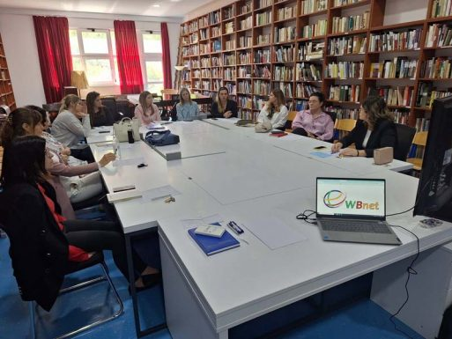
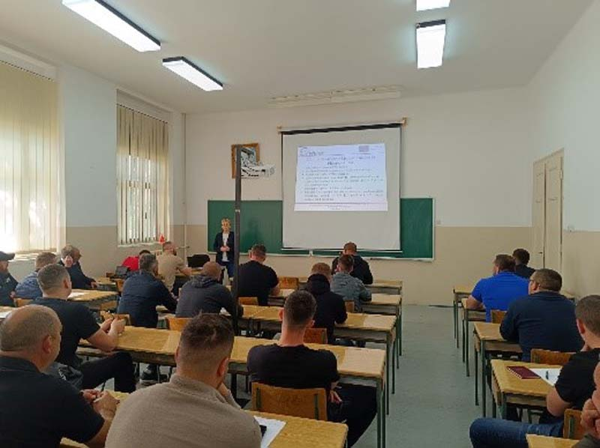
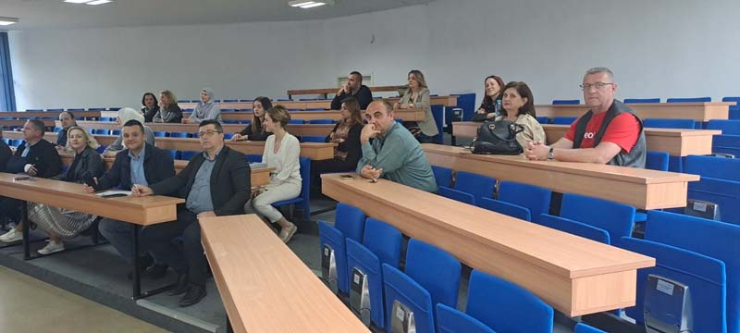
2nd In-Home Training (T2.2)
Done on all partner WBHEIs – UPKM, AASKM, SVEHERC, UNBI
UPKM – 15.05. 2024 at the Faculty of Technical Sciences in Kosovska Mitrovica,
AASKM – 30.04.2024. to the teachers of AASKM department Zvečan,
UNBI – 14.05. 2024. at the Faculty of Technical Engineering of the University of Bihać
SVEHERC – 17.05. 2024,

Slide 10
Defining goals of centers (T 2.3)
AASKM – prepared surveys, done and reported, 100 persons interviewed, goals and objectives defined and reported
Establishment of the Center at WBHEIs(T 2.4)
UNBI – Formed commission at the university level,
SVEHERC – decision on University level of establishing center – July 4th

Slide 11
Registration of Centers according to the law (T 2.5)
SVEHERC – decision on University level of establishing center – July 4th

Slide 12
WP3 - Creating a program of short studies in multimedia engineering and computing (M10 – M25) - UPKM
T 3.1 - Purchasing equipment
MS6 - Equipment procurement – M18
T 3.2 - Training 3 - Training of WB HEI staff in pedagogical skills
T 3.3 Training 4 – Training for conducting placements in companies
T 3. 4 Developing curriculums for short study program
T 3.5 Development of a program of professional practice
T3.6 Developing documentation for accreditation
MS7 - Accreditation of each short study program – M25
T 3.7 Developing teaching materials

Slide 13
Purchasing equipment (T 3.1)
Changes in equipment lists – for UPKM, AASKM, UNBI – April 2024 – approved by Project Officer
Purchasing - started
UPKM – 30.08.2024 . contracted, waiting for the delivery (90 days),
AASKM – expected to finalize,
UNBI – purchasing finished, equipment on the Faculty,
SVEHERC – expected to finalize.

Slide 14
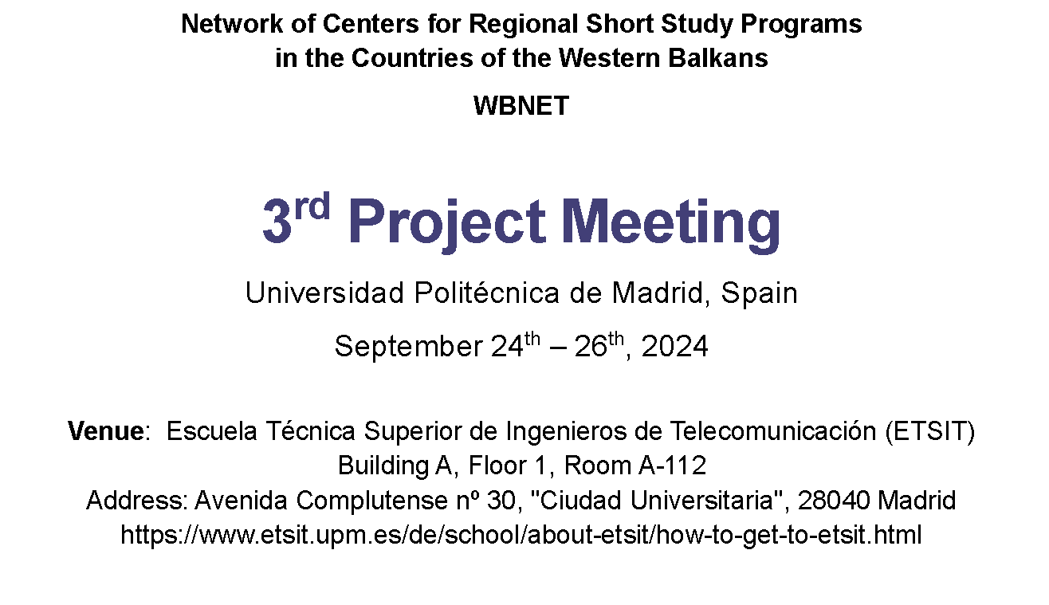
Training 3 - Training of WB HEI staff in pedagogical skills – T 3.2
UPM – IN PROGRESS

Slide 15
WP6 – SUSTAINABILITY -
T 6.1 - Sustainability plan preparing,
MS9 - Sustainability Plan – M18 -31 MAY 2025
T 6.2 - Round tables with identified stakeholders,
T 6.3 - Organizing Interim project conference
T 6.4 - Organizing Final project conference

Slide 16
WP6 – SUSTAINABILITY -
ATUSS – DRAFT OF SUSTAINABILITY PLAN– this meeting first overview
SVEHERC – OVERTAKE FURTHER
UNBI – Draft of cooperation agreement sent to partners
UNBI – signed two agreement with economy partners

Slide 17
WP7 – DISSEMINATION – M01-M36 –(AASKM)
T 7.1 - Developing Dissemination and Exploitation Plan
T 7.2 - Developing website and conducting
MS10 – Website
T 7.3 - Development of promo material
T 7.4 - Promotion on media and social networks
T 7.5 - Promotion on live events
T 7.6 - Monography of the project

Slide 18
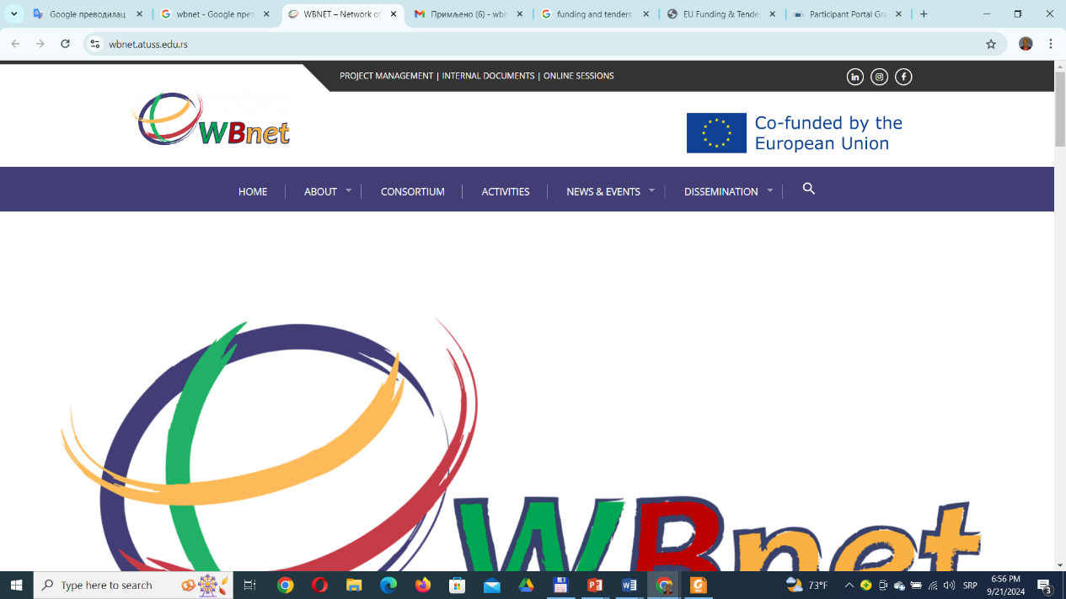
T 7.1 - Developing Dissemination and Exploitation Plan
DP created and everything done according to the plan
T 7.2 – Developing website and conducting

Slide 19
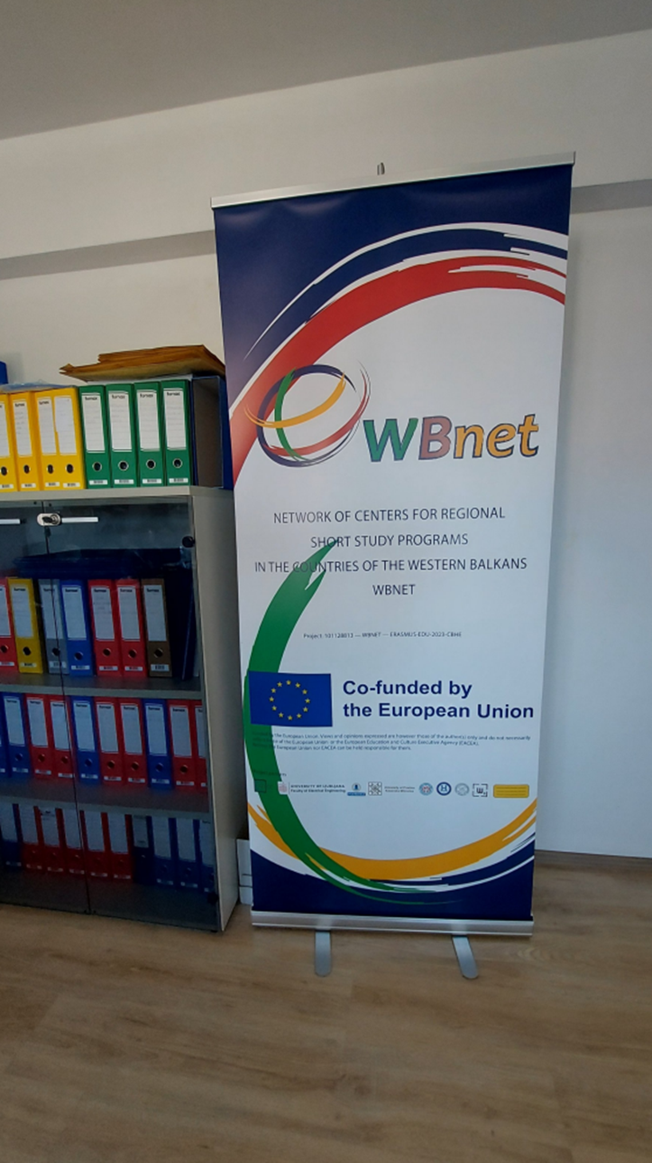
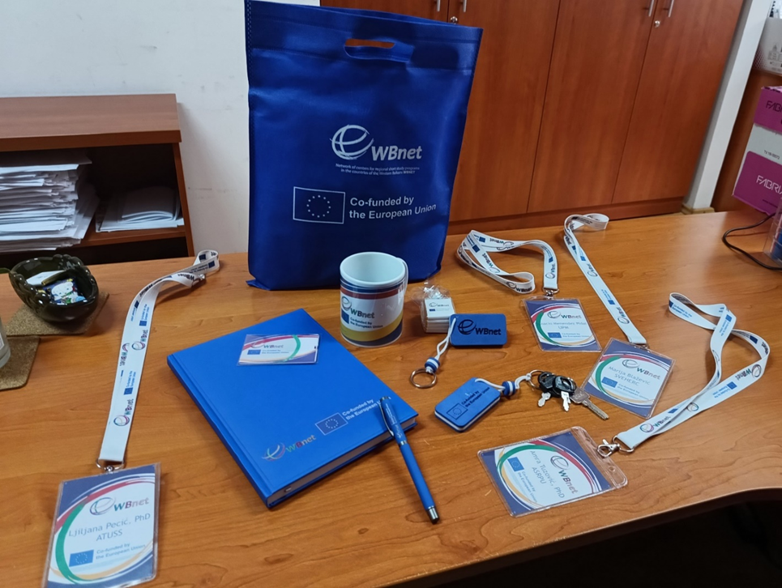
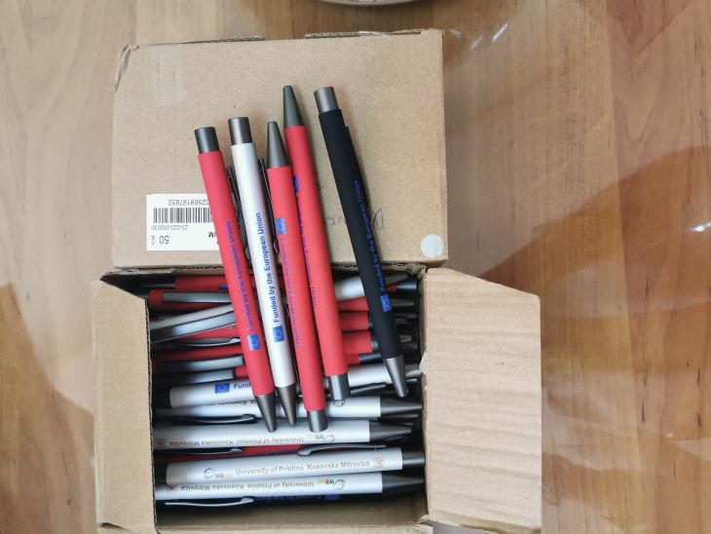
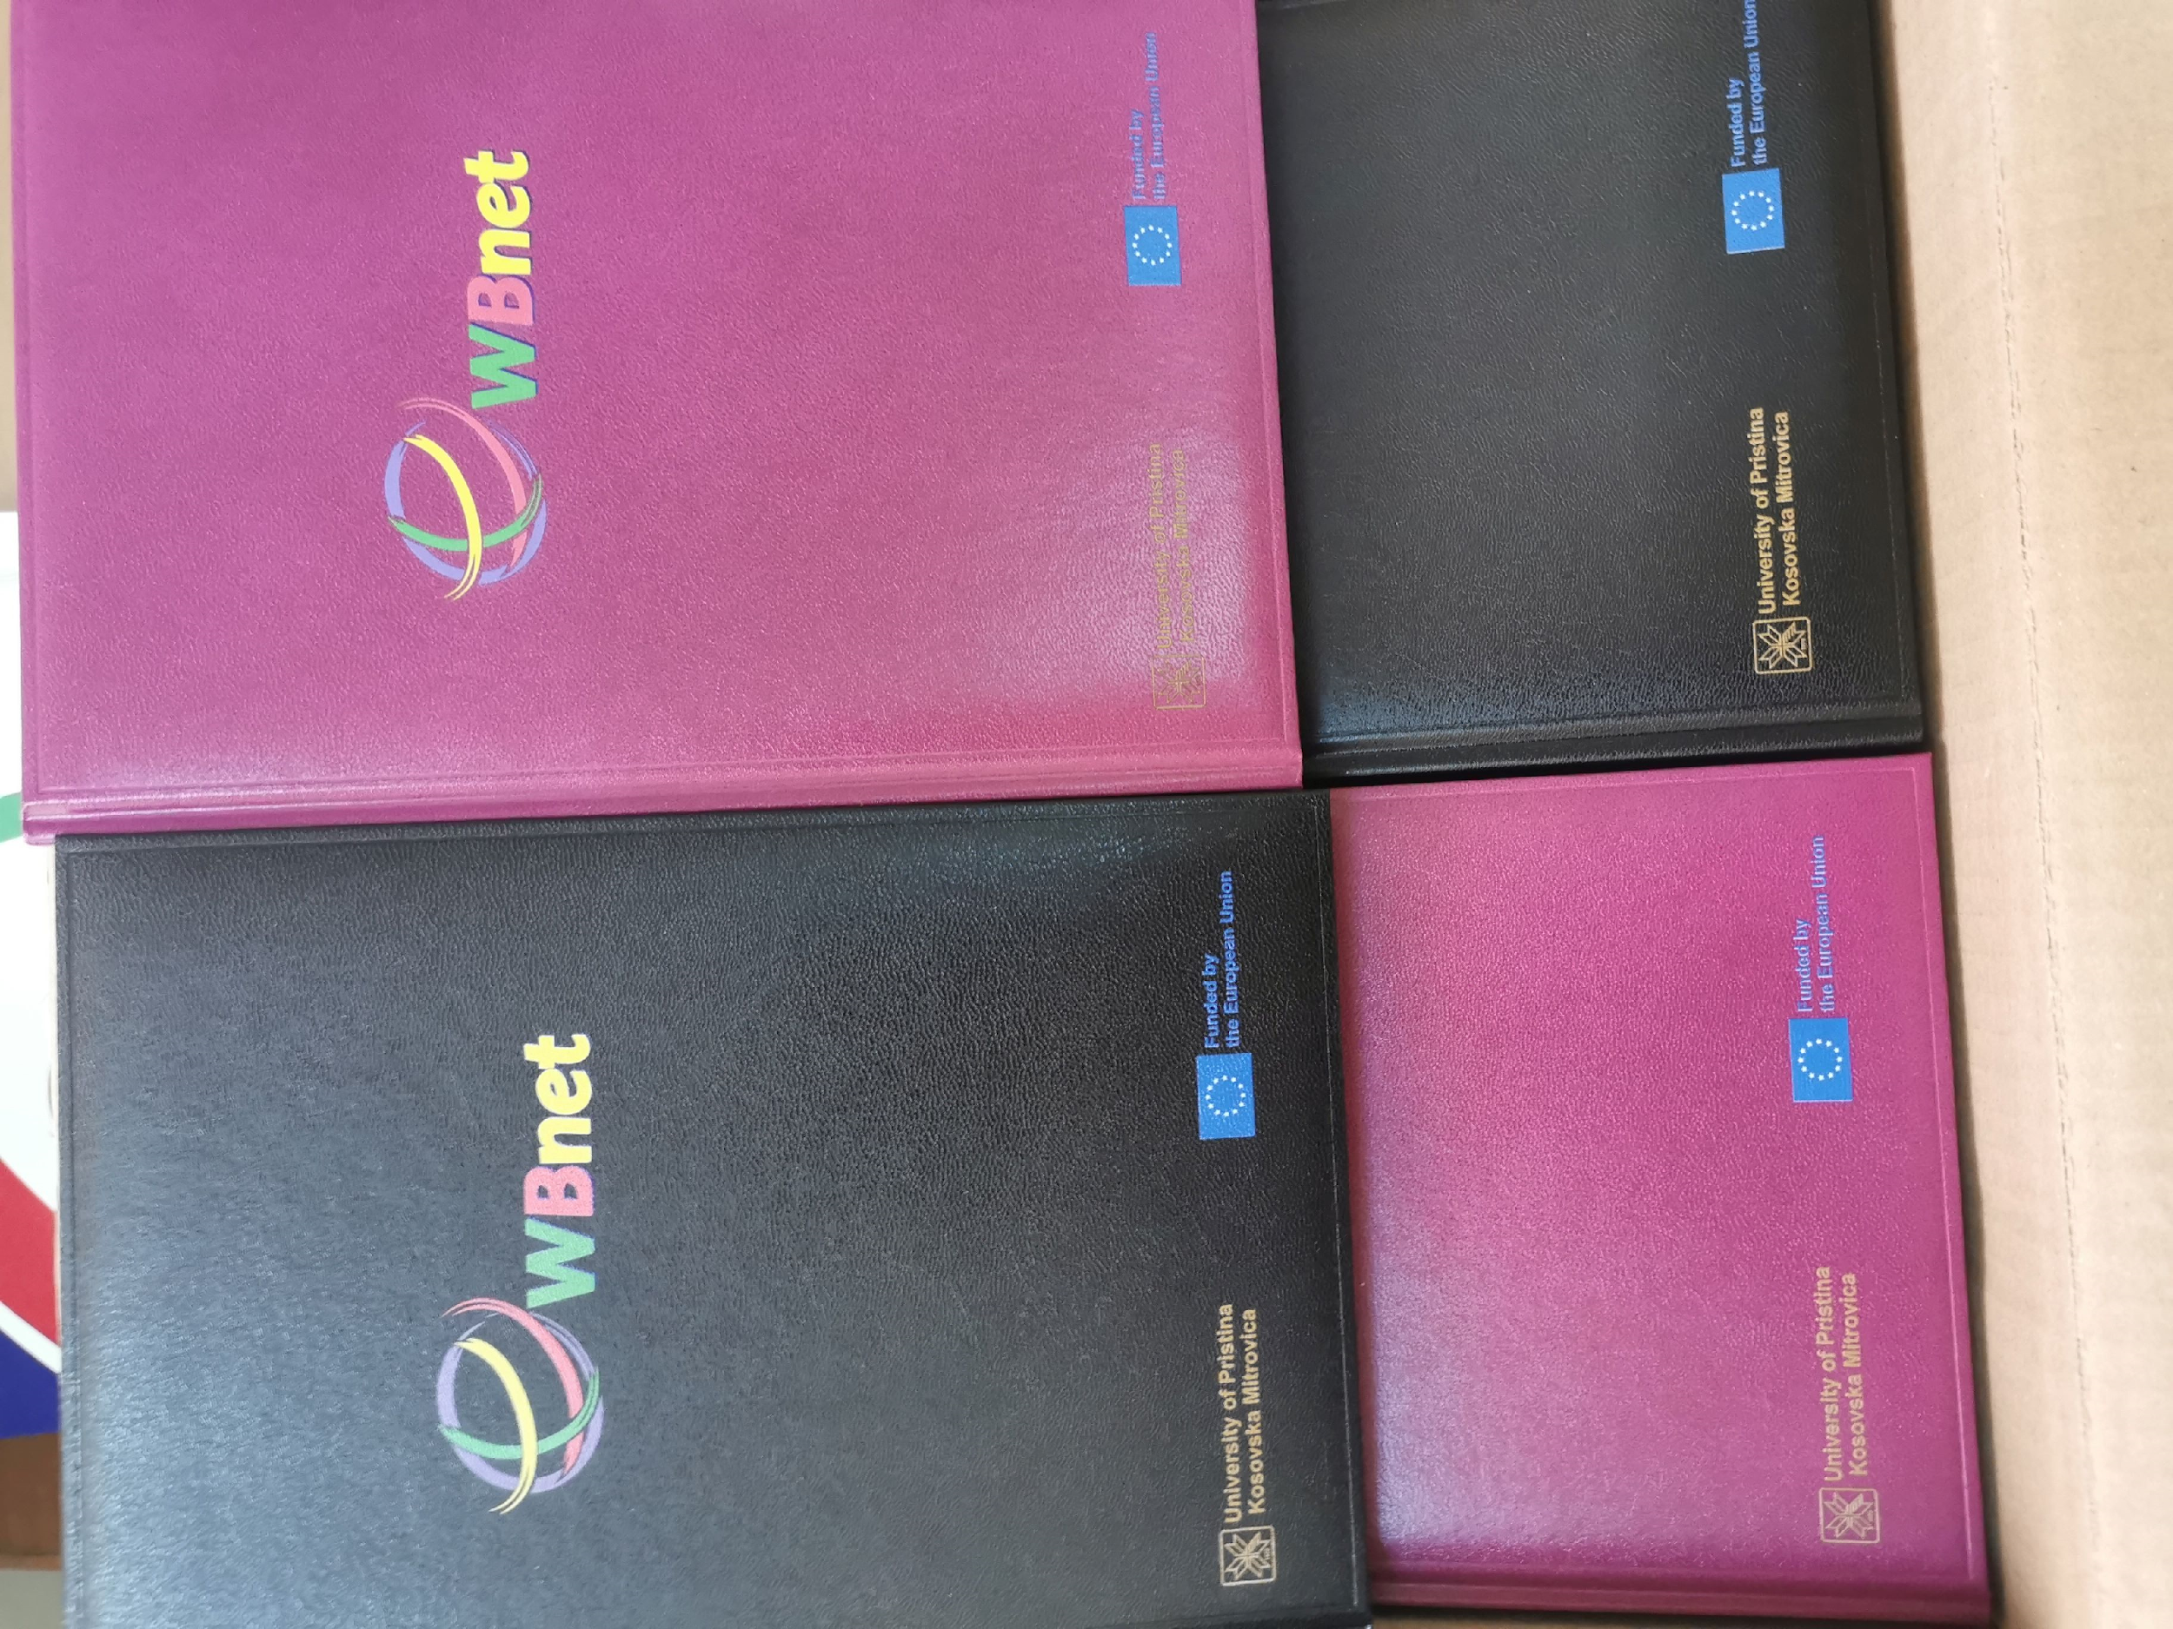
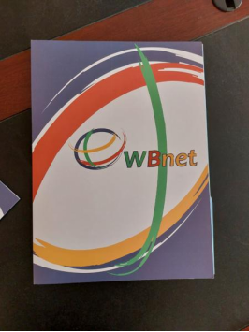
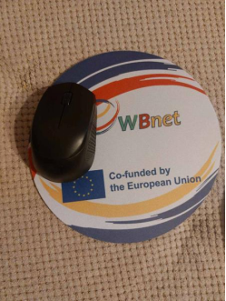
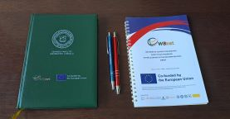
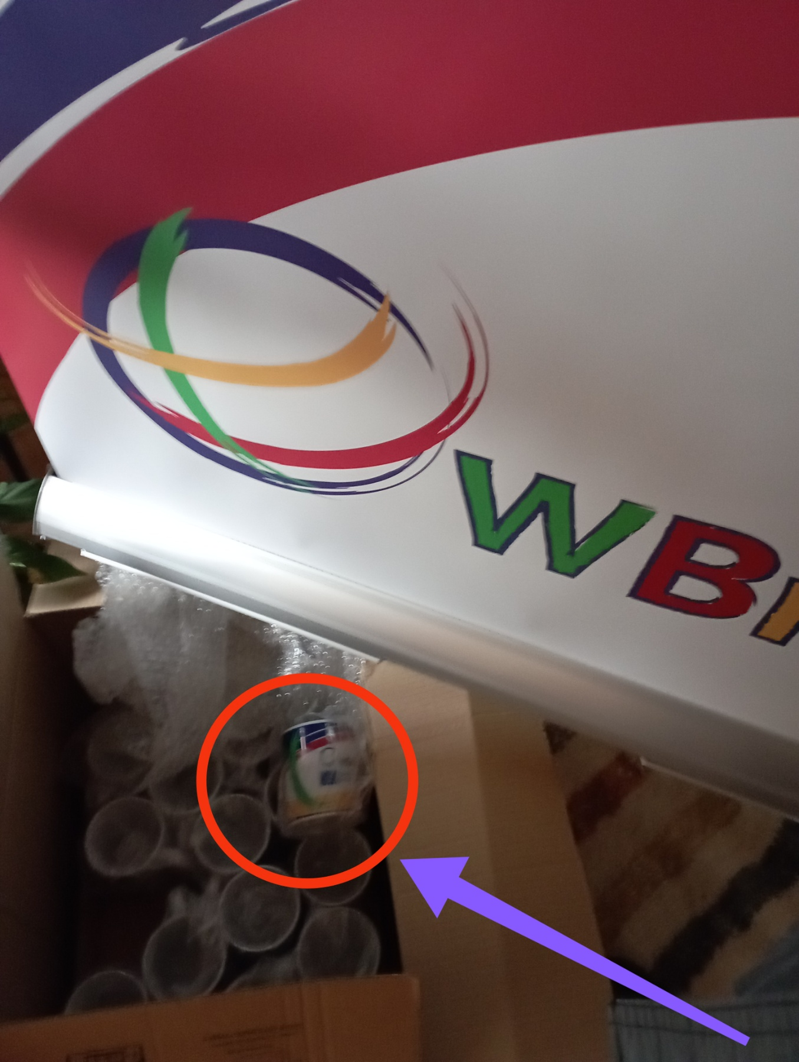
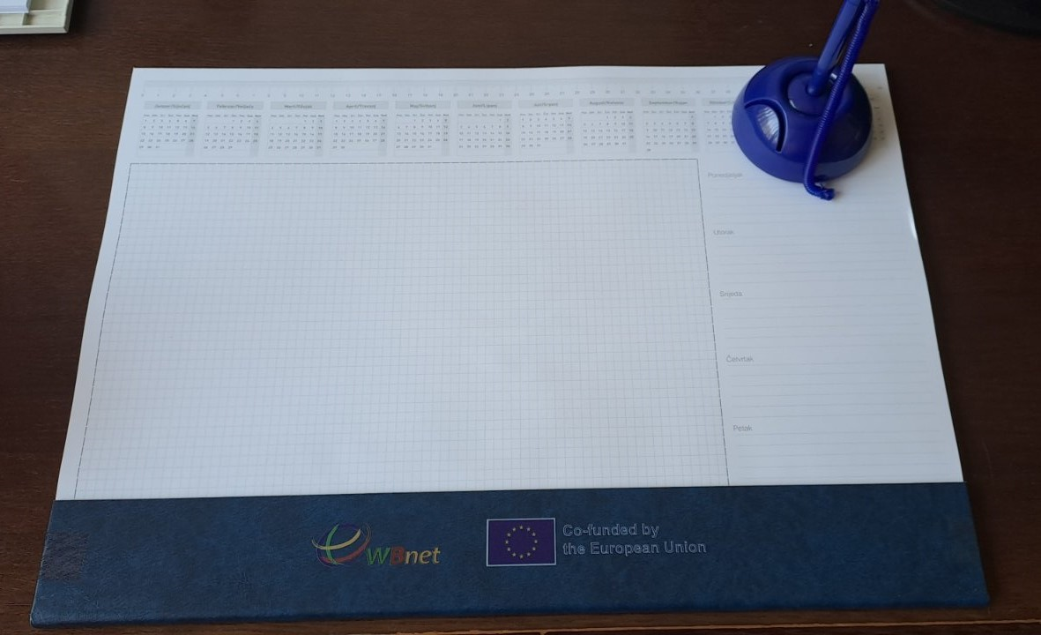
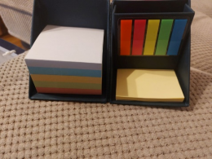
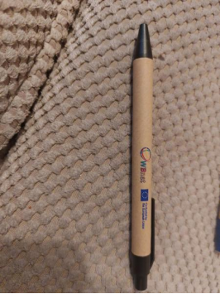
Development of promo material (T 7.3)
Done by on all partner WBHEIs – UPKM, AASKM, SVEHERC, UNBI

Slide 20
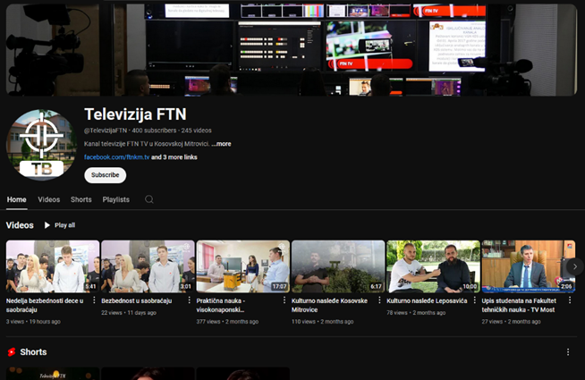
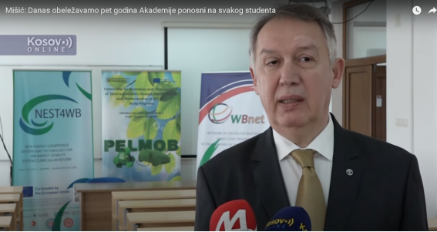
Promotion on media and social networks (T 7.4)
Done by all partner WBHEIs – UPKM, AASKM, SVEHERC, UNBI
Facebook: @univerzitetupristini
Facebook: @ upisiftnkm
Youtube: @TelevizijaFTN
UPKM -
AASKM - Academy day celebrated on 12-13th of March, 2024 in the AASKM settlement Leposavic and in Zvecan Department,

Slide 21
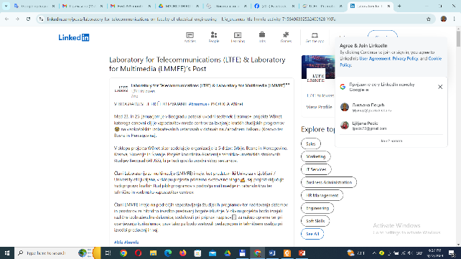
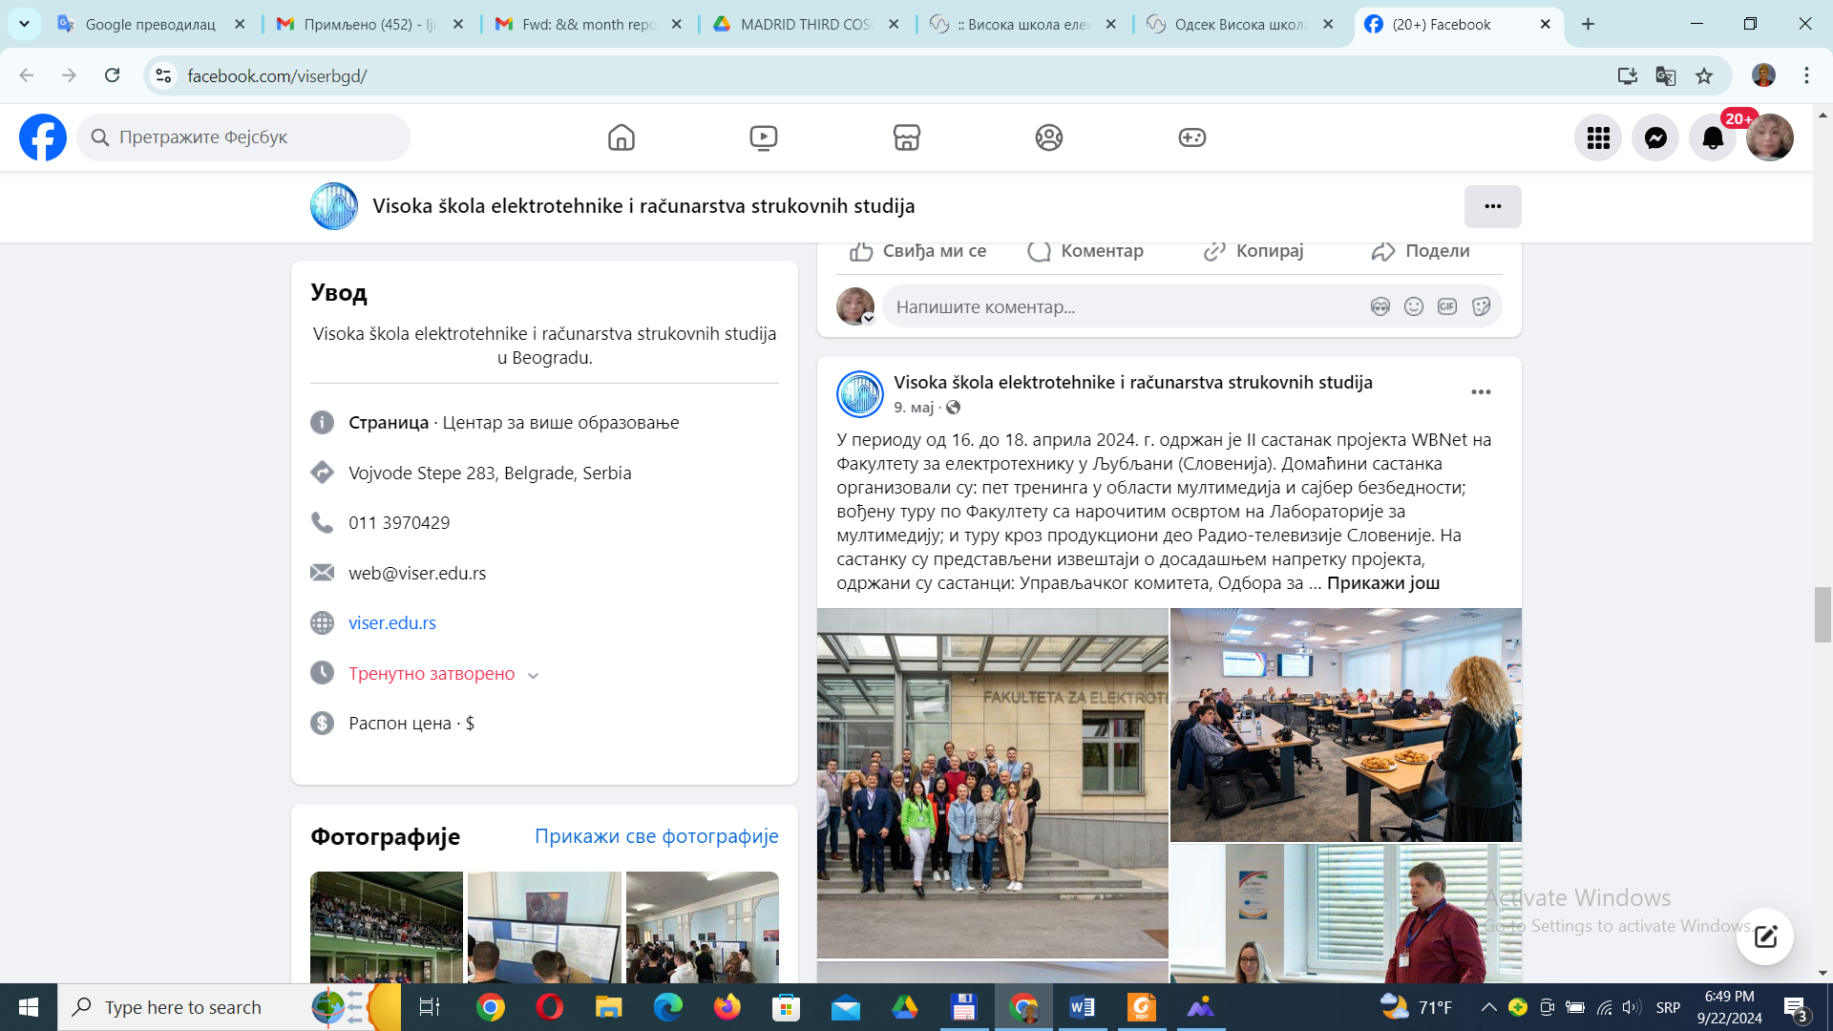
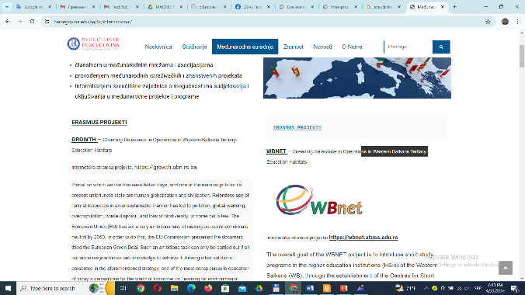
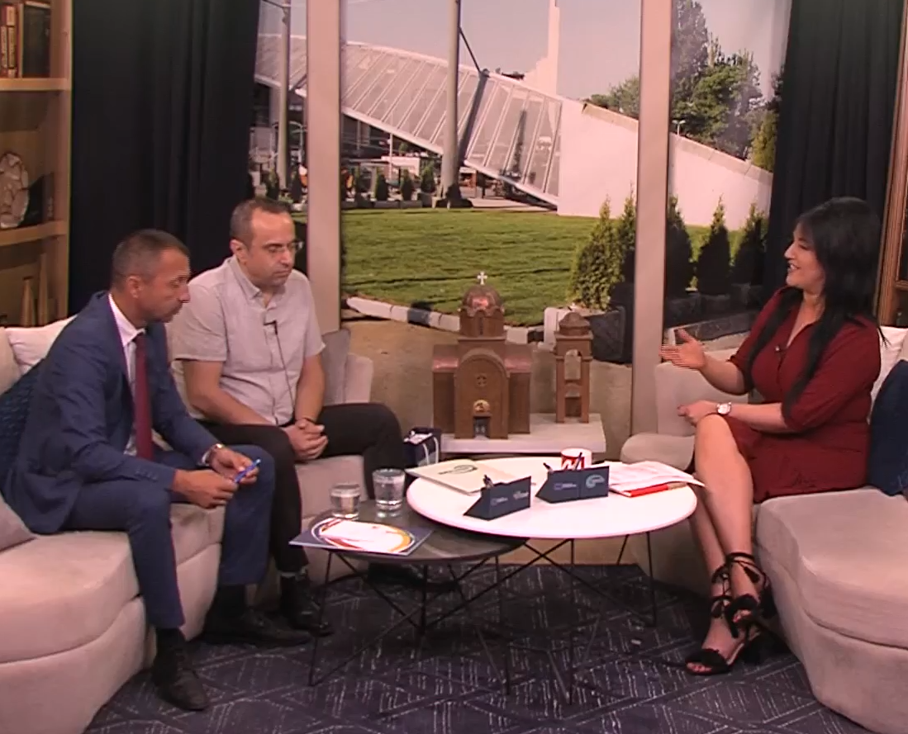
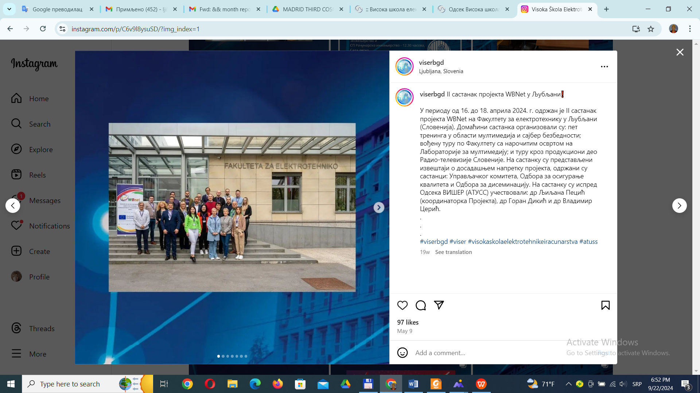
Promotion on media and social networks ( T 7.4)
UPKM - Web site: pr.ac.rs
ULFE - LinkedIn
ATUSS - facebook
ATUSS - Instagram
AASKM - local TV station TV MOST
SVEHERC - website

Slide 22
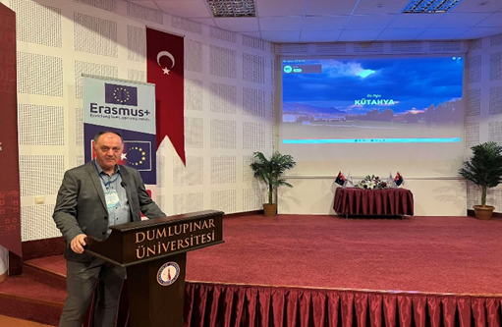
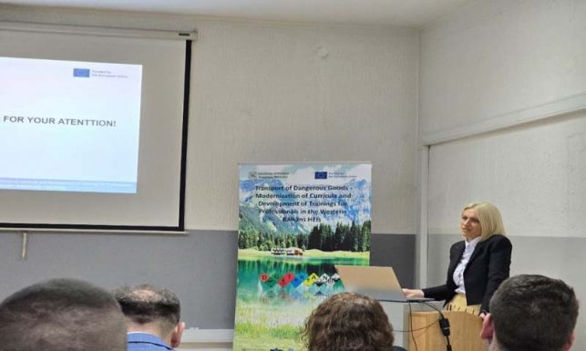
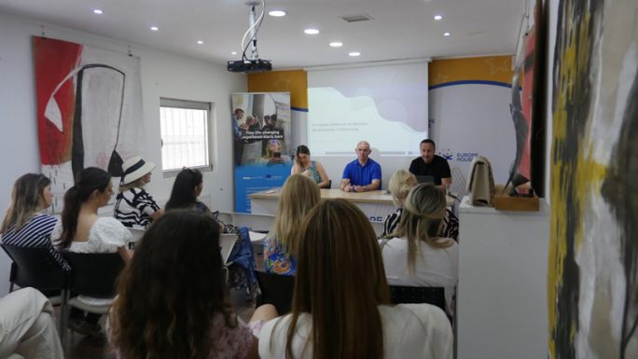
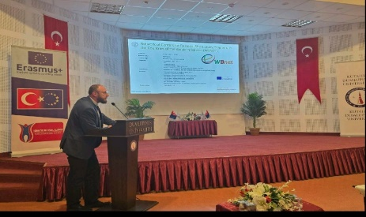
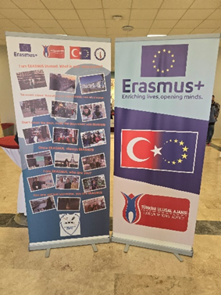
Promotion on live events (T 7.5)
UPKM
Inter project coaching meetings, conferences, Open-door days
Erasmus+ PELMOB Inter project coaching meeting.
Open-door day on the Faculty of Law UPKM.
Preparatory Classes for enrolment FTS – UPKM.
eTwinning info session in European House Kosovska Mitrovica.
AASKM – Academy day
UNBI – May 6th to 10th, 2024, Kütahya Dumlupınar University in Turkey

Slide 23
Annoucement
Cluster meeting in Sarajevo - October 9th
Participants - Project coordinator and UNBI institutional coordinator
coofinancing
Cluster visit to SVEHERC - October 11th
Participants - SVEHERC and Project coordinator
coofinancing

Slide 24
Questions & Answers
"Funded by the European Union. Views and opinions expressed are however those of the author(s) only and
do not necessarily reflect those of the European Union. Neither the European Union nor the granting authority can be."
Network of centers for regional short study programs in the countries of the Western Balkans Call: ERASMUS-EDU-2023-CBHE
Project number: 101128813

