Slide 1

3rd Project Meeting
PROJECT PROGRESS REPORT
"Funded by the European Union. Views and opinions expressed are however those of the author(s) only and do not necessarily reflect those of the European Union. Neither the European Union nor the granting authority can be."
Aladin Crnkić, PhD….
Associate professor
University of Bihać
Husein Rošić, PhD
Assistant professor
University of Bihać
Network of centers for regional short study programs in the countries of the Western Balkans
Call: ERASMUS-EDU-2023-CBHE
sProject number: 101128813

Slide 2
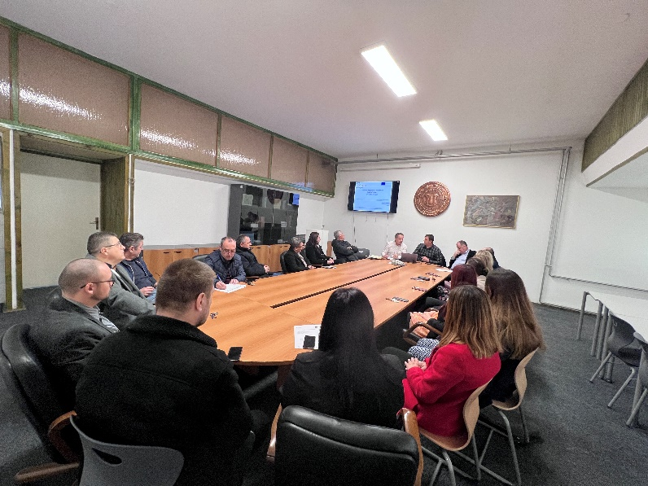
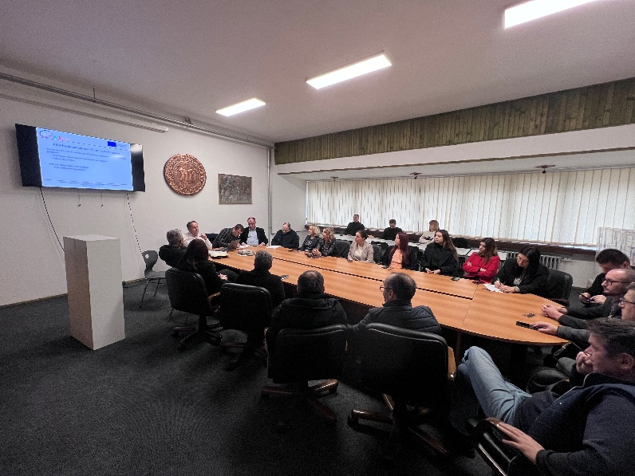
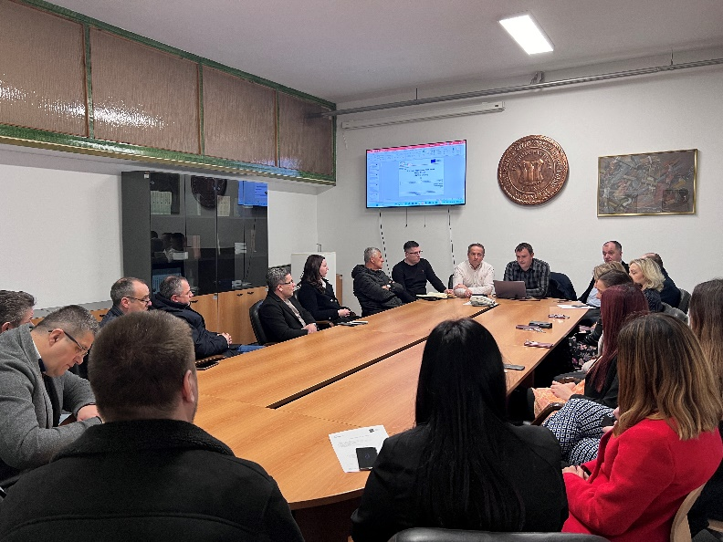
What has been done so far?
Training organization
  First In-Home training (held on 7th February 2024)
Network of centers for regional short study programs in the countries of the Western Balkans
Call: ERASMUS-EDU-2023-CBHE
Project number: 101128813

Slide 3
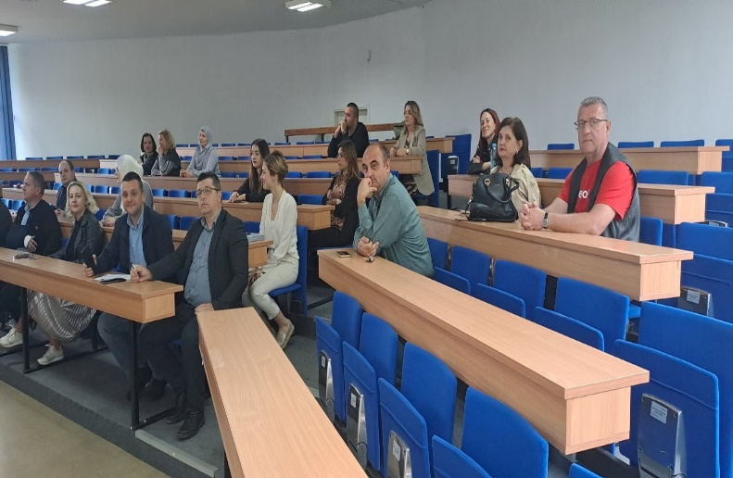
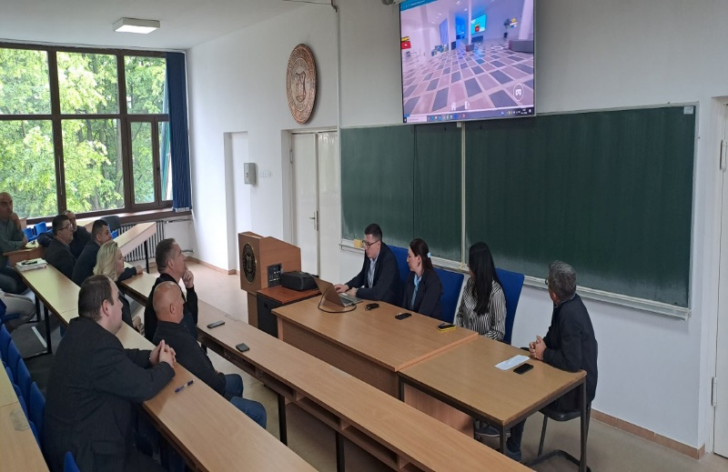
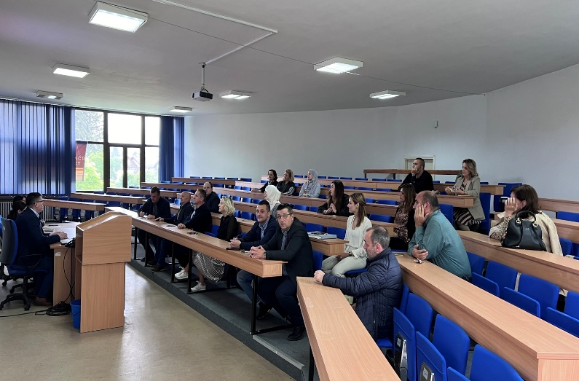
What has been done so far?
Training organization
  Second In-Home training (held on 14th May 2024)
Network of centers for regional short study programs in the countries of the Western Balkans
Call: ERASMUS-EDU-2023-CBHE
Project number: 101128813

Slide 4
What has been done so far?
Center for Short Study Programs
  Formation of a commission at the university level for the establishment of a Center for Short Study Programs
  The commission has met several times and received tasks regarding the initiation of activities.
  A new Law on Higher Education was adopted in the area of ​​Una-Sana Canton, which specifies the concept of short study programs and the possibility of implementing such programs.
Network of centers for regional short study programs in the countries of the Western Balkans
Call: ERASMUS-EDU-2023-CBHE
Project number: 101128813

Slide 5
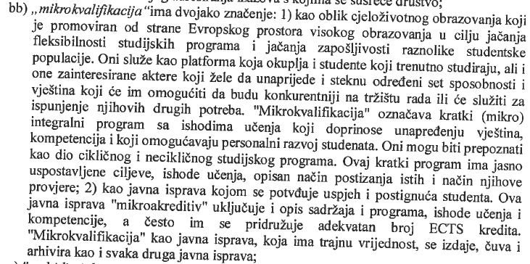
What has been done so far?
Network of centers for regional short study programs in the countries of the Western Balkans
Call: ERASMUS-EDU-2023-CBHE
Project number: 101128813

Slide 6
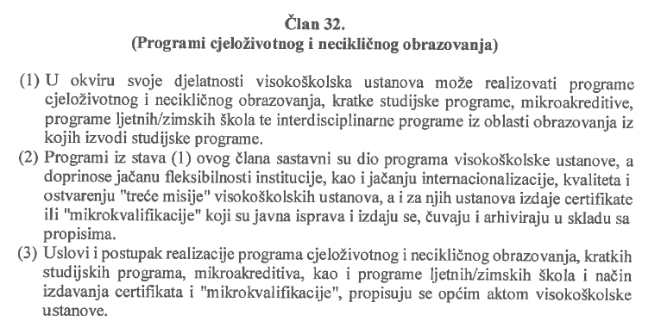
What has been done so far?
Network of centers for regional short study programs in the countries of the Western Balkans
Call: ERASMUS-EDU-2023-CBHE
Project number: 101128813

Slide 7
What has been done so far?
Procurement of equipment
  The equipment procurement procedure is finished, the equipment has been delivered to the Faculty of Technical Engineering, University of Bihać (installation is in progress).
  The tax refund process has been initiated after payment to the supplier.
Network of centers for regional short study programs in the countries of the Western Balkans
Call: ERASMUS-EDU-2023-CBHE
Project number: 101128813

Slide 8
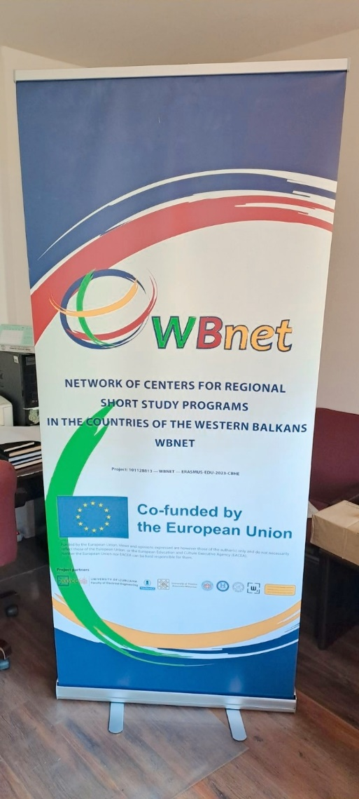
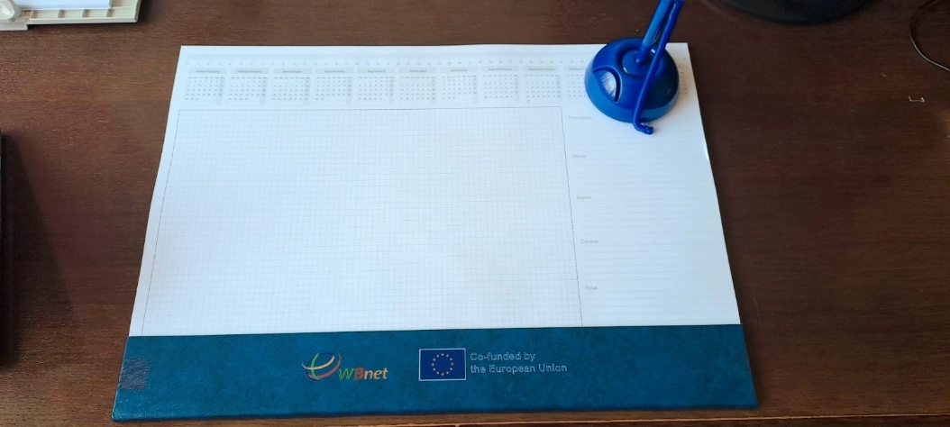
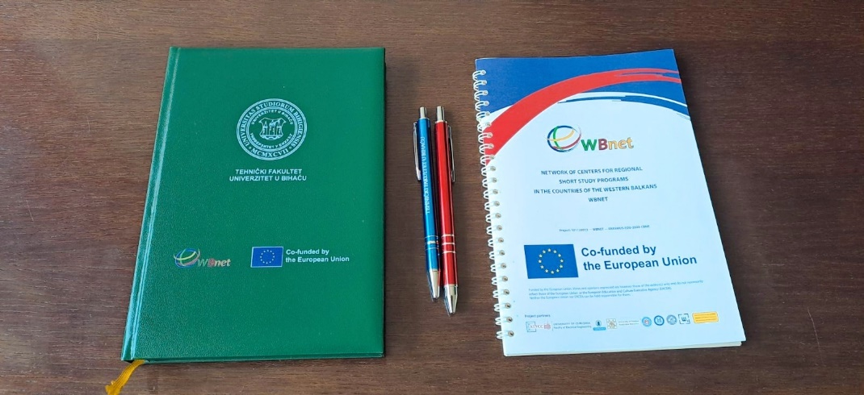
What has been done so far?
Procurement of promotional materials
  The procurement of promotional materials has been completed.
Network of centers for regional short study programs in the countries of the Western Balkans
Call: ERASMUS-EDU-2023-CBHE
Project number: 101128813

Slide 9
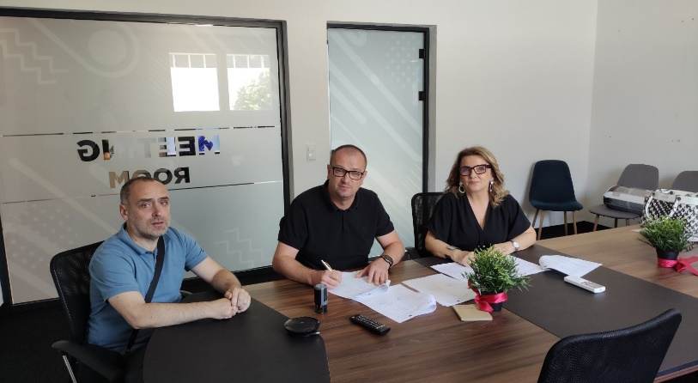
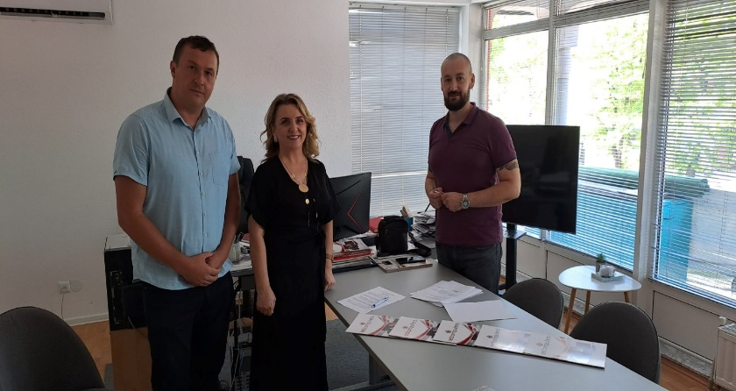
What has been done so far?
Memorandum of cooperation
  Draft of the memorandum of cooperation was made and sent to other partners in the project.
  The memorandum of cooperation between the University of Bihać and IDK Studio was signed on 28th May 2024.
  The memorandum of cooperation between the University of Bihać and Red Computers was signed on 19th July 2024.
Network of centers for regional short study programs in the countries of the Western Balkans
Call: ERASMUS-EDU-2023-CBHE
Project number: 101128813

Slide 10
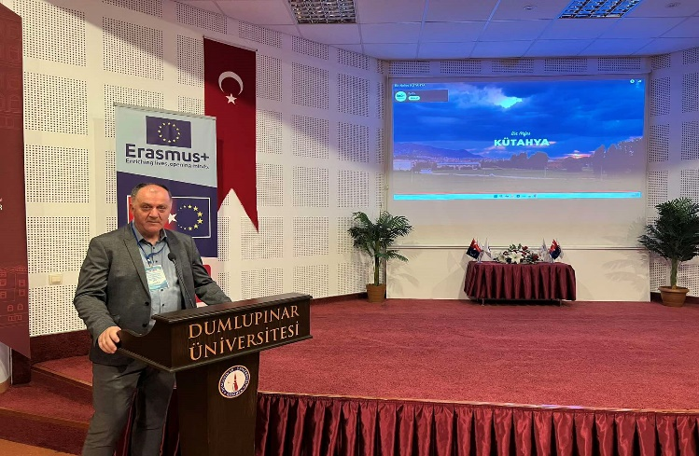
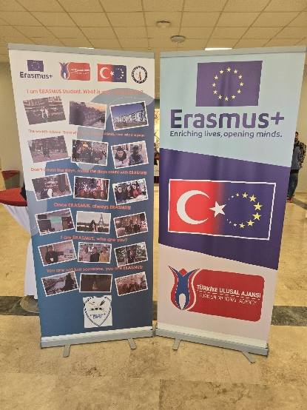
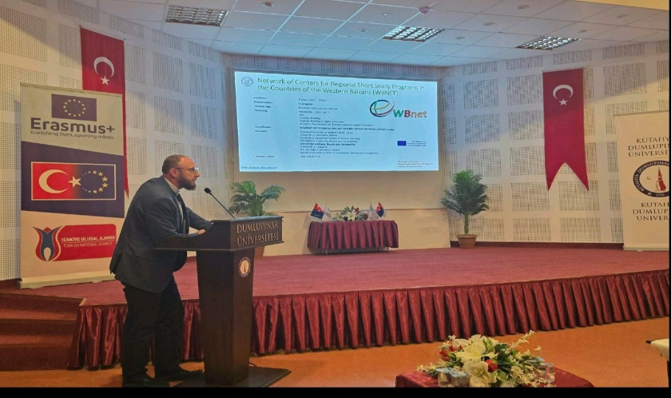
What has been done so far?
Dissemination of the project and its activities
  Dissemination on web sites and social networks (Facebook and Instagram) on the official pages of the Faculty and the University.
  Presentation of the project on the 2nd International Staff Training Week under the theme “Digitalization and EU-Funding Projects” hosted by Kütahya Dumlupınar University in Turkey.
Network of centers for regional short study programs in the countries of the Western Balkans
Call: ERASMUS-EDU-2023-CBHE
Project number: 101128813

Slide 11

Aladin Crnkić, PhD
Faculty of Technical Engineering
University of Bihać
aladin.crnkic@unbi.ba
Husein Rošić, PhD
Faculty of Technical Engineering
University of Bihać
husein.rosic@unbi.ba
Ermin Bajramović, PhD
Faculty of Technical Engineering
University of Bihać
ermin.bajramovic@unbi.ba
Mr. Amel Džanić
Faculty of Technical Engineering
University of Bihać
amel.dzanic@unbi.ba
Network of centers for regional short study programs in the countries of the Western Balkans
Call: ERASMUS-EDU-2023-CBHE
Project number: 101128813

