Slide 1
Madrid, September 24-26th, 2024
Progress Report
University of Mitrovica
prof. dr. Nebojša Arsić, doc. dr. Alaeksandra Petrović,
prof. dr. Branimir Jakšić, doc. dr. Jelena Todorović
UPKM

Slide 2
1st In-Home Training (T2.2)
1st In-home training was held on March 6, 2024 at the Faculty of Technical Sciences in Kosovska Mitrovica.
The training was held by prof. Dr. Nebojsa Arsić, prof. Dr. Branimir Jakšić and Dr. Aleksandra Petrović.
The summary of the project, goals, activities, work packages, deliverables, timeline, as well as the role and obligations of UPKM were presented.
Topics:
"Previous experience with short study cycles presentation - (PTCHE project).
"Aims and technical preconditions for opening Centers for Short Study programs (Serbian Case Study)".

Slide 3
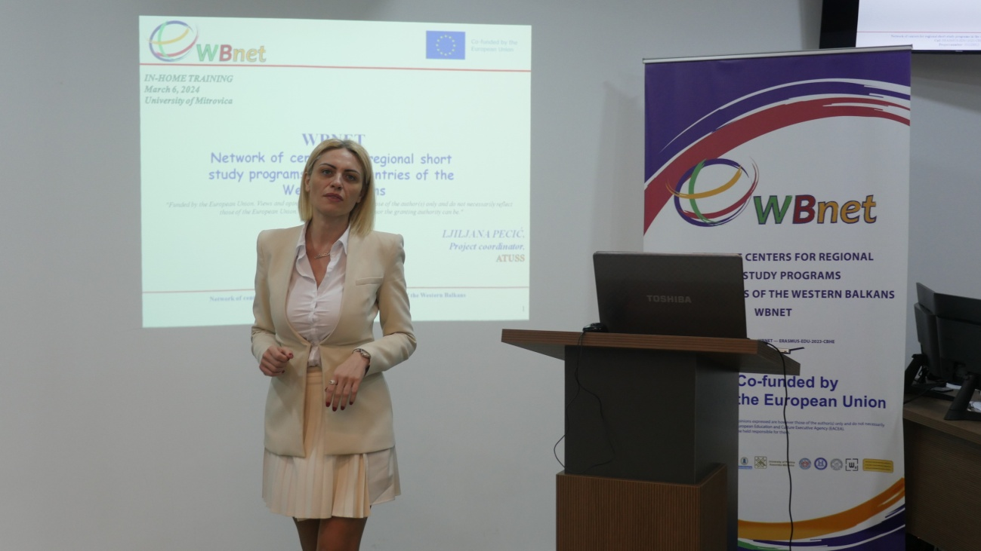
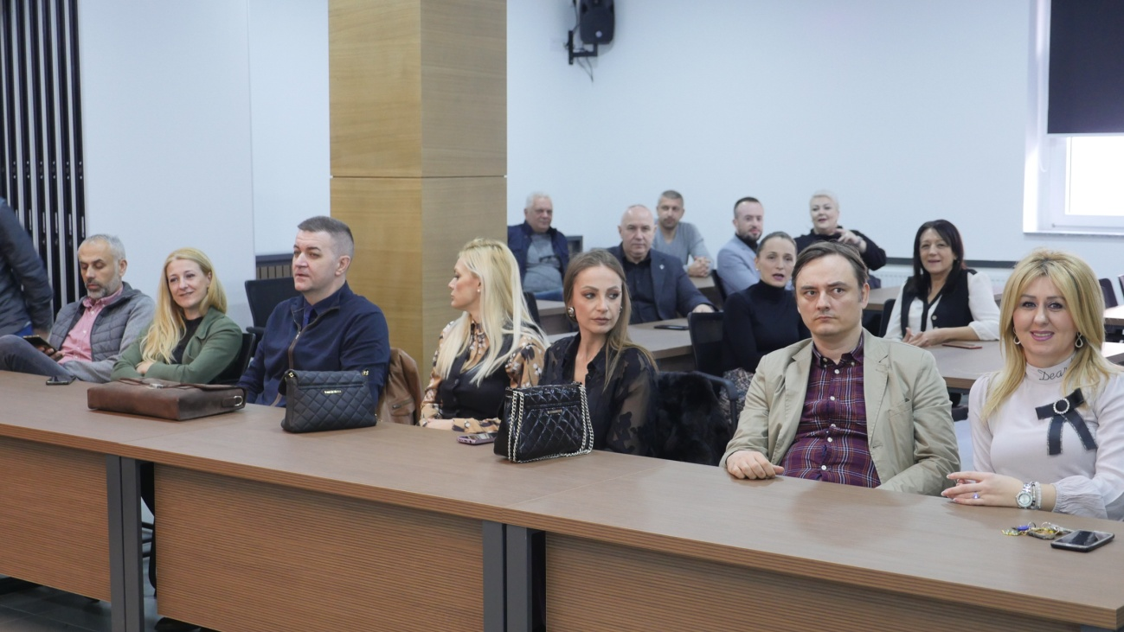
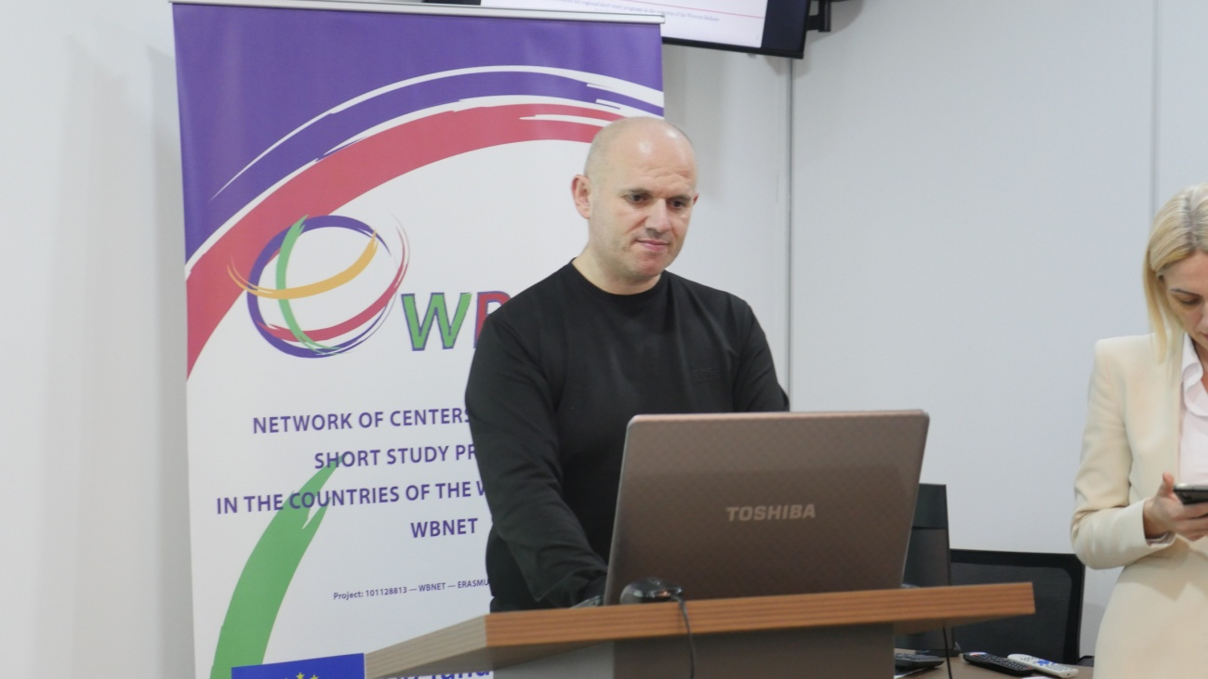
1st In-Home Training (T2.2)

Slide 4
2nd In-Home Training (T2.2)
2nd In-home training was held on May 15, 2024 at the Faculty of Technical Sciences in Kosovska Mitrovica.
The training was held by prof. Dr. Branimir Jakšić, prof. Dr. Dragana Radosavljević, Dr. Vladimir Maksimović, Dr. Jelena Todorović and Dr. Aleksandra Petrović.
The goal of the training was to familiarize UPKM academic and non-academic staff with the topics covered at the training in Ljubljana, such as Multimedia Education, Video Production, XR Technologies, Microcredentials, Cybersecurity and bring them closer to the basic principles of work of EU partners in the WBNET project in these areas, as well as their experiences.

Slide 5
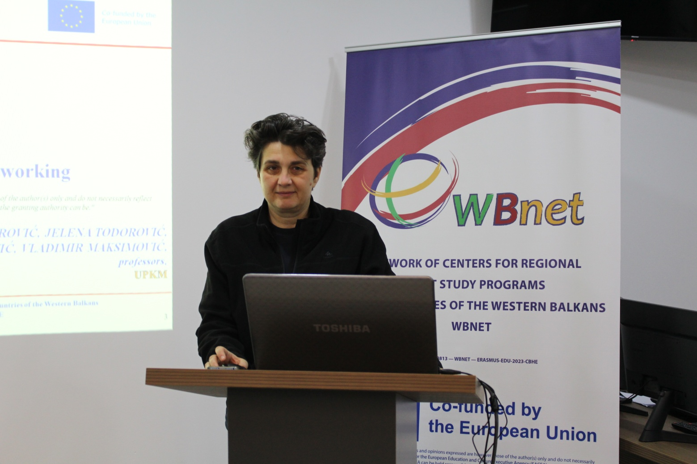
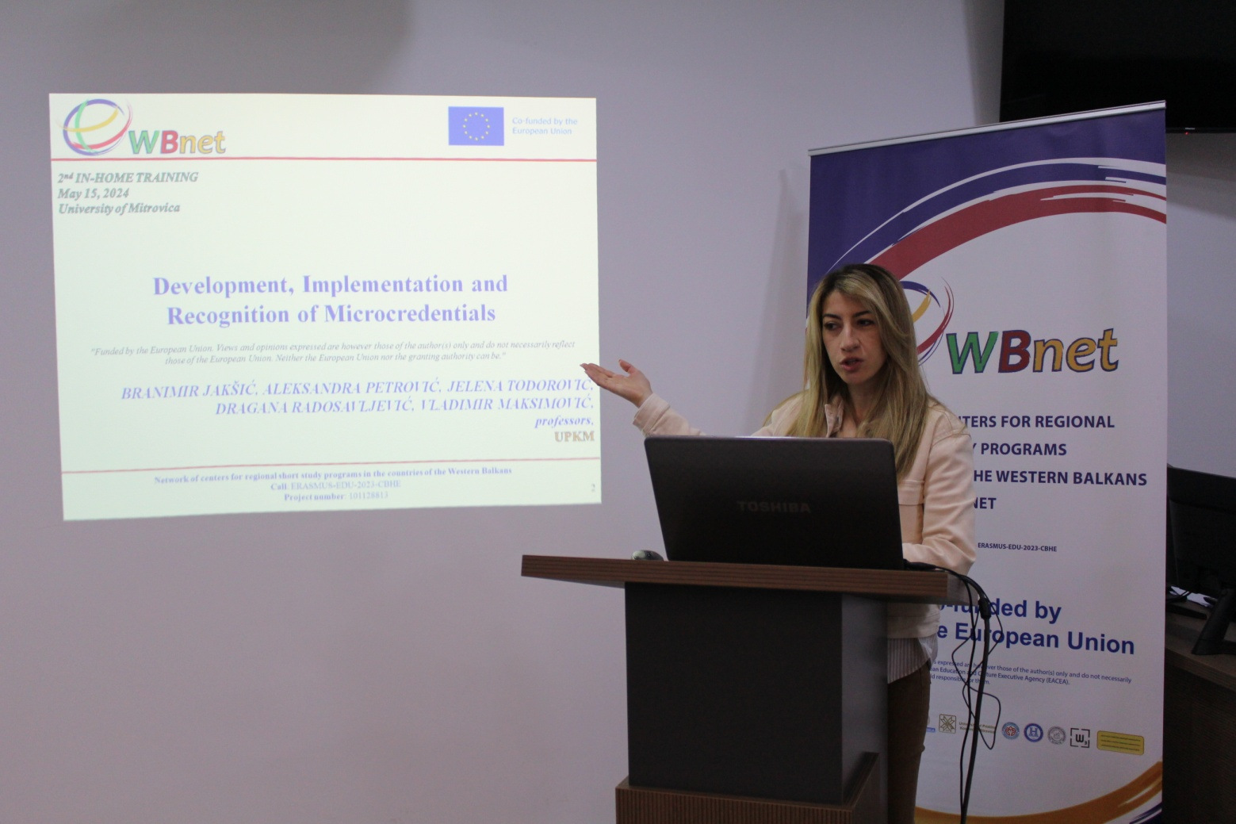
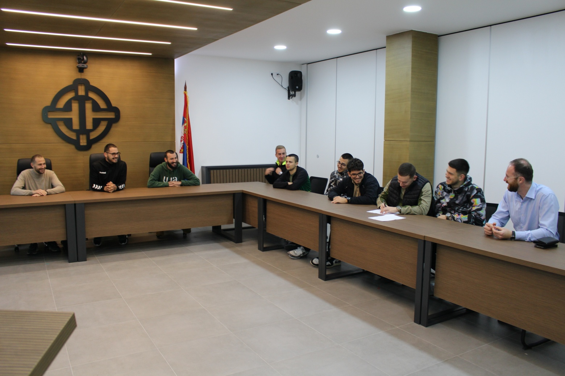
2nd In-Home Training (T2.2)

Slide 6
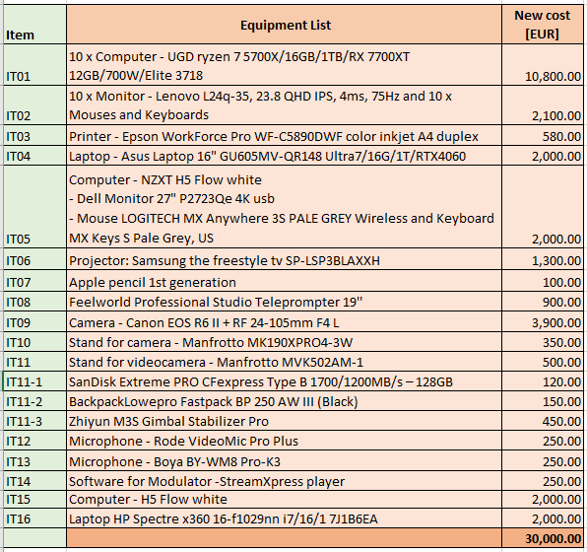
Purchasing equipment (T3.1)
Contract concluded with the supplier (30.08.2024).
Delivery time: 90 days.

Slide 7
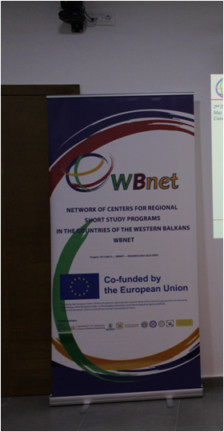
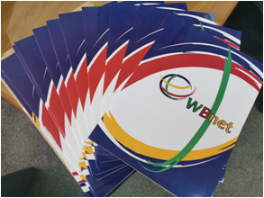
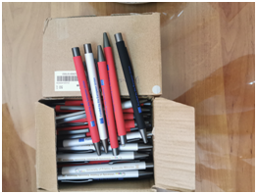
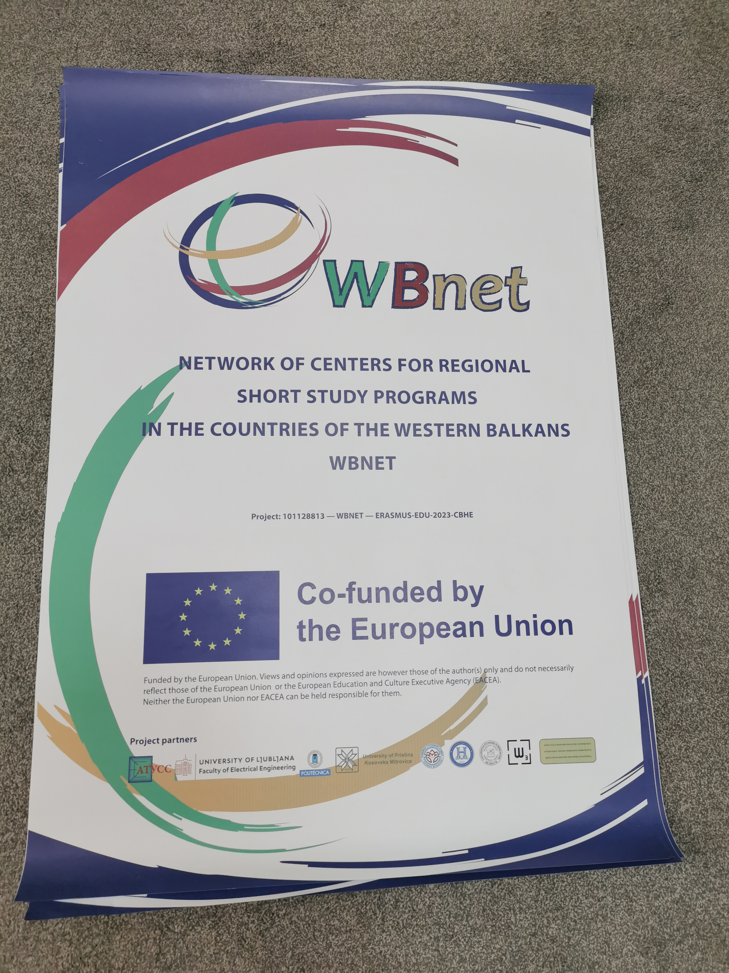
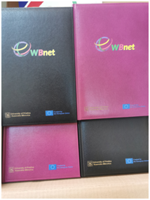
Development of promo material (T7.3)
Printed:
2 Roll-ups,
5 posters A0,
200 pencils,
20 notebooks,
20 folders.

Slide 8
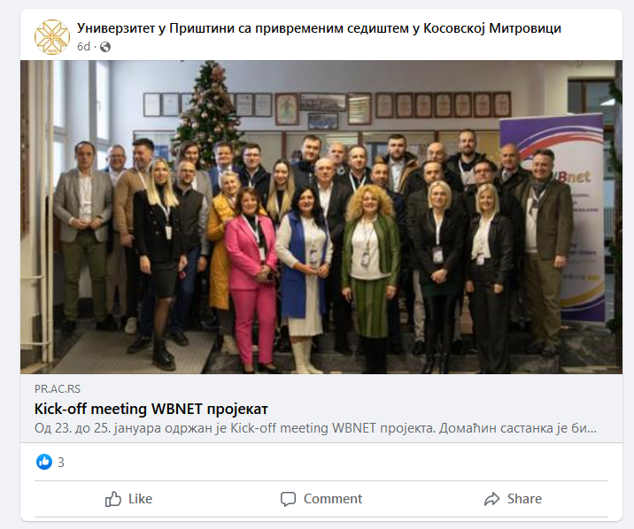
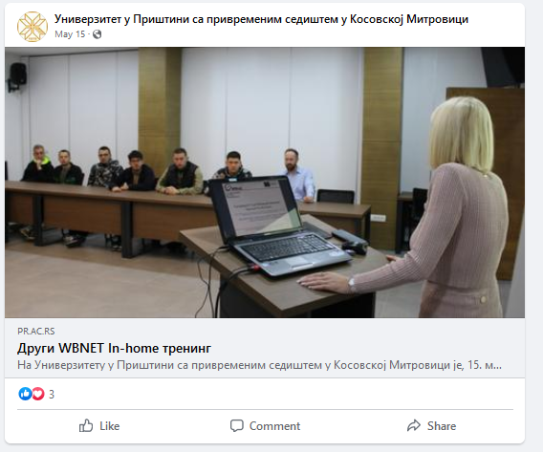
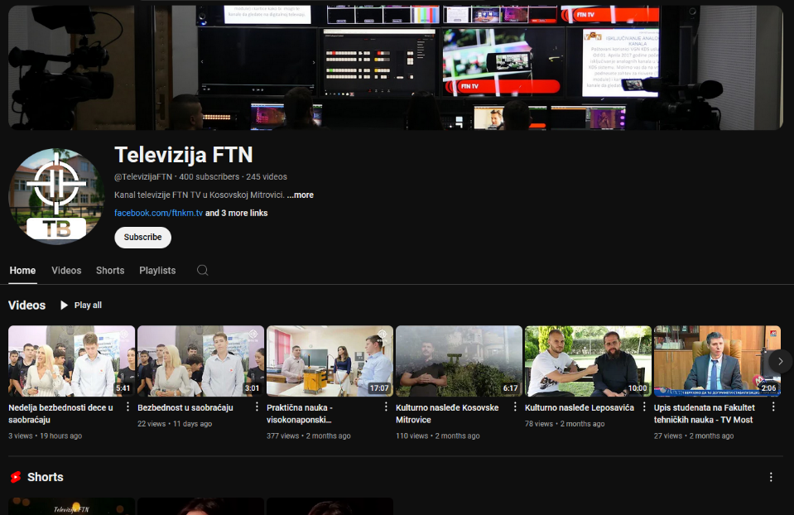
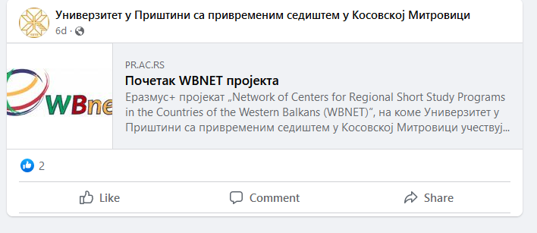
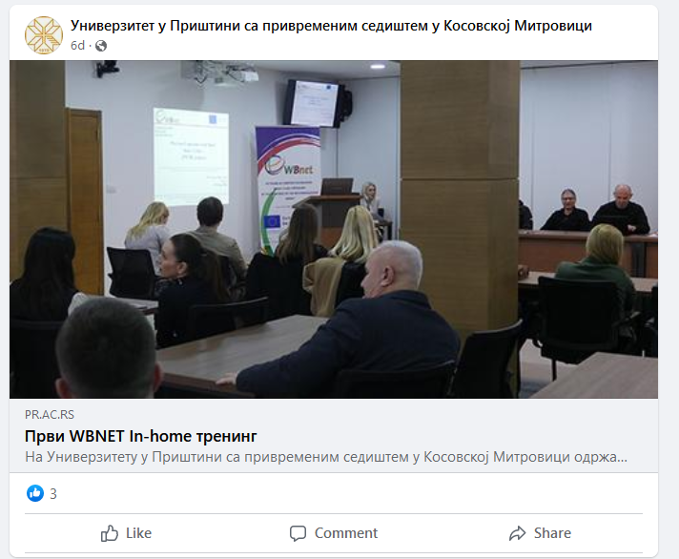
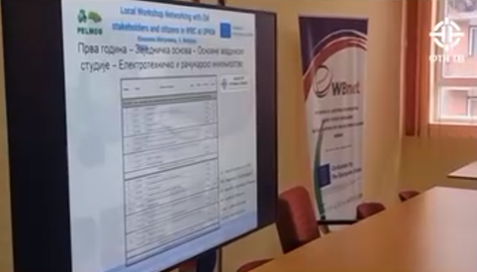
Promotion on media and social networks (T7.4)
Facebook: @univerzitetupristini
Facebook: @ upisiftnkm
Youtube: @TelevizijaFTN

Slide 9
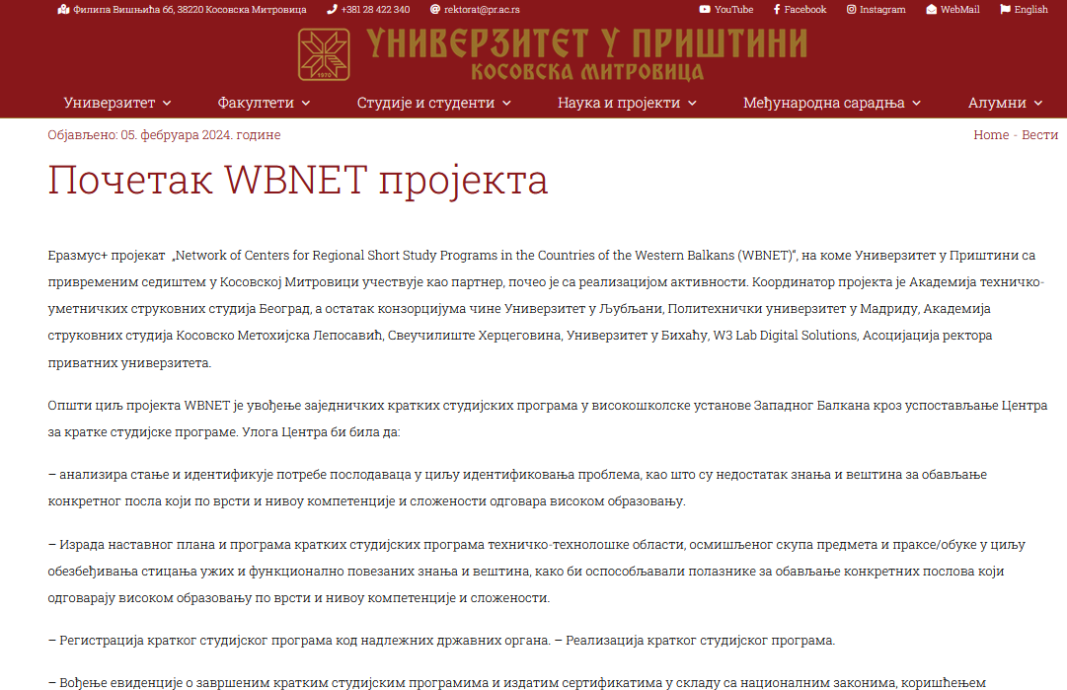
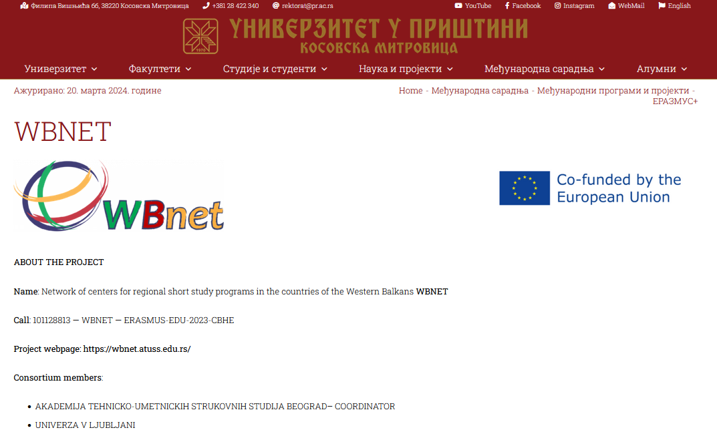
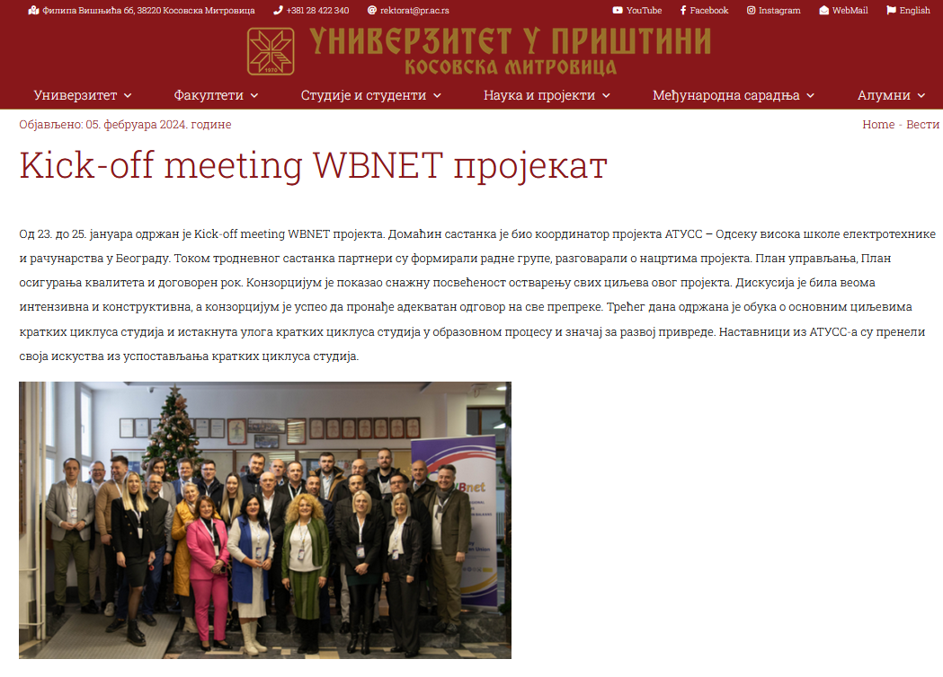
Promotion on media and social networks (T7.4)
Web site: pr.ac.rs

Slide 10
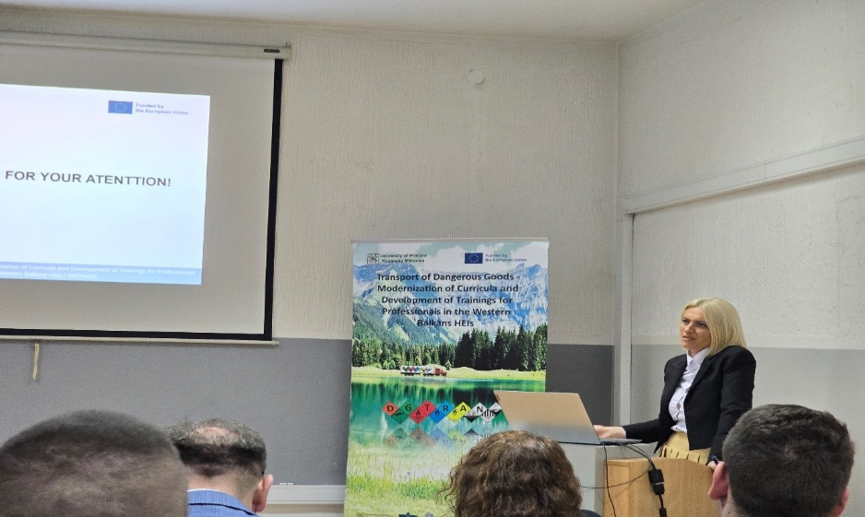
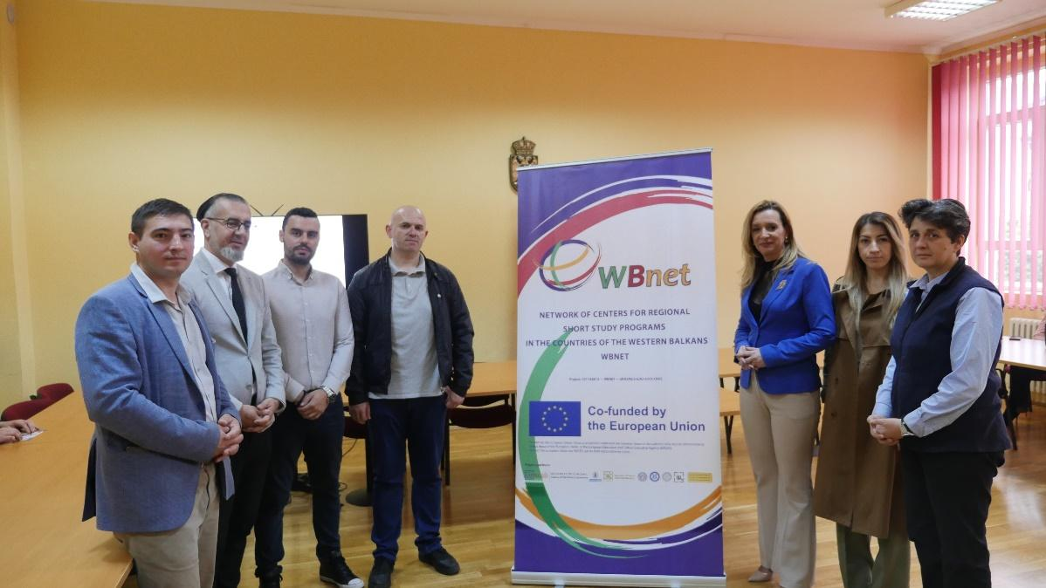
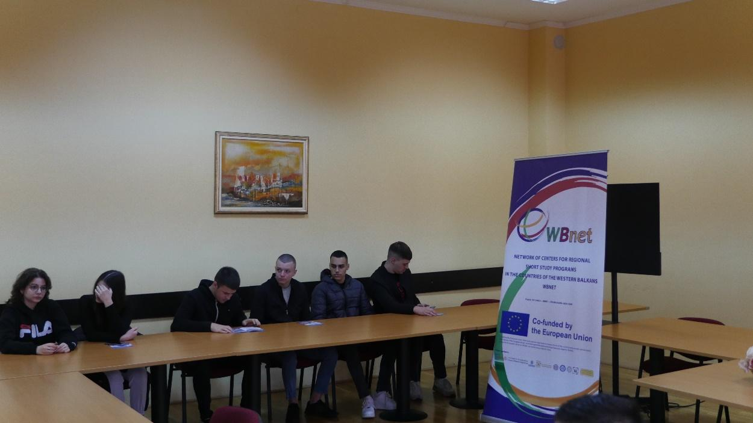
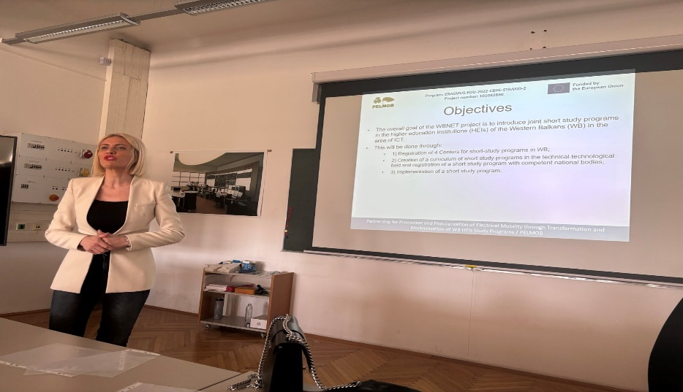
Promotion on live events (T7.5)
Erasmus+ DGTRANS Inter project coaching meeting.
Erasmus+ PELMOB Inter project coaching meeting.
Open-door day on the Faculty of Law UPKM.

Slide 11
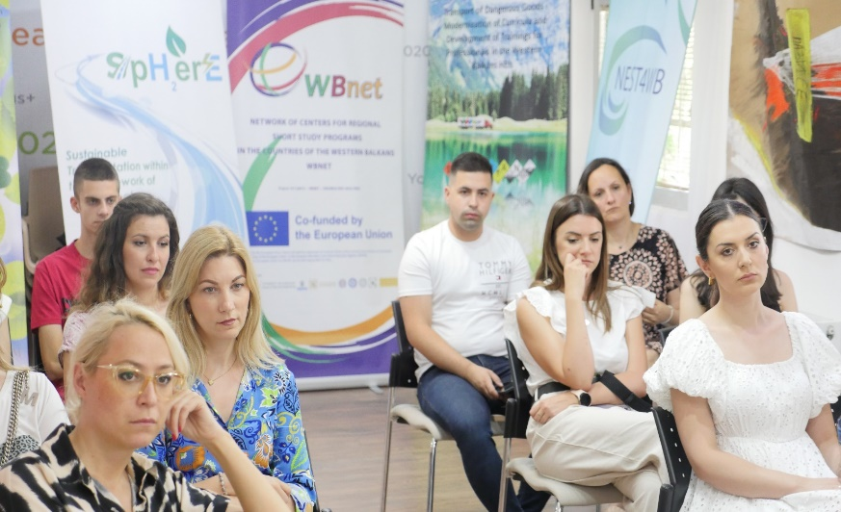
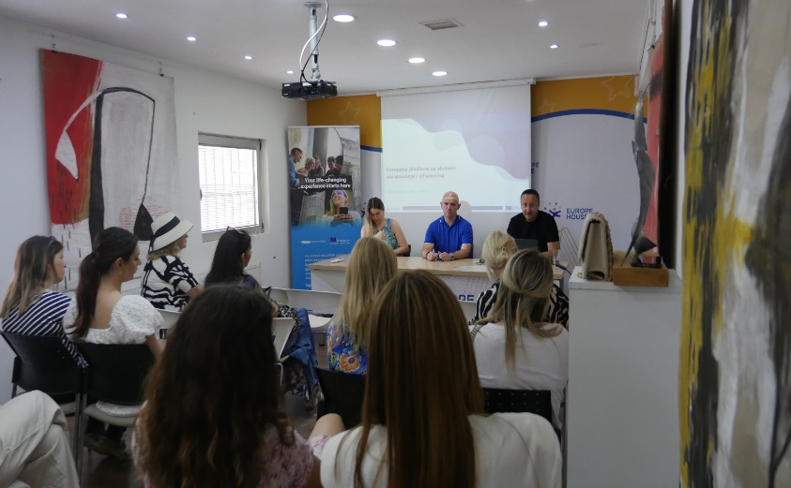
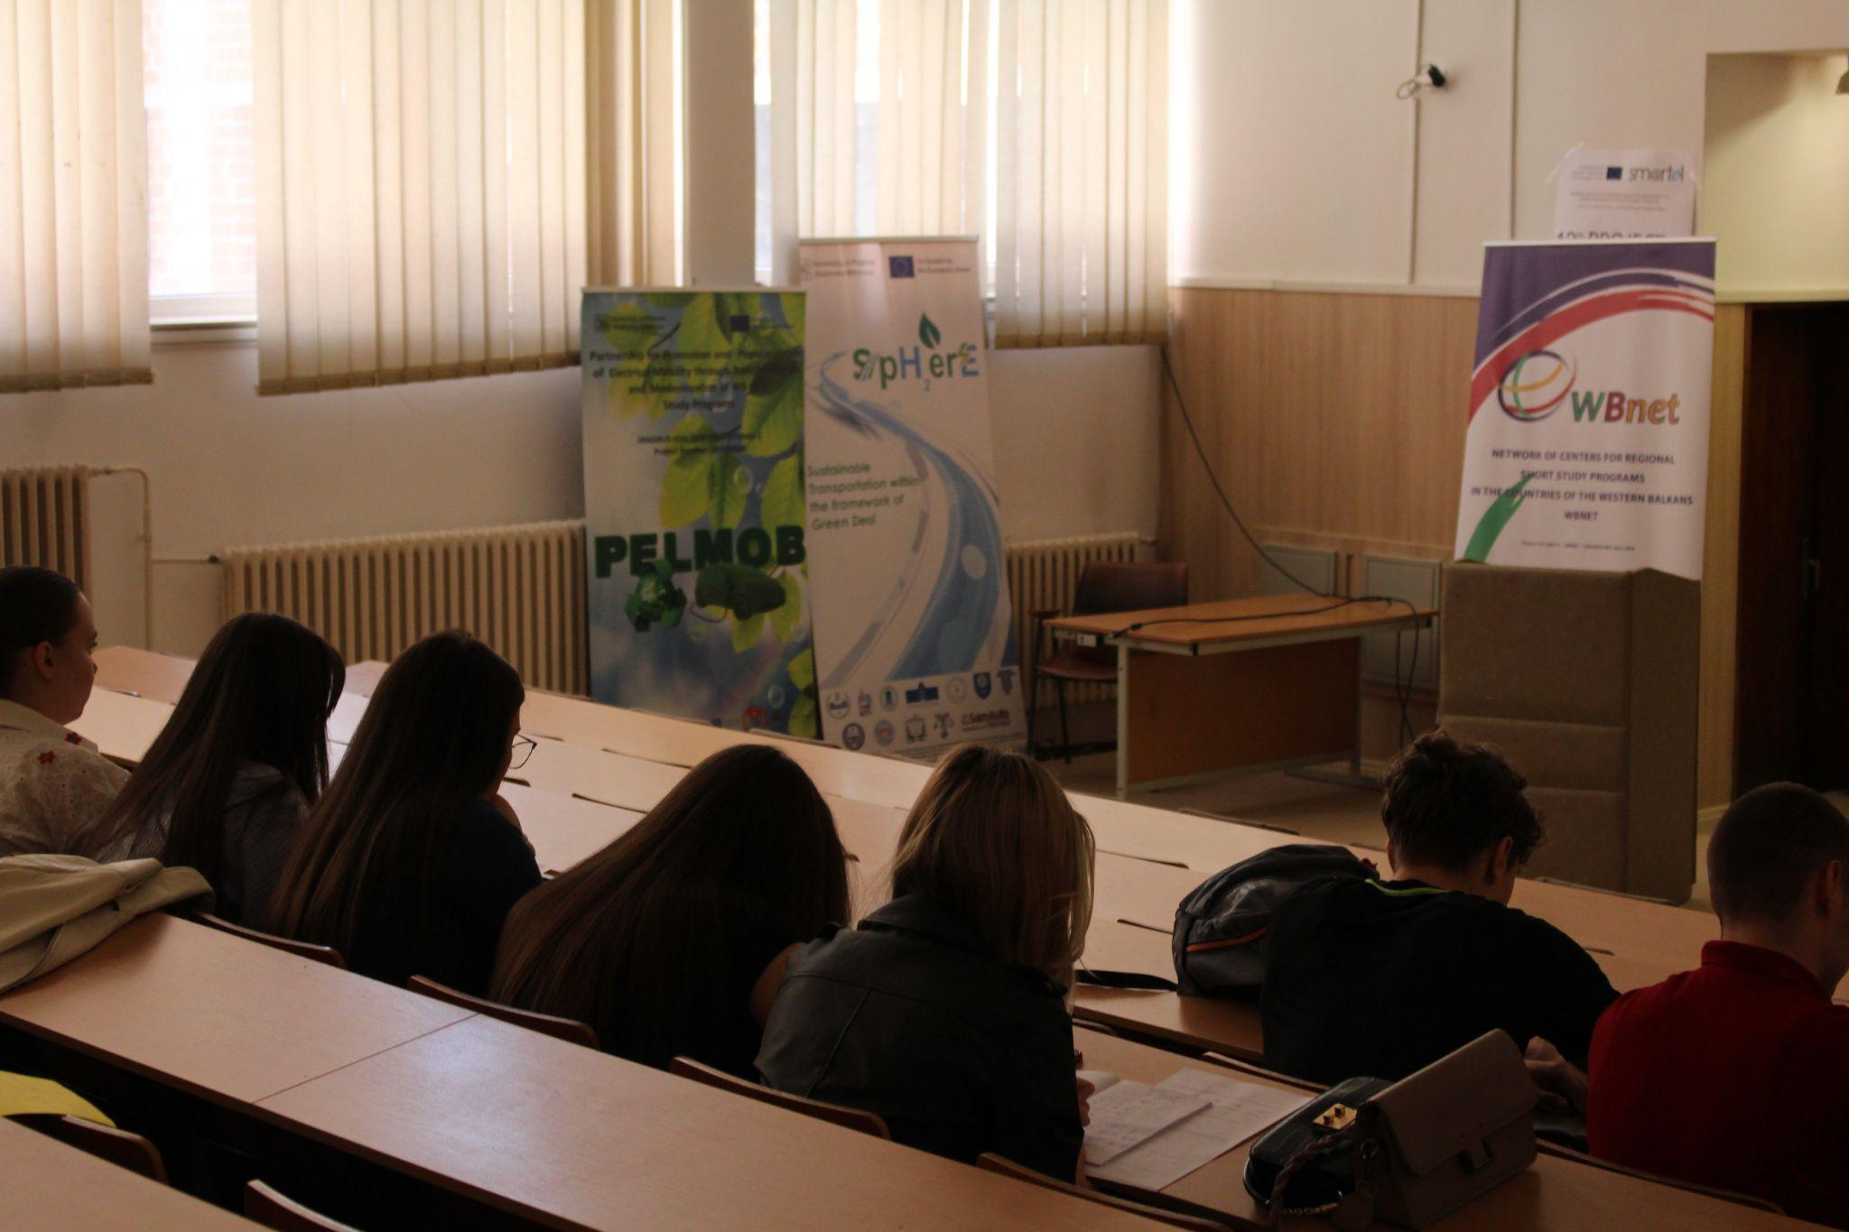
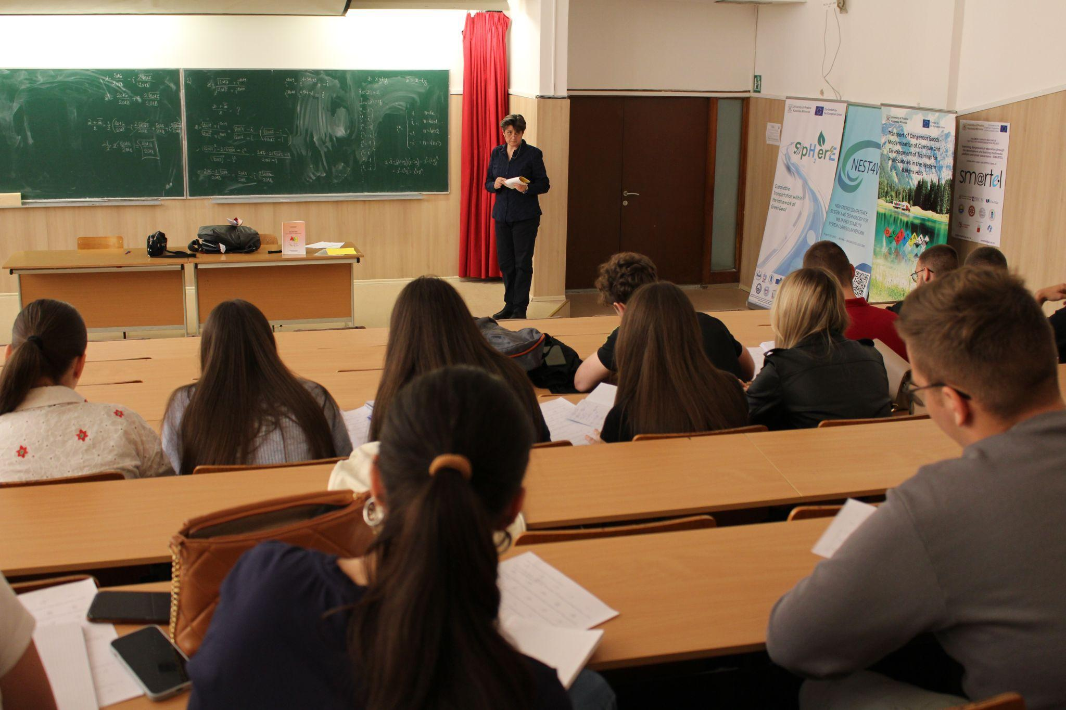
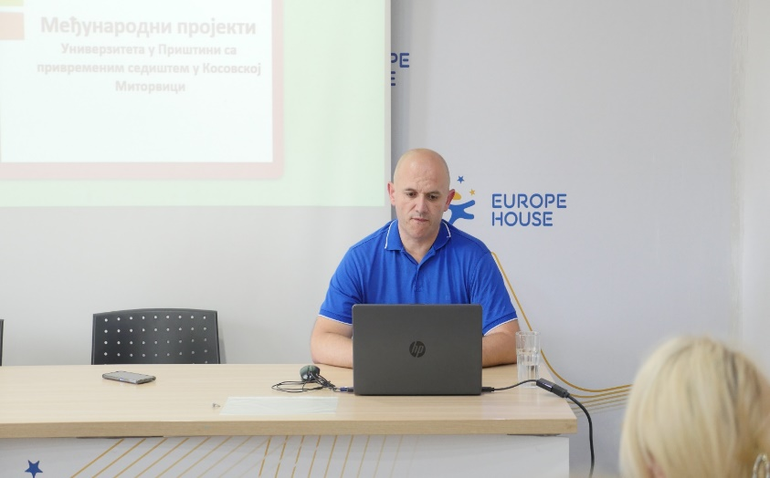
Promotion on live events (T7.5)
Preparatory Classes for enrolment FTS – UPKM.
eTwinning info session in European House Kosovska Mitrovica.

Slide 12
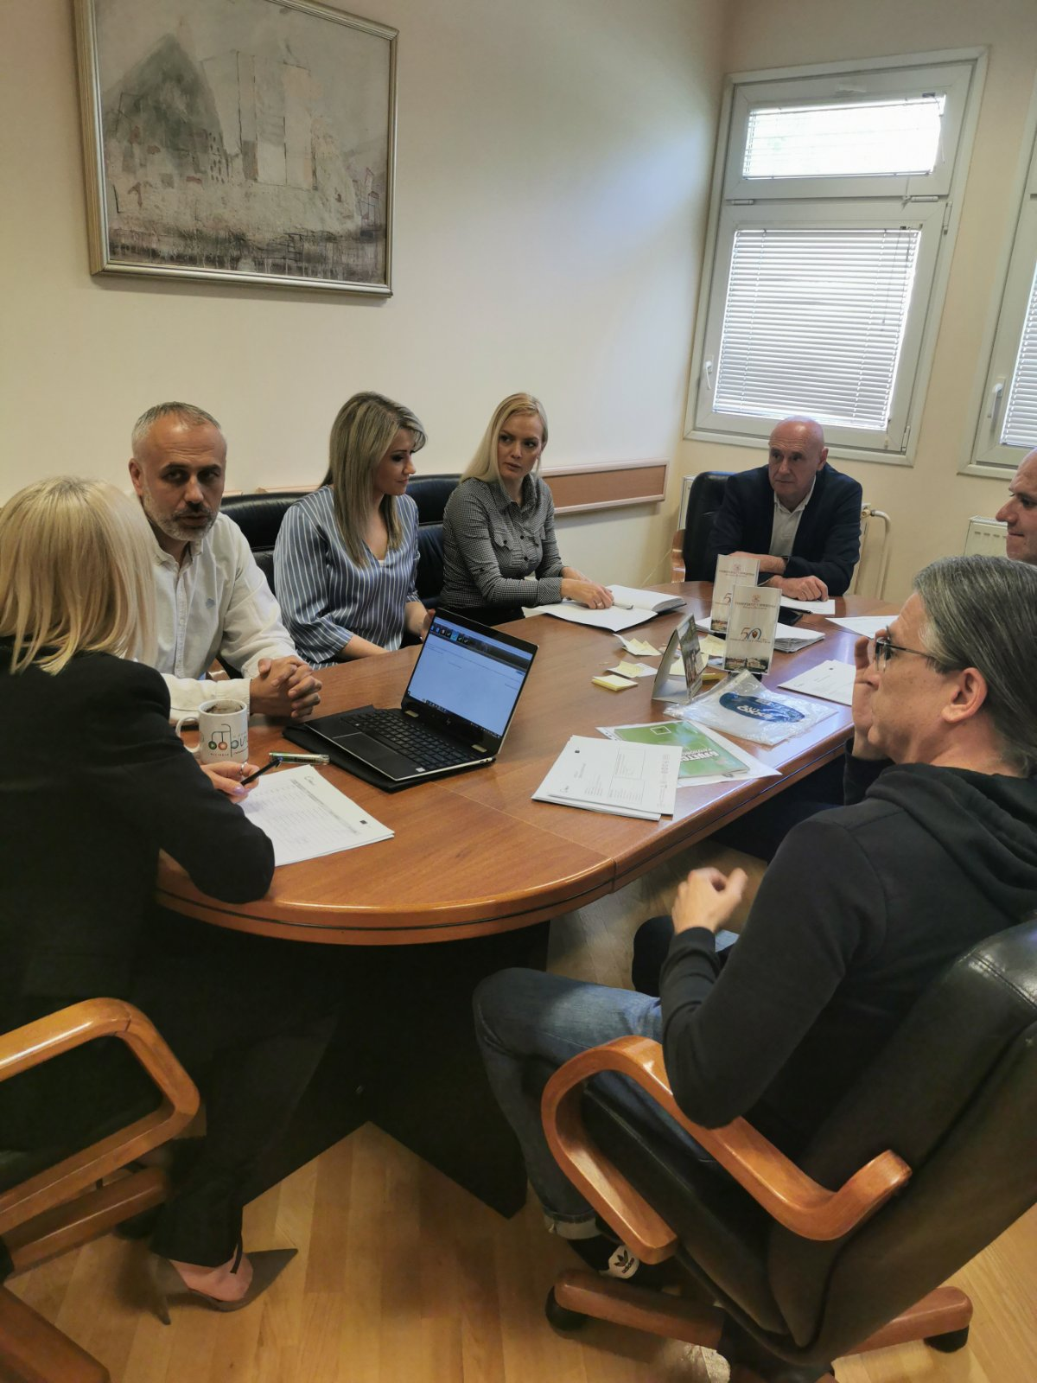
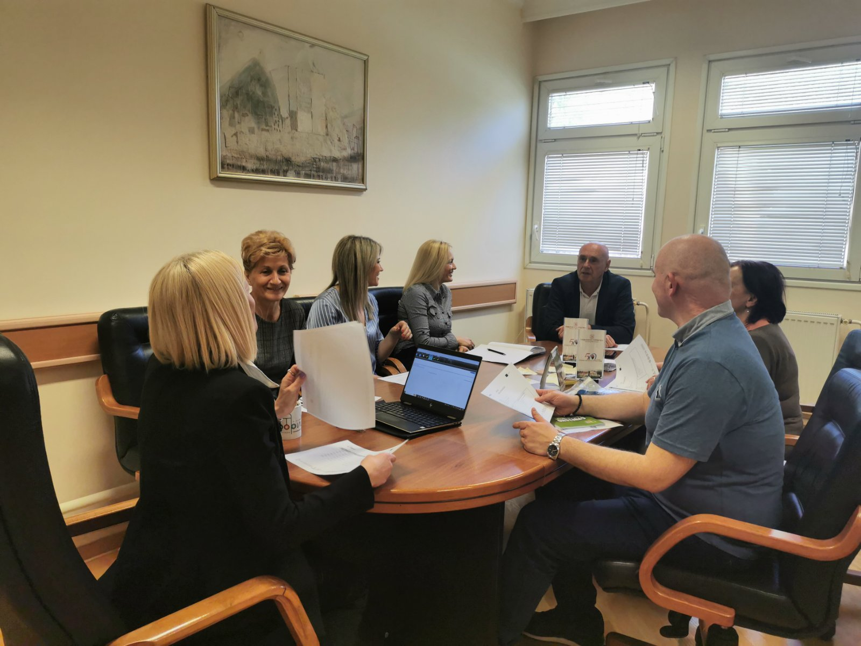
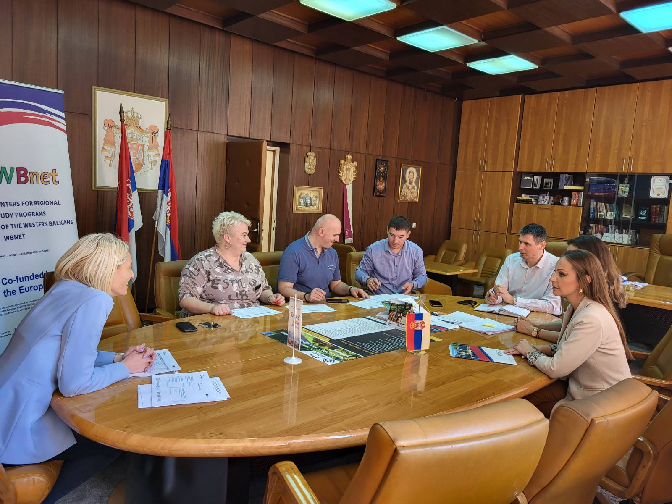
UPKM working groups meetings
Several meetings UPKM working groups for WP2, WP3, WP4 and WP7.

Slide 13
Next Activities - Plan
T2.2: 3rd In-home training (october 2024).
T2.3: Defining goals of centers. Meetings with economy partners, surveys among students, employees and non-employed persons about missing skills.
T2.4: Establishment of the Center at WB HEIs.
T2.5: Registration of Centers according to the law.
T3.1: Instalation equipment (december, 2024).
T3.4: Developing curriculums for short study program. Defining the list of subjects. More working group meetings.
T7.3: Development of promo material: Printing new promotion materials.
T7.4: Promotion on media and social networks: FTS TV promotion.
T7.5: Promotion on live events.
Regular meetings of UPKM working groups.

Slide 14
Questions & Answers
"Funded by the European Union. Views and opinions expressed are however those of the author(s) only and
do not necessarily reflect those of the European Union. Neither the European Union nor the granting authority can be."
Network of centers for regional short study programs in the countries of the Western Balkans Call: ERASMUS-EDU-2023-CBHE
Project number: 101128813

